Slide 1
The problem of organizing, storing, finding, and analyzing stuff

Slide 2
Before there were computers.
From Geek.com:
Google Books calculates the total number of books ever written at almost 130 million
Notes:
It is unknown precisely how many such scrolls were housed in the Alexandria library at any given time, but estimates range from 40,000 to 400,000 at its height.

Slide 3
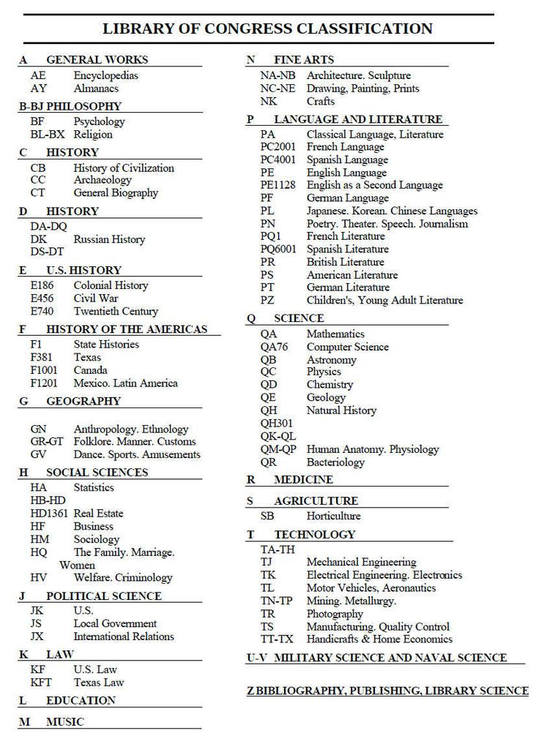
Library of Congress Numbering System

Slide 4
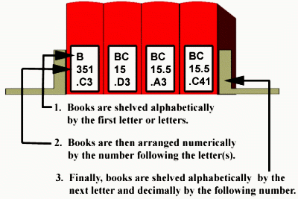
Libraries
QA276?

Slide 5
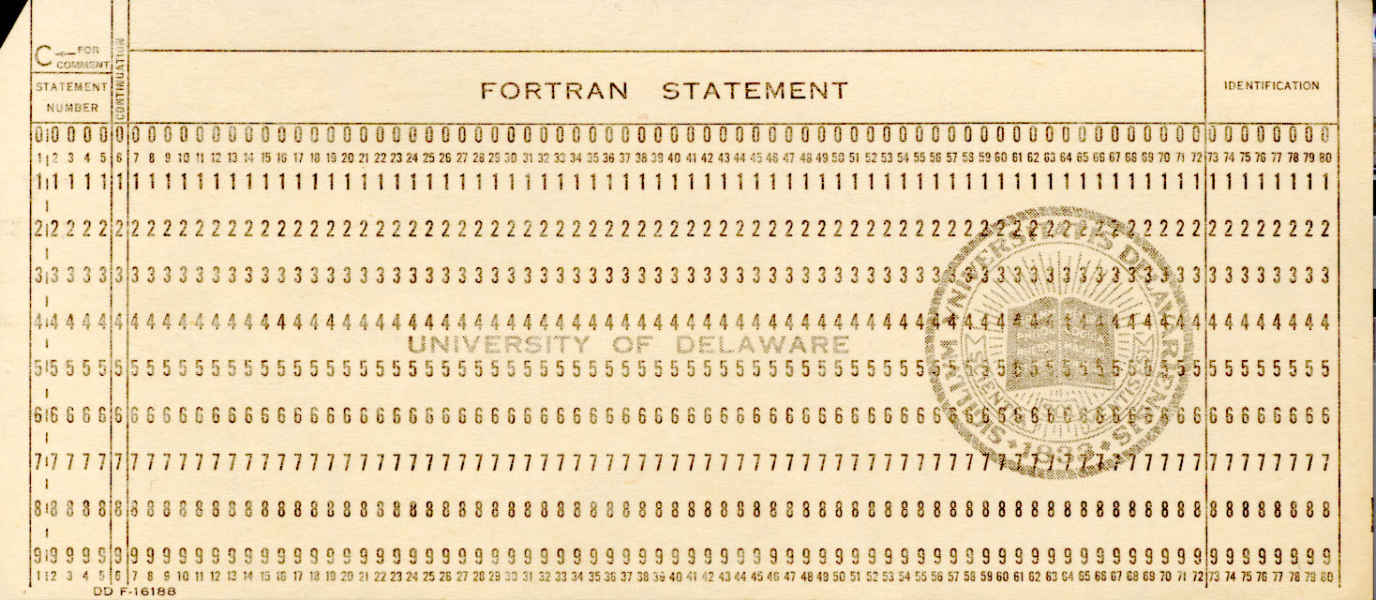
The Hollerith Card existed Pre-computer

Slide 6
Thinking about data.

Slide 7
The early computer age, 1950s to 1970 The advent of “databases.”

Slide 8
DBMS (Data base management system) RDBMS (Relational Data Base Management System)

Slide 9
Data
Queries
Transaction
Data
Data
Warehouse
Analysis
Analytic
File

Slide 10
What is a “database?”
A computerized record keeping system
Data
Hardware (w/operating system) to store the data
Software
Standardized way to access data
Users
Retrieve Information

Slide 11
A database system should allow one to easily access and manipulate data.

Slide 12
Transactional (Operational) Databases
Edit and Clean
Transaction
Data Warehouse
Query, Subset, Analyze
…
Bank
Grocery
Designed Study
…

Slide 13
Flat-file data bases.
ID | Name | Address | Course
1 | Mr. James Johnson | 1023 W Tennessee | STA 4123
1 | Mr. James Johnson | 1023 W Tennessee | STA 4324
1 | Mr. James Johnson | 1023 W Tennessee | STA 4930
1 | Mr. James Johnson | 1023 W Tennessee | STA 5194
2 | Ms. Jill Jones | 1804 N Monroe | STA 2012
2 | Ms. Jill Jones | 1804 N Monroe | STA 4324
2 | Ms. Jill Jones | 1804 N Monroe | STA 2023
3 | Mrs. Jane Smith | 1734 Capitol Circle | STA 2012
What happens if:
Mr. James Johnson moves?

Slide 14
Flat-file data bases.
ID | Name | Address | Course
1 | Mr. James Johnson | 1023 W Tennessee | STA 4123
1 | Mr. James Johnson | 1023 W Tennessee | STA 4324
1 | Mr. James Johnson | 1023 W Tennessee | STA 4930
1 | Mr. James Johnson | 1023 W Tennessee | STA 5194
2 | Ms. Jill Jones | 1804 N Monroe | STA 2012
2 | Ms. Jill Jones | 1804 N Monroe | STA 4324
2 | Ms. Jill Jones | 1804 N Monroe | STA 2023
3 | Mrs. Jane Smith | 1734 Capitol Circle | STA 2012
What happens if:
Ms. Jill Jones gets married and changes her name?

Slide 15
Some data bases (flat files)

Slide 16
Structured vs Unstructured data, Examples

Slide 17
First, Structured data

Slide 18
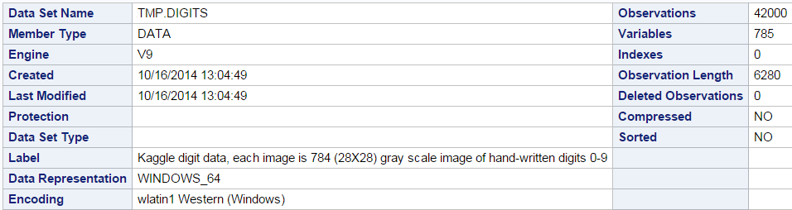
The digits dataset

Slide 19
The digits dataset

Slide 20
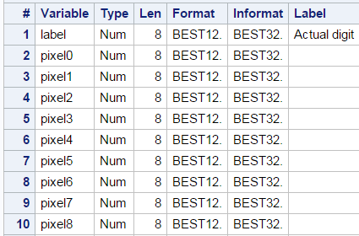
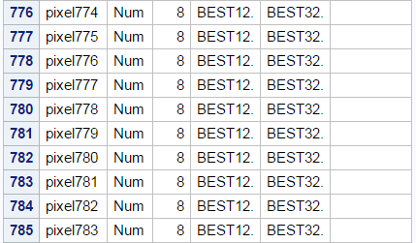
Each Image is 28X28 pixels
…

Slide 21
The first row (partial)

Slide 22
The ALL, AML dataset Micro Arrays

Slide 23
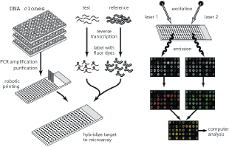
Microarrays
Test RNA
Reference RNA
excitation
laser 1
laser 2
reverse transcription
label with fluor dyes
emission
computer analysis
hybridize target to microarray
Duggan et. al, Nature, 1999

Slide 24
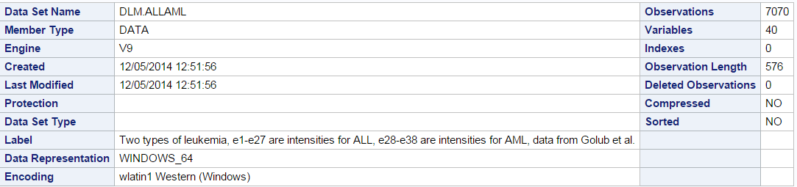

Slide 25
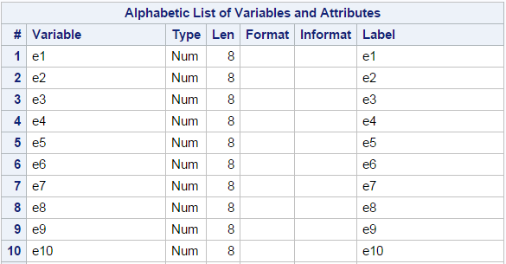
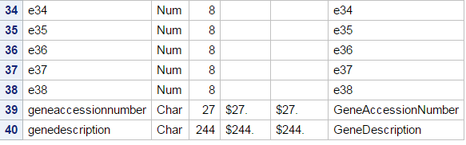

Slide 26

First Observation

Slide 27
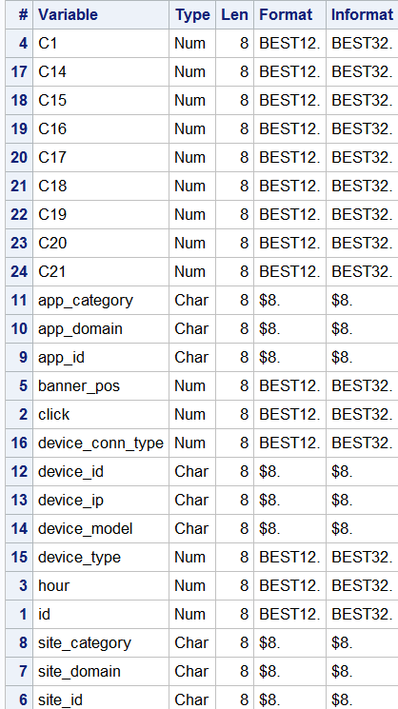
The “click through” dataset (Kaggle)

Slide 28
Beginning in the 1970s, the methods of storage and accessing data became a topic of research and debate. The emphasis of this period was on structured data.

Slide 29
Unstructured Data
Tweets
e-mails
Web Searches

Slide 30
Unstructured data, a digitized book (actually a short story), AsimovYouthPlainText. (From Gutenberg Project)
YOUTH
_by_ ISAAC ASIMOV
Red and Slim found the two strange little animals the morning after they heard the thunder sounds. They knew that they could never show their new pets to their parents.
[Illustration]
There was a spatter of pebbles against the window and the youngster stirred in his sleep. Another, and he was awake.
He sat up stiffly in bed. Seconds passed while he interpreted his strange surroundings. He wasn't in his own home, of course. This was out in the country. It was colder than it should be and there was green at
the window.
"Slim!"
The call was a hoarse, urgent whisper, and the youngster bounded to the open window.

Slide 31
Structured Data
Medical Studies
Administrative and Business Data
Digital Images
Micro-array and other high-throughput data
…

Slide 32
Data Models

Slide 33
Data models are abstractions – the way we think about data.
Data schema are (often graphical) representations of particular data bases noting how different files are related.
Data bases are the actual data (sometimes referred to as “instances”.

Slide 34
Competing Data Models for Structured Data (1970s)
Hierarchical
Network
Relational

Slide 35
The Hierarchical Model
Parent
Level 1
(child)
Level 1
(child)
Level 2
(child)
Level 2
(child)
Level 2
(child)

Slide 36
The Hierarchical Model
Course
Student
Student1
Student2
Student3
Name
Address
Name
Address
Name
Address

Slide 37
Problems – Complexity and Redundance
Complexity
Can’t add to child table before adding to parent table
Adding child fields often requires re-programming
Data manipulation is difficult
Redundancy
Data may exist in numerous places

Slide 38
The Relational Model
Dr. E. F. Codd at IBM in the late 1960s
Wanted to solve the problems with the existing models.
Mathematical model (“A Relational Model of Data for Large Shared Databanks” 1970).
Used by most major commercial database systems
Very simple model
Efficient implementations

Slide 39
The Relational Model
All data stored in tables (relations)
Where or how the tables are stored in unimportant.
Tables are identified by a unique name.

Slide 40
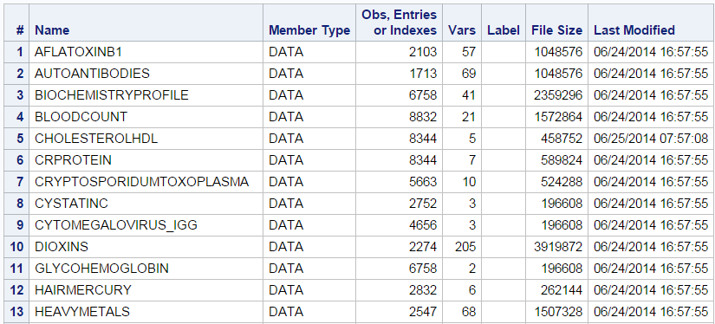
Database = set of named tables (relations) Example: The Nhanes (1999) Lab Database
Partial Listing

Slide 41
Each relation (table, data set) has a set of named columns (variables, attributes) Each row( tuple, observation) has a value for each attribute Each attribute has a domain (type)

Slide 42
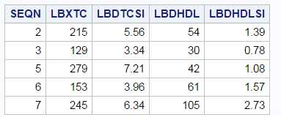
The cholestrolhdl relation (partial listing)
Each row( tuple, observation) has a value for each attribute

Slide 43
The cholestrolhdl relation (partial listing)
Each relation has a set of named columns (variables, attributes)

Slide 44
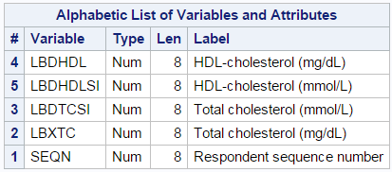
Each attribute has a type (domain)

Slide 45
All manipulations can be accomplished by only a few simple operations. AND The results of these manipulations is a new relation. Closure

Slide 46
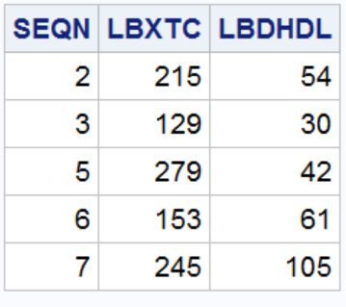
Select columns
Relation (table, data set)
Relation (table, data set)

Slide 47
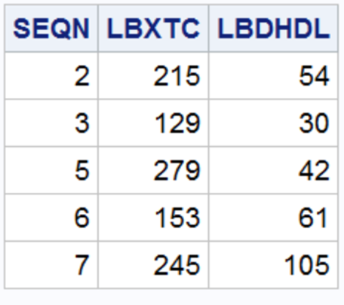
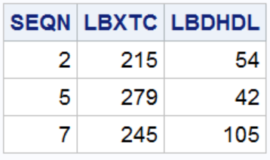
Restrict Rows (usually according to some condition)
Relation (table, data set)
Relation (table, data set)

Slide 48
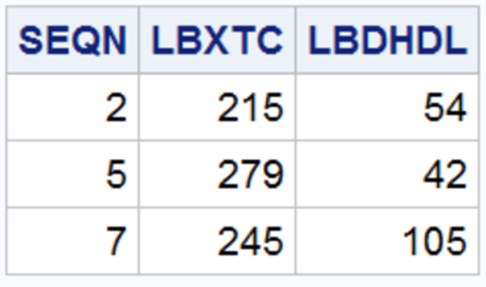
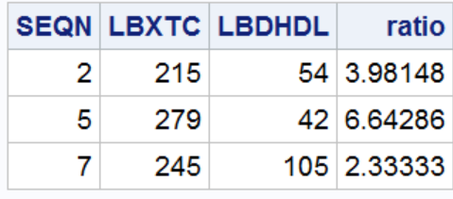
Create a new column
Relation (table, data set)
Relation (table, data set)

Slide 49
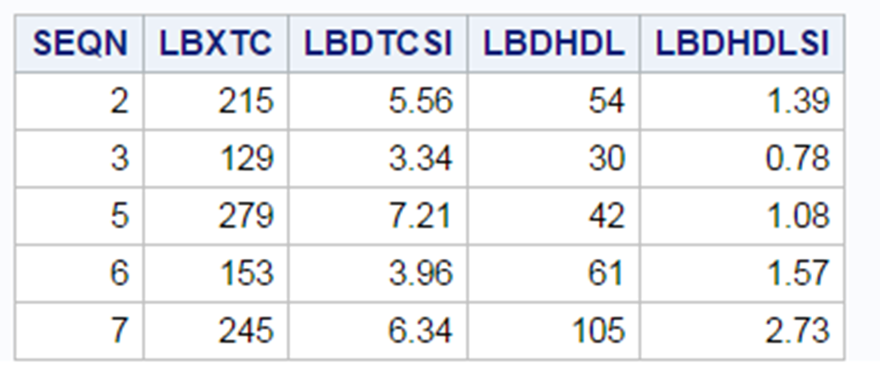
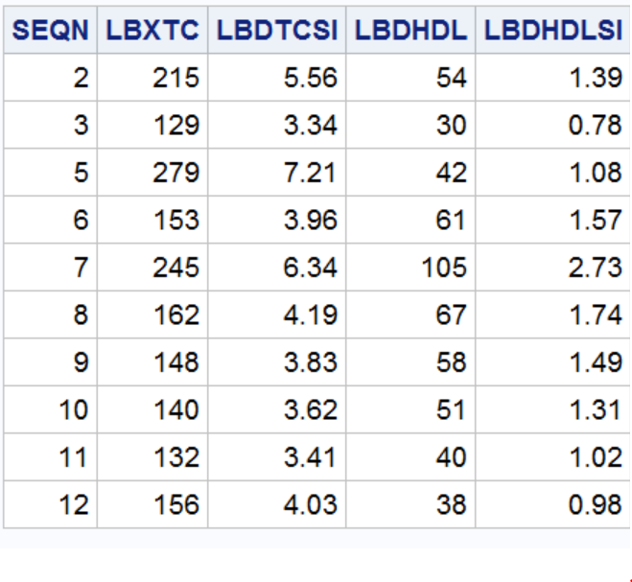
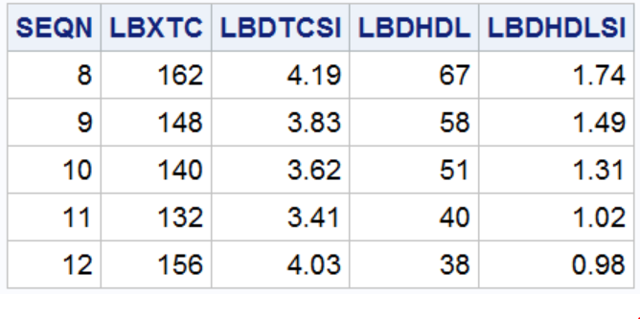
Combine Relations Vertically
Relation (table, data set)
Relation (table, data set)
Relation (table, data set)

Slide 50

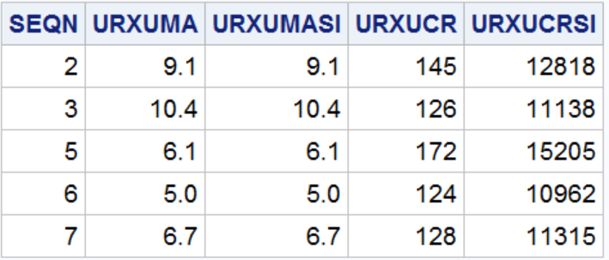
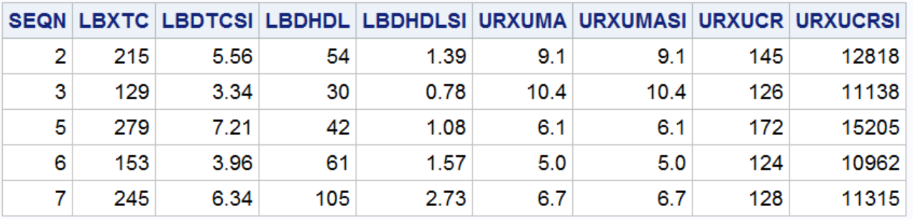
Join (merge) relations horizontally

Slide 51
An aside, “Normal” forms
First normal form -- all records contain the same number of fields.

Slide 52
Under second and third normal forms, a non-key field must provide a fact about the key, use the whole key, and nothing but the key. In addition, the record must satisfy first normal form.
Key
Non-key

Slide 53
A simple schema, Nhanes 3

Slide 54



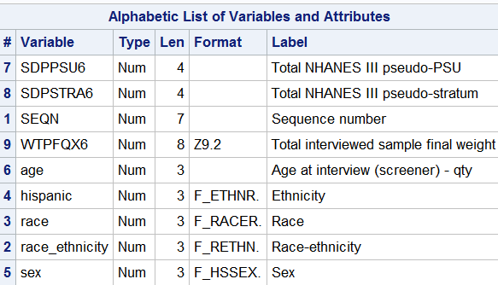
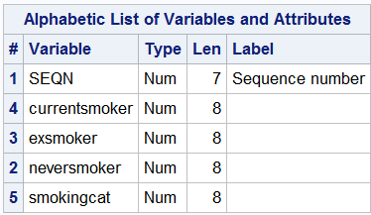

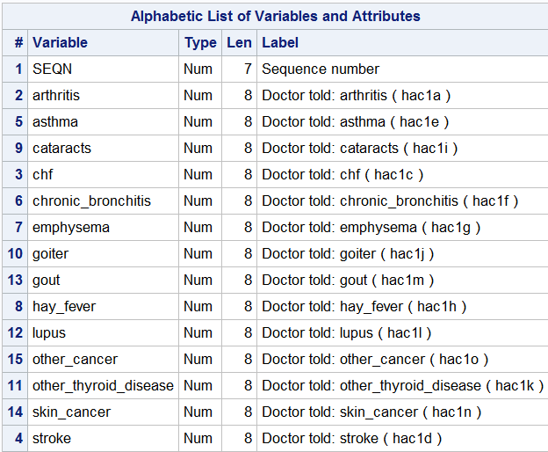
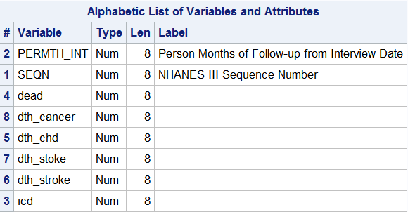

Slide 55
The important point
In order to use data in the hierarchical or network model, the user needs to understand how the data are stored.
In the relational model all the user needs to know is the name of the table and the columns (variables, fields) containing the data.
A simple structured query language (SQL) is available for to manipulate relational databases

