Slide 1
Orion Star Sports & Outdoors
Orion Star Sports & Outdoors is a fictitious global sports and outdoors retailer with traditional stores, an online store, and a large catalog business.
The corporate headquarters is located in the United States with offices and stores in many countries throughout the world.
Orion Star has about 1,000 employees and 90,000 customers, processes approximately 150,000 orders annually, and purchases products from 64 suppliers.

Slide 2
The Orion Star Database
Acknowledgement
This data and much of the material used was provided by or adapted from material received from SAS

Slide 3
Orion Star Data
As is the case with most organizations, Orion Star has a large amount of data about its customers, suppliers, products, and employees. Much of this information is stored in transactional systems in various formats.
This transactional information was extracted, transformed, and loaded into a data warehouse.
Data sets were created to meet the needs of specific departments such as Marketing.

Slide 4
The Orion Star Company
We will use a subset of Orion Star data including employees in the United States and Australia customers from Australia, Canada, Germany, Israel, South Africa, the United States, and Turkey
  This is a relational database.

Slide 5
Seven data sets deal with employees and their information.

Slide 6
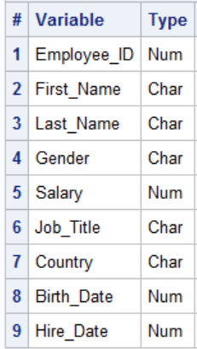
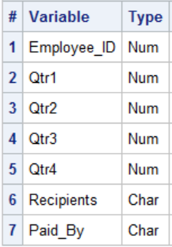
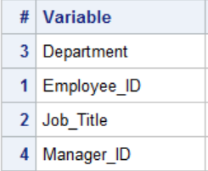
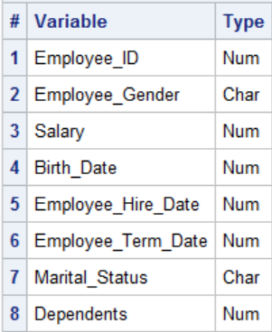
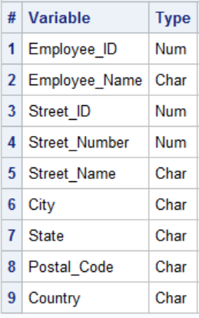
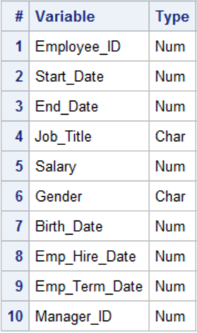
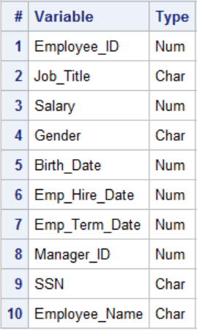
Employee_donations (n=124)
Sales (n=165)
Employee_organization (n=424)
Employee_payroll (n=424)
Employee_addresses (n=424)
Staff (n=424)
Salesstaff (n=163)

Slide 7
Employee_donations (n=124)
Sales (n=165)
Employee_organization (n=424)
Employee_payroll (n=424)
Employee_addresses (n=424)
Staff (n=424)
Salesstaff (n=163)
Employee_id is the primary key for HR data

Slide 8
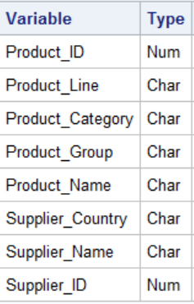
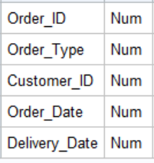
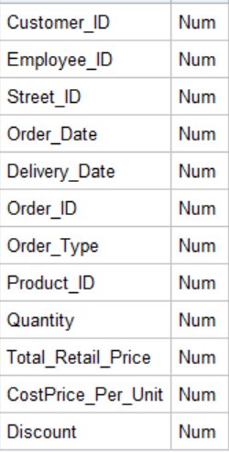
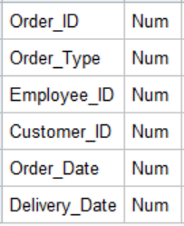
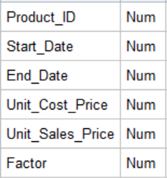
Five Data sets deal with orders.
Product_dim (n=481)
Qtr1_2007 (n=36)
Order_fact (n=617)
Qtr2_2007 (n=22)
Price_list (n=259)

Slide 9
Five Data sets deal with orders.
Product_dim (n=481)
Qtr1_2007 (n=36)
Order_fact (n=617)
Qtr2_2007 (n=22)
Price_list (n=259)

Slide 10
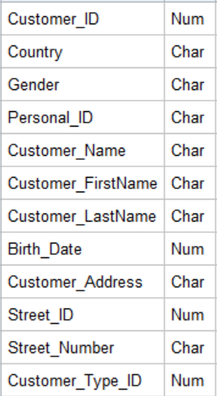
Customer data resides in one file
Customer (n=77)

Slide 11
Orion Country Codes
Code | Country
AU | Australia
CA | Canada
DE | Germany
IL | Israel
TR | Turkey
US | United States
ZA | South Africa

Slide 12
Orion Product ID Codes
Codes are numeric in the form XXYYZZZZZZZZ.
Product Type
Individual Product Identifier
XXYYZZZZZZZZ
Subcategory

Slide 13
Orion Product ID Codes
Code | Product Type
21 | Children
22 | Clothes and Shoes
23 | Outdoors
24 | Sports

Slide 14
The orion.Order_Fact table contains the key identifier columns Employee_ID, Customer_ID, Order_ID, and Product_ID, and these can be used to relate data from the different groups to each other.
Order_fact (n=617)

Slide 15
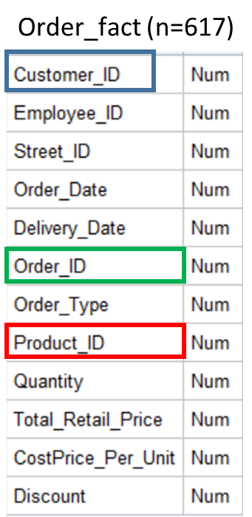
To identify the name of an employee who made any sale to a customer in South Africa in 2007, you need information from three different tables: Employee_Name from orion.Employee_Addresses, Order_Date from orion.Order_Fact, and Country from orion.Customer
Customer (n=77)
Employee_addresses (n=424)

