Slide 1
Example, Create an analytic file for Nhanes 1999

Slide 2
The Nhanes 1999 data
libname nh9Mort "&path/nhanes1999/mortality/sas";
libname nh9ques "&path/nhanes1999/questionnaire/sas";
libname nh9lab "&path/nhanes1999/lab/sas";
libname nh9exam "&path/nhanes1999/exam/sas";
libname nh9demo "&path/nhanes1999/demographics/sas";
libname nh9diet "&path/nhanes1999/dietary/sas";

Slide 3
Concatenating Libnames and a handy use of SQL
libname nh9 (nh9demo nh9exam nh9lab nh9mort nh9ques);

Slide 4
Meta Data in SAS, a handy use of PROC SQL

Slide 5
proc sql;
describe table dictionary.tables
;
select memname,nvar,nobs
from dictionary.tables
where libname="NH9"
;
quit;

Slide 6
The data for creating the analytic file is on five different datasets.
proc contents data=nh9.mortality;
proc contents data=nh9.bloodpressure;
proc contents data=nh9.demographics;
proc contents data=nh9.bodymeasurements;
proc contents data=nh9.cholesterolhdl;
run;

Slide 7
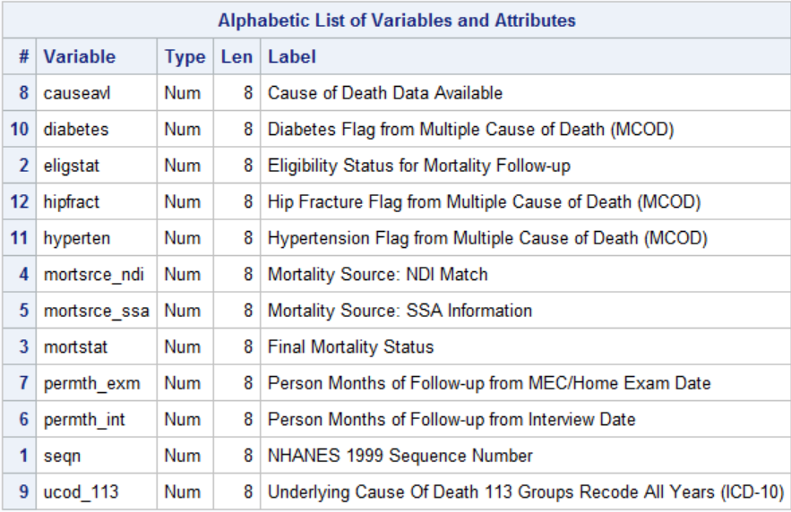
Mortality
Primary Key

Slide 8
From Documentation:
Coding for eligstat
1= Eligible
2 =Under age 18, not available for public release1
3 =Ineligible
Coding for mortstat
0 Assumed alive
1 Assumed deceased

Slide 9
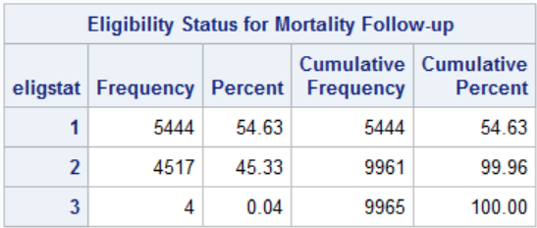
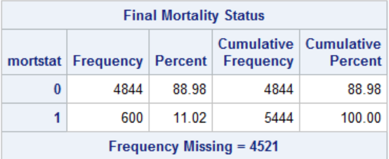
proc freq data=nh9.mortality;
tables eligstat mortstat;
run;

Slide 10
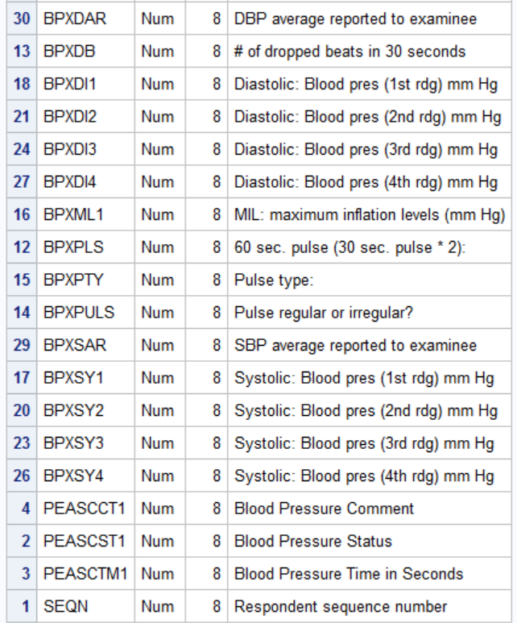
Blood Pressure (partial)
Primary Key

Slide 11
Check averages
proc sql inobs=100;
select mean(BPXSY1,BPXSY2,BPXSY3,BPXSY4),BPXSar
from nh9.bloodpressure
;
quit;

Slide 12
Calculate Averages
proc sql ;
create table newbp as
select mean(BPXSY1,BPXSY2,BPXSY3,BPXSY4) as mnsbp,
mean(BPXDI1,BPXDI2,BPXDI3,BPXDI4) as mndbp,
seqn
from nh9.bloodpressure
;
select n(mnsbp) "mnsbp",n(mndbp) "mndbp"
from newbp
;
quit;

Slide 13
Calculate averages with data step
data newbp( drop=bpxsy1-bpxsy4);
set nh9.bloodpressure(keep=seqn bpxsys1-bpxsys4);
mnsbp=mean(of BPXSY1-BPXSY4);
mndbp=mean(of BPXDI1-BPXDI4);
run;
proc means data=newbp;
run;

Slide 14
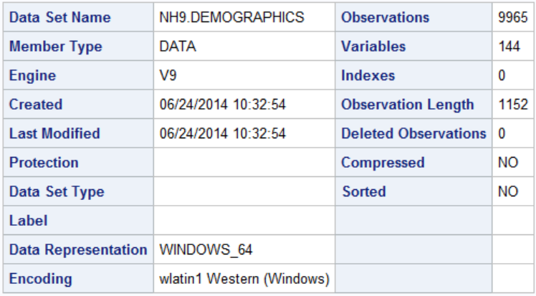
Demographics
Figure out which ones desired

Slide 15
proc means data=nh9.demographics;
var ri: seqn;
run;

Slide 16
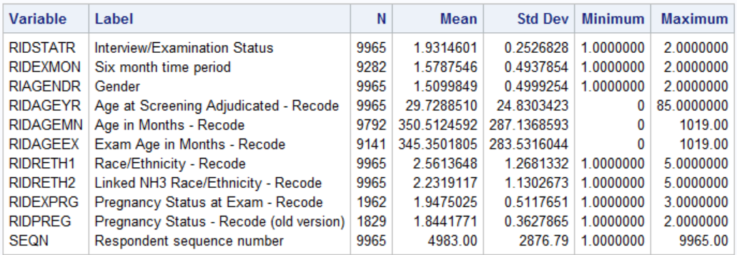
Primary Key

Slide 17
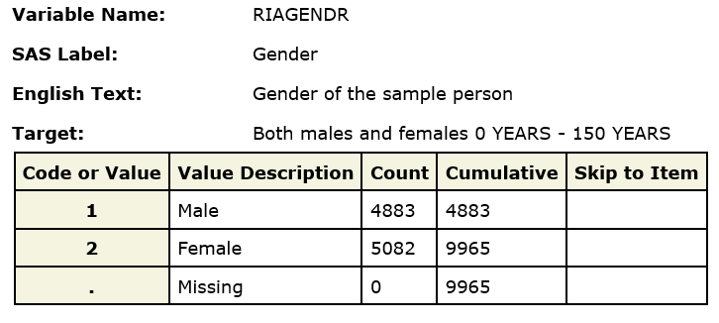
From Documentation

Slide 18
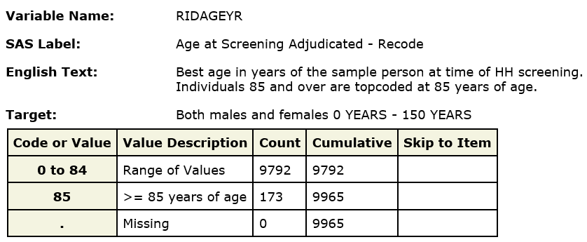
From Documentation

Slide 19
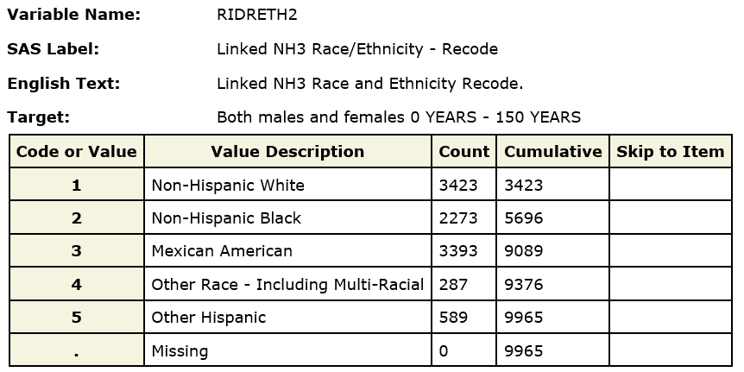
From Documentation

Slide 20
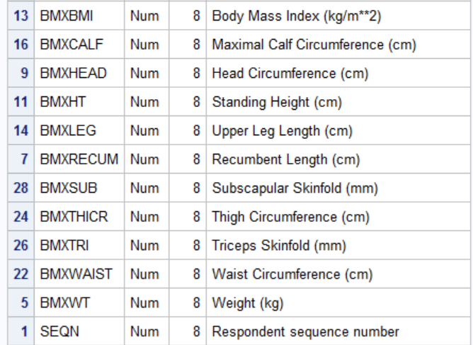
Bodymeasurements (partial)
Primary Key

Slide 21
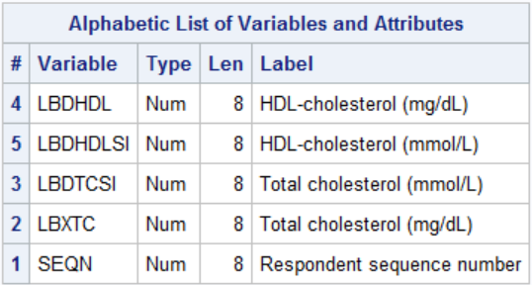
CholesterolHdl
Primary Key

Slide 22
Data | Variable(s) | New Variable/recode
Mortality | mortstat | Dead (0,1)
Demographics | riagendr | Male(0,1)
 | RIDAGEYR | Age
 | RIDRETH2 | Race_ethn
Bodymeasurements | bmxbmi | bmi
Bloodpressure | BPXSY1-BPXSY4 | mnsbp
 | BPXDI1-BPXDI4 | mndbp
CholesterolHdl | LBDHDL | hdl
 | LBXTC | chol

Slide 23
Doing it in the data step
Create five (temporary) datasets
Sort and Merge

Slide 24
Create five datasets
data mort (drop=mortstat eligstat);
set nh9.mortality(keep=seqn eligstat mortstat permth_exm);
where eligstat eq 1;
dead=mortstat=1;
data newbp(drop=bpxsy1-bpxsy4 BPXDI1-BPXDI4);
set nh9.bloodpressure(keep=seqn bpxsy1-bpxsy4 BPXDI1-BPXDI4);
mnsbp=mean(of BPXSY1-BPXSY4);
mndbp=mean(of BPXDI1-BPXDI4);
data demog (drop=riagendr);
set nh9.demographics (keep=seqn ridageyr riagendr RIDRETH2);
male=riagendr=1;
rename ridageyr=age
ridreth2=race_ethn;
data chol;
set nh9.cholesterolhdl(keep= seqn LBDHDL LBXTC);
rename lbdhdl=hdl
lbxtc=chol;
data body;
set nh9.bodymeasurements(keep=seqn bmxbmi rename=(bmxbmi=bmi));
run;

Slide 25
Sort and Merge
proc sort data=mort;
by seqn;
proc sort data=newbp;
by seqn;
proc sort data=demog;
by seqn;
proc sort data=chol;
by seqn;
proc sort data=body;
by seqn;
data analysis;
merge mort(in=a) newbp(in=b) demog(in=c) chol(in=d) body(in=e);
by seqn;
if a and b and c and d and e;
run;

Slide 26
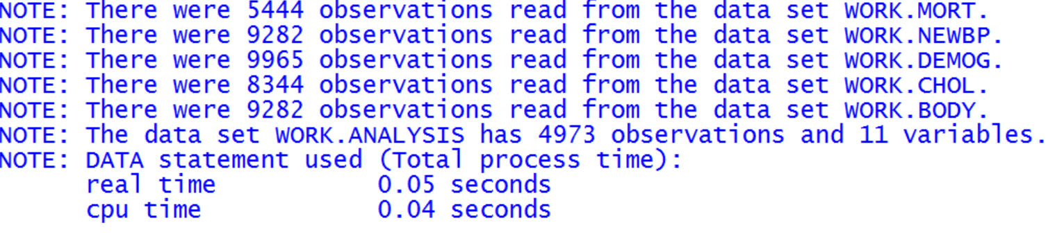

Slide 27
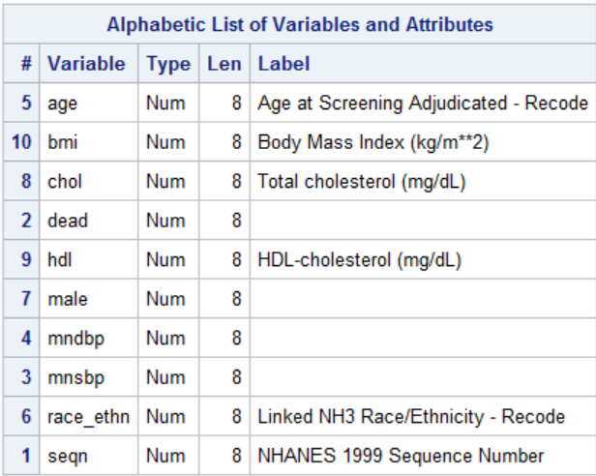
proc contents data=analysis;
run;

Slide 28
The same thing in Proc SQL

Slide 29
proc sql;
create table analysis as
select a.seqn,mortstat=1 as dead,permth_exm,
mean(BPXSY1,BPXSY2,BPXSY3,BPXSY4) as mnsbp,
mean(BPXDI1,BPXDI2,BPXDI3,BPXDI4) as mndbp,
riagendr=1 as male,
ridageyr as age,
ridreth2 as race_ethn,
lbdhdl as hdl,
lbxtc as chol,
bmxbmi as bmi
from nh9.mortality(keep=seqn eligstat mortstat permth_exm) a,
nh9.bloodpressure(keep=seqn bpxsy1-bpxsy4 BPXDI1-BPXDI4) b,
nh9.demographics (keep=seqn ridageyr riagendr RIDRETH2) c,
nh9.bodymeasurements(keep=seqn bmxbmi) d,
nh9.cholesterolhdl(keep= seqn LBDHDL LBXTC) e
where eligstat eq 1 and
a.seqn=b.seqn and
b.seqn=c.seqn and
c.seqn=d.seqn and
d.seqn=e.seqn
order by seqn
;
quit;

Slide 30
