Slide 1
3
Basic Queries
Specifying Columns

Slide 2
Produce a report that contains the employee identifier, gender, and salary for all Orion Star employees.
The data is contained in the orion.Employee_Payroll table

Slide 3
Retrieving Descripter Data from a Table
proc sql;
describe table orion.Employee_Payroll
;
quit;
Notes:
s102d07

Slide 4
Retrieving Data from a Table (* means everything)
proc sql;
select *
from orion.Employee_Payroll
;
quit;

Slide 5
The FEEDBACK Option expands the * (in the log)
PROC SQL FEEDBACK;
SELECT *
FROM table-1|view-1<, ...table-n|view-n>
<WHERE expression>
<GROUP BY column-1<, …column-n>>
<HAVING expression>
<ORDER BY column-1<DESC><, …column-n>>;
QUIT;

Slide 6
proc sql feedback;
select *
from orion.Employee_Payroll;
quit;

Slide 7
Retrieving Data from a Table
proc sql;
select Employee_ID, Employee_Gender,Salary
from orion.Employee_Payroll;
quit;
Notes:
Desired variable are listed following the select keyword
Column names are separated by commas
No comma after the last variable name

Slide 8
Creating New Columns

Slide 9
Creating New Columns
Create a new column by including any valid SAS expression in the select clause
Assign a column alias or a name to the new column by using keyword AS
The new column can be either text or results of a calculation (new columns exist only for the duration of the query unless a table or view is created).

Slide 10
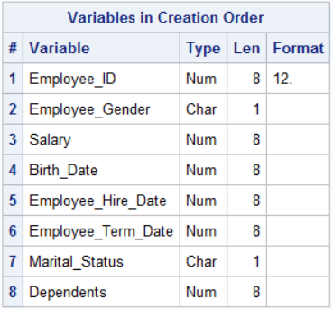
proc contents data=orion.Employee_Payroll position;run;
Display employee_id, salary, and add a new column named Bonus containing 10% of the employee’s salary.

Slide 11
Calculated Columns
proc sql;
select Employee_ID, Salary,
Salary * .10 as Bonus
from orion.Employee_Payroll;
quit;
Notes:
Note that the definition of bonus is backwards from what we would do in the data step.
We do the calculation first, then the as keyword. The function of the as keyword is just to put in the column header of the report.
When a data set is created, the as keyword causes a variable of that name to be created.

Slide 12
Modify the bonus report to conditionally calculate bonuses based on the employee’s job title:
Level I employees receive a 5% bonus.
Level II employees receive a 7% bonus.
Level III employees receive a 10% bonus.
Level IV employees receive a 12% bonus.
All others receive an 8% bonus.

Slide 13
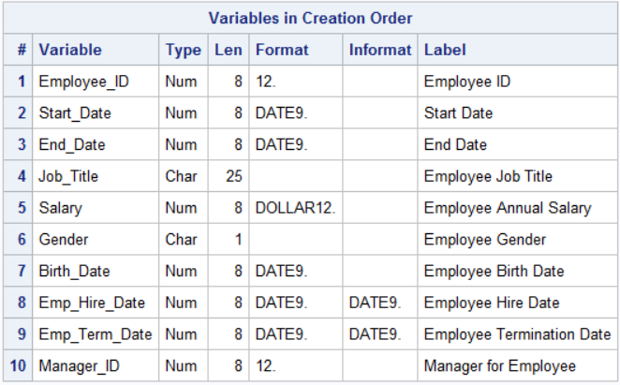
proc contents data=orion.staff position;run;
Notes:
The Staff table contains the information needed to create this report.

Slide 14
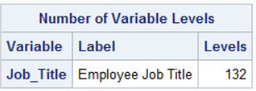
proc freq data=orion.staff nlevels;
tables job_title/noprint;
run;

Slide 15
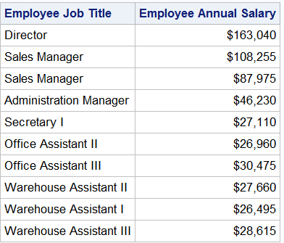
proc sql;
select *
from orion.staff(keep=job_title salary obs=10);
quit;
Level I employees receive a 5% bonus.
Level II employees receive a 7% bonus.
Level III employees receive a 10% bonus.
Level IV employees receive a 12% bonus.
All others receive an 8% bonus.
Notes:
Employees who have a “level” have a job title ending with the roman numeral specifying the level, those without the roman numeral get an 8% bonuse

Slide 16
The SCAN Function (Review)
The SCAN function returns the nth word or segment from a character string after breaking it up by the delimiters.
General form of the SCAN function:
string a character constant, variable, or expression
n an integer specifying the number of the word or segment that you want SCAN to select
charlist characters used as delimiters to separate words
modifier a character that modifies the action of the SCAN function
SCAN(string,n<,charlist><,modifier(s)>)

Slide 17
Extracting the Level from Job_Title
Return the third word from Job_Title and use a blank space as the delimiter.
scan(Job_Title,3,' ')
Office Assistant II
II
1
2
3
...

Slide 18
Extracting the Level from Job_Title
scan(Job_Title,3,' ')
Secretary I
1
2
Notes:
If Job_Title values have fewer than three words. If the value of n is greater than the number of words in the character string, the SCAN function returns a missing value.

Slide 19
Extracting the Level from Job_Title
If the value of n is negative, the SCAN function selects the word in the character string starting from the end of the string.
scan(Job_Title,-1,' ')
Secretary I
I
-2
-1
Office Assistant II
II
-3
-2
-1

Slide 20
The CASE Expression
You can use a CASE expression in a SELECT statement to create new columns.
General form of the CASE expression in the SELECT statement:
SELECT column-1<, ...column-n>
CASE <case-operand>
WHEN when-condition THEN result-expression
<WHEN when-condition THEN result-expression>
<ELSE result-expression>
END <as column>
FROM table;

Slide 21
Calculating the Bonus, Method 1
proc sql;
select Job_Title, Salary,
case scan(Job_Title,-1,' ')
when 'I' then Salary*.05
when 'II' then Salary*.07
when 'III' then Salary*.10
when 'IV' then Salary*.12
else Salary*.08
end as Bonus
from orion.Staff
;
quit;

Slide 22
Calculating the Bonus, Method 2
proc sql;
select Job_Title, Salary,
case
when scan(Job_Title,-1,' ')='I'
then Salary*.05
when scan(Job_Title,-1,' ')='II'
then Salary*.07
when scan(Job_Title,-1,' ')='III'
then Salary*.10
when scan(Job_Title,-1,' ')='IV'
then Salary*.12
else Salary*.08
end as Bonus
from orion.Staff
;
quit;
Notes:
s102d09a

Slide 23
SAS Dates and Date Functions in PROC SQL

Slide 24
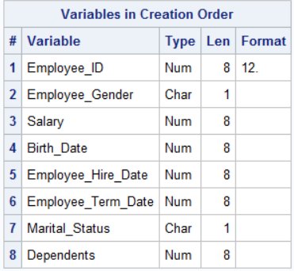
Prepare a report including employee identifier, gender and age
proc contents data=orion.Employee_Payroll position;run;
Notes:
Need to calculate age based on birth date and date calculation is made

Slide 25
SAS Date Values (Review)
A SAS date is stored as the number of whole days between January 1, 1960, and the date specified.
Stored Values
-365
0
366
01/01/1959
01/01/1960
01/01/1961
Display Values (formatted MMDDYY10.)

Slide 26
Some SAS Numeric Functions frequently used when you work with SAS dates
Function | Used To Return | Example
TODAY() | today’s date in SAS date form | today() as date
MONTH(arg) | the month portion of a SAS date variable as an integer between 1-12 | month(Birth_Date) as Birth_Month
INT(arg) | the integer portion of a numeric value | int(fullage) as age

Slide 27
Calculated Columns Using SAS Dates -- Calculating the age of each employee.
proc sql;
select Employee_ID, Employee_Gender,
int((today()-Birth_Date)/365.25)
as Age
from orion.Employee_Payroll;
quit;
...
Notes:
s102d10

Slide 28
Using SAS Dates in Calculations
Calculate Age based on today’s date being 14NOV2007 and a Birth_Date value of 18AUG1976.
6074
17484
proc sql;
select Employee_ID, Employee_Gender,
int((today()-Birth_Date)/365.25)
as Age
from orion.Employee_Payroll;
quit;
...
Notes:
s102d10

Slide 29
Using SAS Dates in Calculations
Calculate Age based on today’s date being 14NOV2007 and a Birth_Date value of 18AUG1976.
proc sql;
select Employee_ID, Employee_Gender,
int((today()-Birth_Date)/365.25)
as Age
from orion.Employee_Payroll;
quit;
31.23887748
...
Notes:
s102d10

Slide 30
Using SAS Dates in Calculations
Calculate Age based on today’s date being 14NOV2007 and a Birth_Date value of 18AUG1976.
proc sql;
select Employee_ID, Employee_Gender,
int((today()-Birth_Date)/365.25)
as Age
from orion.Employee_Payroll;
quit;
31
31.23887748
...
Notes:
s102d10

Slide 31
Using SAS Dates in Calculations
Calculate Age based on today’s date being 14NOV2007 and a Birth_Date value of 18AUG1976.
proc sql;
select Employee_ID, Employee_Gender,
int((today()-Birth_Date)/365.25)
as Age
from orion.Employee_Payroll;
quit;
31
Notes:
s102d10

Slide 32
Creating Tables with PROC SQL

Slide 33
Create a table (file, data set)
CREATE TABLE table-name AS query-expression;

Slide 34
Create and Populate a Table with an SQL Query
proc sql;
create table work.birth_months as
select Employee_ID, Birth_Date,
month(Birth_Date) as
Birth_Month,
Employee_gender
from orion.Employee_Payroll
;
describe table work.birth_months
;
quit;
proc print data=birth_months;
run;

Slide 35
A review of variable list shortcuts in SAS

Slide 36
Shortcuts for Variable Lists in SAS (Review)

Slide 37
Refer to all variable with the same prefix
/* all body measurements begin with "bm"*/
data body;
set nhanes3.exam (keep=seqn bm:);
run;
proc contents data=body;
run;

Slide 38
Refer to Numbered variables
libname fram "&path/fram";
/*use single - for numbered variables*/
proc contents data=fram.fram40;
run;
data sbp20;
set fram.fram40(keep=id spf1-spf20);
run;
proc print data=sbp20 (obs=5);
run;

Slide 39
Sometimes the order of variables on a file is determines their “grouping,”
proc contents data=fram.fram40 position;
run;

Slide 40
Refer to contiguous variables Using --
/* double dash -- signifies
all contiguous variables from the first to last specified
*/
data lipids;
set fram.fram40(keep=ex_date--vldl);
run;
proc contents data=lipids;
run;
proc print data=lipids (obs=10);
run;

Slide 41
Rename data set option
data sbp20;
set fram.fram40(keep=id spf1-spf20
rename=(spf1-spf20=sbp1-sbp20));
run;
proc print data=sbp20 (obs=5);
run;

Slide 42
Mix and Match
data lipids;
set fram.fram40(keep=ex_date--vldl spf1-spf20 sex chd
rename=(spf1-spf20=sbp1-sbp20));
run;
proc contents data=lipids;
run;
proc print data=lipids (obs=10);
run;

Slide 43
Multiple Drop Options
data chdmen (drop=male);
set s5238.chd5238(drop=dead eversmok height smkamt weight);
where male;
run;
proc contents data=chdmen;
run;

Slide 44
A problem with queries is that you can’t use SAS variable lists to specify variables in a select statement. So, use data set options to accomplish pre-processing.

Slide 45
Using data set options – a SAS enhancement
proc sql;
select libname,memname,nvar
from dictionary.tables
where memname="EXAM" and libname="NHANES3"
;
quit;
Notes:
A limitation in sql is the lack of variable lists, you can get around much of this limitation with data set options.

Slide 46
proc sql;
create table body as
select *
from nhanes3.exam (keep=seqn bm:)
order by seqn
;
quit;
proc means data=body;
run;

Slide 47
proc sql;
create table sbp as
select spf1-spf20
from fram.fram40
;
quit;
proc print data=sbp;
run;

Slide 48
proc sql;
create table sbp as
select *
from fram.fram40 (obs=10 keep=spf1-spf20 rename=(spf1-spf20=sbp1-sbp20))
;
quit;
proc print data=sbp;
run;

