Slide 1
3
Specifying Rows

Slide 2
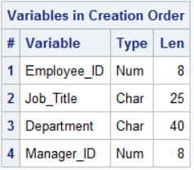
orion.Employee_Organization
proc contents data=orion.Employee_Organization position; run;

Slide 3
Display the names of the Orion Star departments
proc sql;
select Department
from orion.Employee_Organization
;
quit;
Notes:
s102d11

Slide 4
The distinct and unique keywords

Slide 5
Eliminating Duplicate Rows, the Distinct keyword
proc sql;
select distinct Department
from orion.Employee_Organization
;
quit;
Notes:
s102d11

Slide 6
The unique keyword
proc sql;
select unique department
from orion.Employee_Organization
;
quit;
Although the UNIQUE argument is identical to DISTINCT, it is not an ANSI standard.

