Slide 1
2
Displaying Queries
Notes:
Display a query’s results in a specified order.
Use SAS formats, labels, and titles to enhance the appearance and usability of a query’s output.

Slide 2
Ordering Data
From the orion.Employee_payroll table, list the employee ID and salary of all employees hired prior to January 1, 1979
proc sql;
select Employee_ID, Salary
from orion.Employee_payroll
where Employee_Hire_Date < '01JAN1979'd
;
quit;

Slide 3
Ordering Data
Use the ORDER BY clause to sort query results in a specific order.
  Ascending order (No keyword; this is the default.)
  Descending order (by following the column name
  with the DESC keyword)

Slide 4
Ordering Data
In an ORDER BY clause, order the query results by specifying:
  Any column name from any table in the FROM clause, even if the column is not in the SELECT list
  A column name or a number representing the position of an item in the SELECT list
  An expression
  A combination of any of the above, with individual items separated by commas

Slide 5
From the orion.Employee_payroll table, list the employee ID and salary of all employees hired prior to January 1, 1979, in descending salary order.
proc sql;
select Employee_ID, Salary
from orion.Employee_payroll
where Employee_Hire_Date < '01JAN1979'd
order by Salary desc;
quit;

Slide 6
Producing an Ordered Report
Sort output in descending order of amount and then by employee ID.
proc sql;
select Employee_ID,
max(Qtr1,Qtr2,Qtr3,Qtr4)
from orion.Employee_donations
where Paid_By="Cash or Check"
order by 2 desc, Employee_ID;
quit;

Slide 7
Enhancing Query Output
You can use SAS formats and labels to customize PROC SQL output.
In the SELECT list, after the column name, but before the commas that separate the columns, you can include:
  Text in quotation marks (ANSI) or the LABEL= column modifier (SAS enhancement) to alter the column heading
  The FORMAT= column modifier to alter the appearance of the values in that column

Slide 8
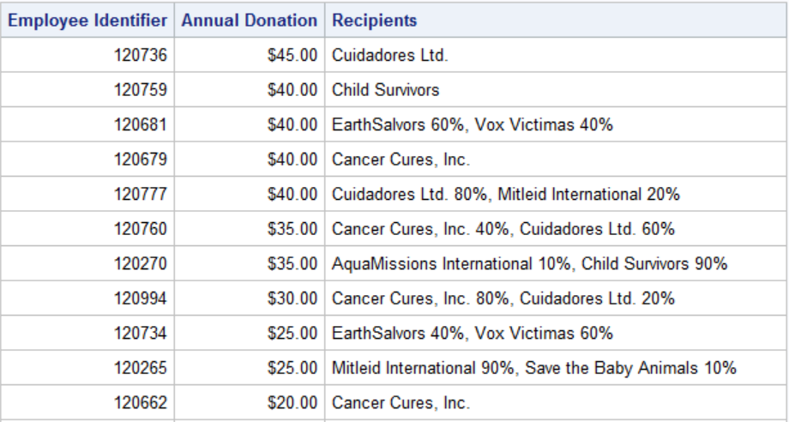
Prepare a report that shows the employee ID of each Orion Star employee who makes charitable donations, lists the amount of the highest quarterly donation and the recipients. Rows should be sorted first in descending order of amount, and then by employee ID.

Slide 9
Enhancing Query Output
You can enhance a report by displaying column labels instead of variable names, and formatting cash amounts with dollar signs and commas.
proc sql;
select Employee_ID
label="Employee Identifier",
sum(Qtr1,Qtr2,Qtr3,Qtr4)
"Annual Donation" format=dollar7.2,
Recipients
from orion.Employee_donations
where Paid_By="Cash or Check"
order by 2 desc
;
quit;

Slide 10
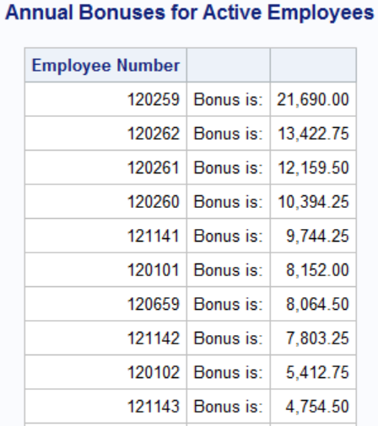
Produce a report of bonus values for all active employees. Bonuses are 5% of salary.
Employee_ID
fixed text
Salary*0.05

Slide 11
Enhancing Query Output
You can also enhance the appearance of the query output by defining a new column containing the same constant character value for every row
  using SAS titles and footnotes
Use a combination of these techniques to produce the Annual Bonuses for Active Employees report.

Slide 12
Enhancing Query Output
proc sql;
title 'Annual Bonuses for Active Employees';
select Employee_ID label='Employee Number',
'Bonus is:',
Salary *.05 format=comma12.2
from orion.Employee_Payroll
where Employee_Term_Date is missing
order by Salary desc
;
quit;
title;
Notes:
s103d04

