Slide 1
Framingham, Exam 5 subset

Slide 2
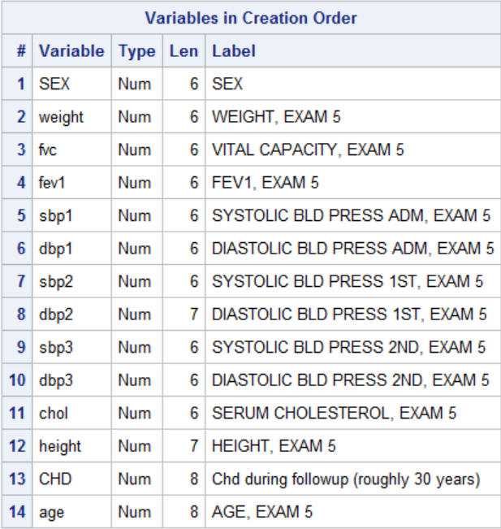
proc contents data=fram.framexam5subset position;run;

Slide 3
Counts, Means, standard deviations by gender
proc sql;
select sex as gender, count(chol) as n,
mean(chol) format=8.1 as mnchol,
std(chol) as stdchol format=8.1
from fram.framexam5subset
group by sex
;
quit;

Slide 4
Average Blood Pressure for each observation
proc sql outobs=17;
select sex,chol,
mean(sbp1, sbp2, sbp3) as mnsbp,
n(sbp1,sbp2,sbp3) as nsbp
from fram.framexam5subset
where calculated mnsbp ne .
;
quit;

Slide 5
proc sql;
create table sbptmp as
select sex,
mean(sbp1, sbp2, sbp3) as mnsbp
from fram.framexam5subset
where calculated mnsbp ne .
;
quit;
proc print data=sbptmp (obs=17);
run;

Slide 6
proc sql outobs=11;
create table fram1 as
select sex as gender,age,chd,chol,
mean(sbp1, sbp2, sbp3) as mnsbp,
weight/height**2*703 as bmi,
fev1/fvc*100 as fev1pc
from fram.framexam5subset
where calculated mnsbp ne . ;
quit;

Slide 7
Find Number of Observations
proc sql;
select count(*)
from fram.framexam5subset;
quit;

