Slide 1
Demonstrating the Linear Model

Slide 2
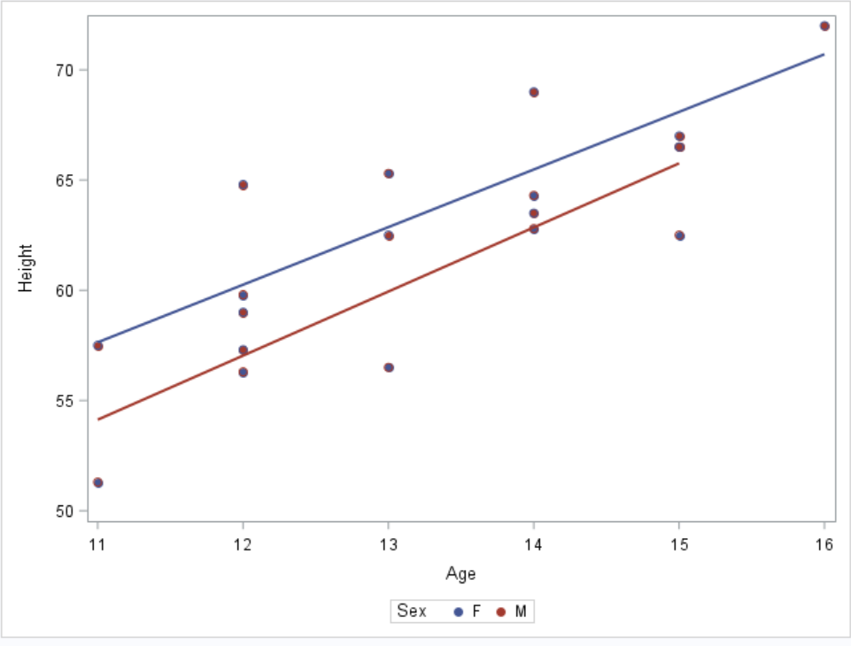
A “typical” example.
proc sgplot data=sashelp.class;
scatter x=age y=height/group=sex
markerattrs=(symbol=circlefilled);
reg x=age y=height/group=sex;
run;

Slide 3
What is the relationship between age and systolic blood pressure?

Slide 4
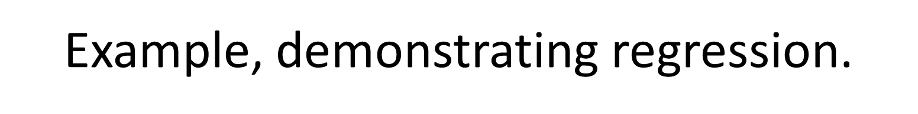
proc sgplot data=fram.framexam5subset;
scatter x=age y=sbp1;
run;

Slide 5
Example, demonstrating regression.
proc reg data=fram.framexam5subset plots=none;
model sbp1=age;
run;

Slide 6
Statistical Assumptions

Slide 7
Conditional Mean

Slide 8
For any value of age, we need to calculate the conditional mean
Then examine whether these conditional means fall at least approximately on a straight line
This is easily by incorporating PROC SQL with summary functions into the process

Slide 9
Demonstrate the relationship of average sbp to age
proc sql noprint;
create table mnsbpage as
select age,count(sbp1) as n,mean(sbp1) as mnsbp
from fram.framexam5subset
group by age;
quit;
proc sgplot data=mnsbpage;
series x=age y=mnsbp;
run;

Slide 10
Demonstrate the relationship of average dbp to age
proc sql noprint;
create table mndbpage as
select age,count(dbp1) as n,mean(dbp1) as mndbp
from fram.framexam5subset
group by age;
quit;
proc sgplot data=mndbpage;
series x=age y=mndbp;
run;

Slide 11
Demonstrate the relationship of average pulse pressure to age
proc sql noprint;
create table mndbpage as
select age,count(sbp1) as n,mean(sbp1-dbp1) as mnpulsepr
from fram.framexam5subset
group by age;
quit;
proc sgplot data=mndbpage;
series x=age y=mnpulsepr;
run;

