Slide 1
Create a subset of DPC data

Slide 2
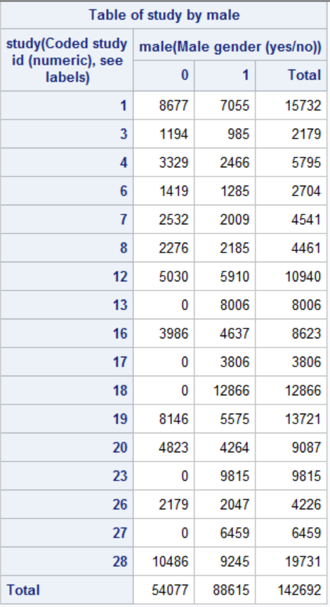
proc freq data=dpc.ipd_student;
tables study*male/norow nocol nopercent;
run;

Slide 3
proc sql;
select study,sum(not male) as numfemale
from dpc.ipd_student
group by study
having numfemale = 0
;
quit;

Slide 4
proc sql;
create table bothgenders as
select study, name, age, chol, currsmok, male, dead, d_chd,
followd, sbp, dbp, bmi, diab
from dpc.ipd_student
where study not in (13,17,18,23,27)
order by study, male, race
;
run;
proc freq data=bothgenders;
tables study*male/norow nocol nopercent;
run;

