Slide 1
Meta Analysis -- The Fixed Effects Model

Slide 2
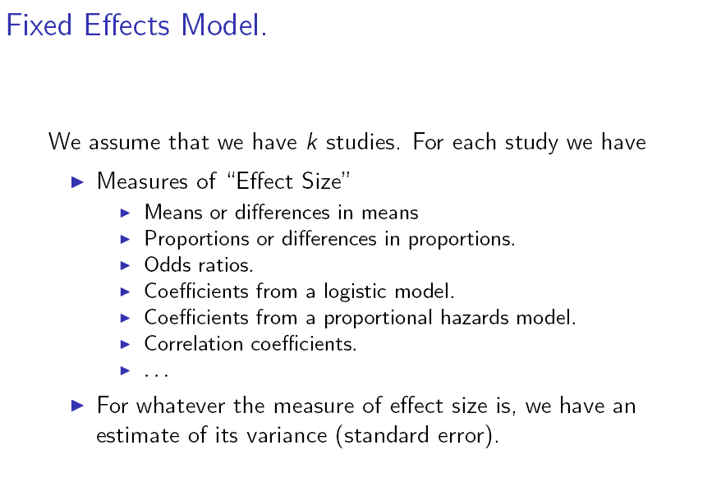
Meta Analysis

Slide 3
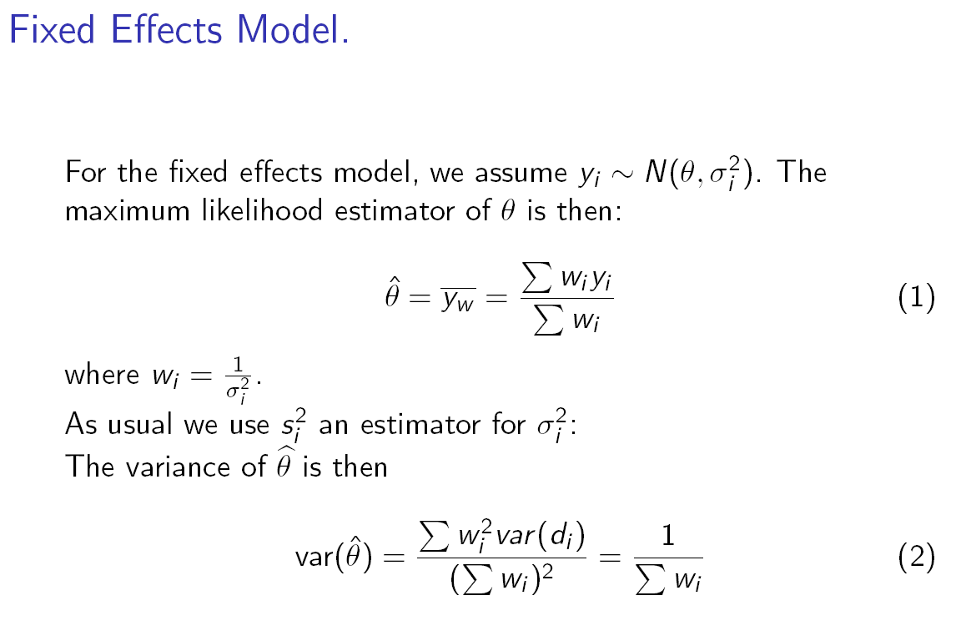

Slide 4
/*Specialist care for stroke patients from nine studies: comparing specialist
multidisciplinary team care for managing stroke inpatients with routine management
in general medical wards.
Data are from Normand, Meta-Analysis Tutorial, Stat Med 1989
*/
data stroke;
input source $20. n1 los1 sd1 n2 los2 sd2;
label n1 ="Number strokes (specialist)"
los1 ="Length of stay (specialist)"
sd1="Standard deviation (specialist)"
n2 ="Number strokes (routine)"
los2 ="Length of stay (routine)"
sd2="Standard deviation (routine)"
;
mndiff=los1-los2;
vardiff=sd1*sd1/n1+sd2*sd2/n2;
precdiff=1/vardiff;
datalines;
Edinburgh 155 55 47 156 75 65
Orpington-Mild 31 27 7 32 29 4
Orpington-Moderate 75 64 17 71 119 29
Orpington-Severe 18 66 20 18 137 48
Montreal-Home 8 14 8 13 18 11
Montreal-Transfer 57 19 7 52 18 4
Newcastle(1993) 34 52 45 33 41 34
Umea(1985) 110 21 16 183 31 27
Uppsala(1982) 60 30 27 52 23 20
;
run;

Slide 5
PROC SQL;
SELECT SUM(mndiff*precdiff)/SUM(precdiff) AS estimate,
1/SUM(precdiff) AS VarEst
FROM work.stroke;
QUIT;

