Slide 1
Fixed Effects estimate using person level data

Slide 2
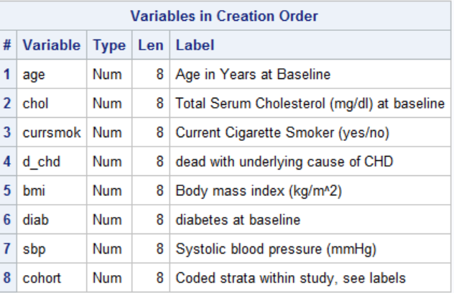
Some person level data
data ipdtmp;
set dpc.ipd_student(keep=cohort d_chd age bmi chol sbp diab currsmok);
run;
proc contents data=ipdtmp position;run;

Slide 3

proc sql;
select count(distinct cohort)
from ipdtmp
;
quit;

Slide 4
Logistic Regression
We assume we have a sample
and that

Slide 5
Create the “effect” variables and their standard errors
proc logistic data=ipdtmp descending outest=betas covout noprint;
by cohort;
model d_chd=age bmi chol sbp diab currsmok;
run;
proc print data=betas;
run;

Slide 6
Create separate tables with effect sizes and variances
proc sql;
create table bmibetas as
select cohort,bmi as bmibeta
from betas
where _type_ eq "PARMS"
order by cohort
;
select *
from bmibetas
;
select count(*)
from bmibetas
;
create table bmivar as
select cohort, bmi as varbeta label="Variance of estimate",
1/varbeta as precbeta label="Precision of estimate"
from betas
where _type_ eq "COV" and _name_ eq "bmi"
order by cohort
;
select *
from bmivar
;
select count(*)
from bmivar
;
quit;

Slide 7
Put them together
data metabetas;
merge bmibetas bmivar;
by cohort;
run;
proc print data=metabetas;run;

Slide 8
Calculate Fixed Effects Estimate
PROC SQL;
SELECT SUM(bmibeta*(1/varbeta))/SUM((1/varbeta)) AS estimate,
1/SUM(1/varbeta) AS VarEst
FROM metabetas;
QUIT;

Slide 9
An aside – the data step version
data bmibetas1(keep=cohort bmi)
bmivar1(keep=cohort bmivar);
set betas;
if _type_="PARMS" then output bmibetas1;
else if _type_ eq "COV" and _name_ eq "bmi" then do;
bmivar=bmi;
output bmivar1;
end;
run;
proc sort data=bmibetas;by cohort;run;
proc sort data=bmivar;by cohort;run;
data metabetas1;
merge bmibetas1 bmivar1;by cohort;run;
proc print data=metabetas1;run;

