Slide 1
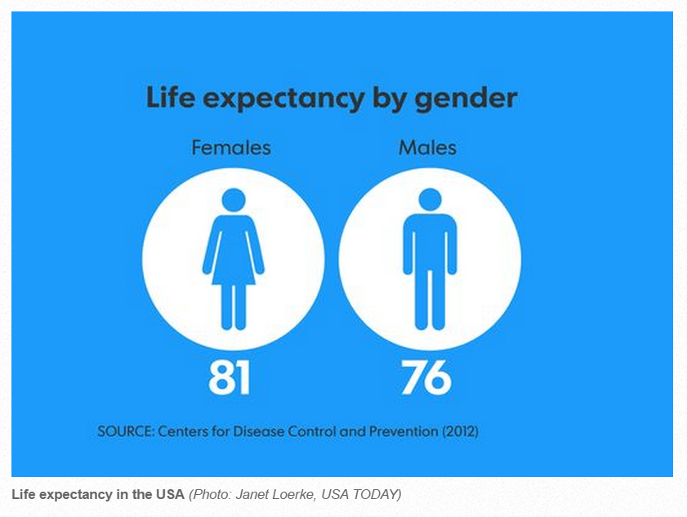
USA Today, October 9, 2014

Slide 2
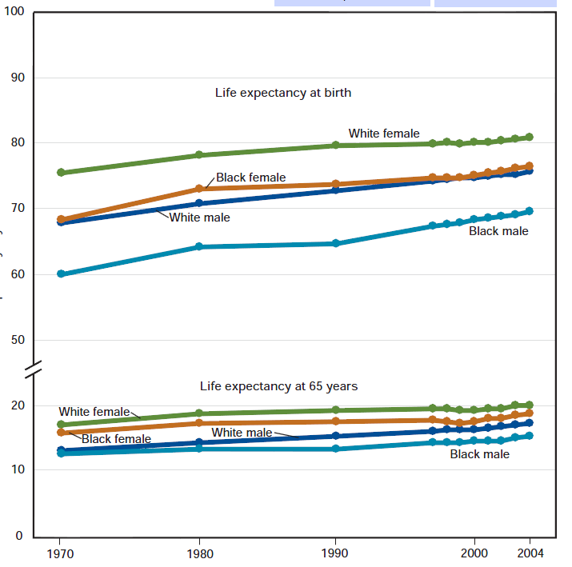

Slide 3
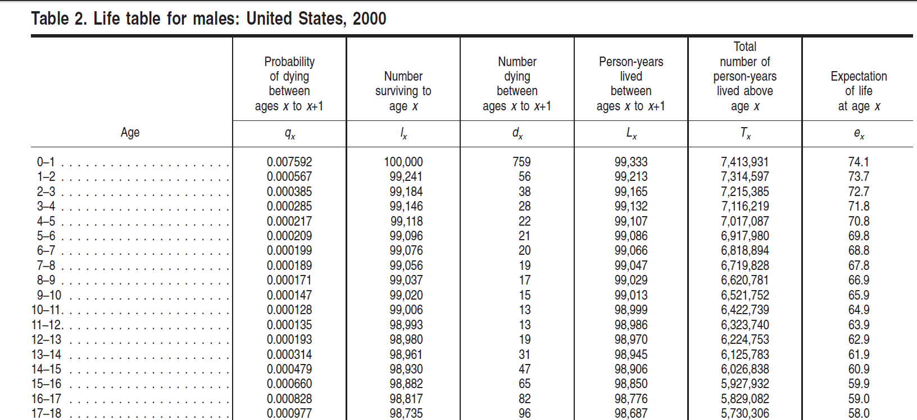
A complete current lifetable (partial)

Slide 4
Some data for creating an abridged current life table.
data lifetable88;/*data are from 1988*/
input agegrp $ rate;
label age="Age Group"
rate="Death rate per 1,000";
datalines;
0 11.22
1-4 0.56
5-14 0.31
15-24 1.54
25-34 1.96
35-44 2.96
45-54 6.37
55-64 16.24
65-74 35.83
75-84 82.43
85+ 184.75
;
proc print data=lifetable88 noobs;
run;

Slide 5
CurrentAbridgedLifetableSimplified.xlsx

Slide 6
data lifetable88a;
set lifetable88;
retain numalive;
if _n_=1 then numalive=100000;
numdths=round(numalive*rate/1000);
numalive=sum(numalive,-lag(numdths));
run;
proc print data=lifetable88a noobs;run;

