Slide 1
Introduction to Subqueries, An Example
Create an analytic file containing blood pressure values for participants who were eligible for mortality follow-up.
Two files involved:
nh9.bloodpressure
nh9.mortality

Slide 2
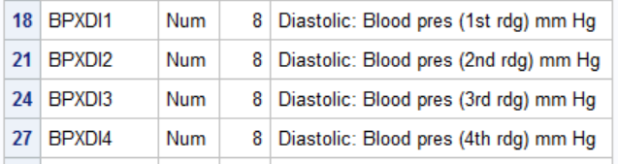
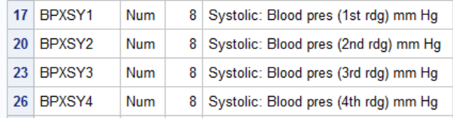
nh9.bloodpressure (partial contents)

Slide 3
nh9.mortality (partial contents)

Slide 4
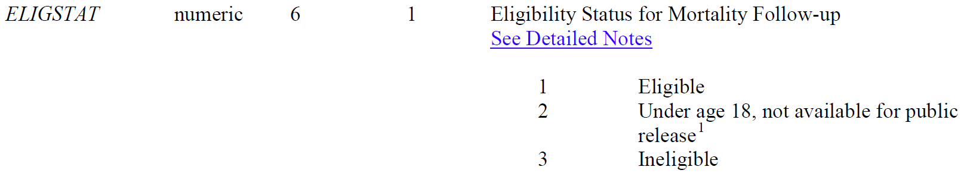
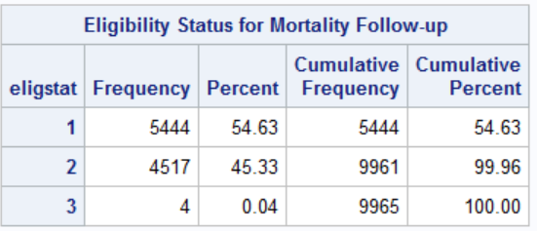
From nh9.mortality documentation

Slide 5
This could be accomplished with SQL if we had a list of sequence numbers in the parens.
proc sql;
create table bp2 as
select
mean(bpxsy1,bpxsy2,bpxsy3,bpxsy4) as mnsbp,
mean(bpxdi1,bpxdi2,bpxdi3,bpxdi4) as mndbp,
seqn
from nh9.bloodpressure
where calculated mnsbp ne . and calculated mndbp ne . and
seqn in (a list of sequence numbers)
;
quit;
proc means data=bp2;
run;

Slide 6
The list of seqn’s can be gotten with a query
proc sql;
select seqn
from nh9.mortality
where eligstat=1
;
Putting this in the parentheses
makes it a SUBQUERY

Slide 7
Subqueries
proc sql;
create table bp2 as
select
mean(bpxsy1,bpxsy2,bpxsy3,bpxsy4) as mnsbp,
mean(bpxdi1,bpxdi2,bpxdi3,bpxdi4) as mndbp,
seqn
from nh9.bloodpressure
where calculated mnsbp ne . and calculated mndbp ne . and
seqn in (select seqn from nh9.mortality
where eligstat=1)
;
quit;
proc means data=bp2;
run;

