Slide 1
Noncorrelated subquery

Slide 2
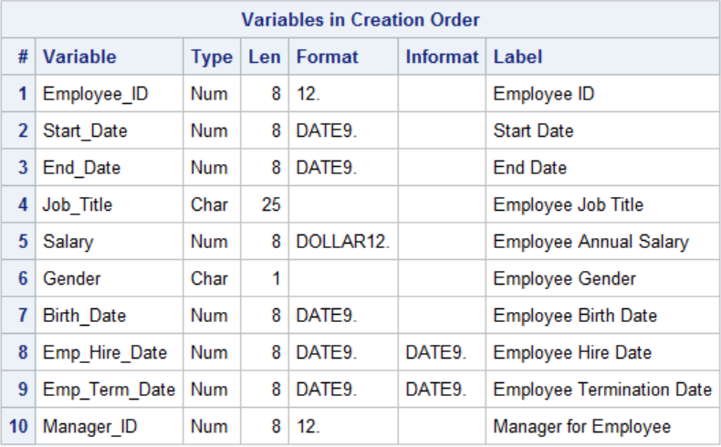
Example: Create a report that displays Job_Title for job groups with an average salary greater than the average salary of the company as a whole.
proc contents data=orion.staff position;run;
Notes:
Orion staff file contains necessary information

Slide 3

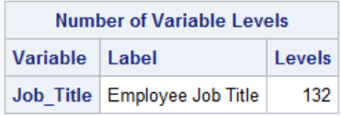
How many unique job titles?
proc sql;
select count(distinct job_title)
from orion.staff
;
proc freq data=orion.staff nlevels;
table job_title/noprint;
run;
Notes:
We can find number of job titles in two ways

Slide 4
The standalone query
select avg(Salary) as MeanSalary
from orion.Staff

Slide 5
Use the standalone query as a subquery
proc sql;
select Job_Title, avg(Salary) as MeanSalary
from orion.Staff
group by Job_Title
having avg(Salary) >
( select avg(Salary) as MeanSalary
from orion.Staff );
quit;
Notes:
Note MeanSalary appears in two different contexts

Slide 6
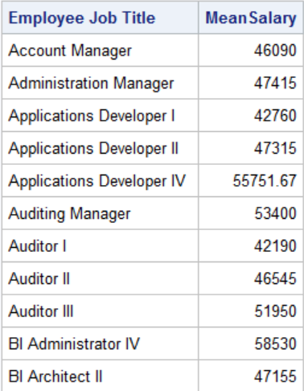

Slide 7
Noncorrelated Subqueries
proc sql;
select Job_Title, avg(Salary) as MeanSalary
from orion.Staff
group by Job_Title
having avg(Salary) >
( select avg(Salary) as MeanSalary
from orion.Staff );
quit;
Evaluate the subquery first.
Notes:
The noncorrelated subquery is evaluate first.
In this case a single number is created

Slide 8
Noncorrelated Subqueries
proc sql;
select Job_Title, avg(Salary) as MeanSalary
from orion.Staff
group by Job_Title
having avg(Salary) > (38041.51);
quit;
Then pass the results to the outer query.
Notes:
The number is then passed to the outer query

Slide 9
Example:
Create a report listing the names and addresses of employees with February birthdays.
Notes:
In this case, the necessary info isn’t on a single file

Slide 10
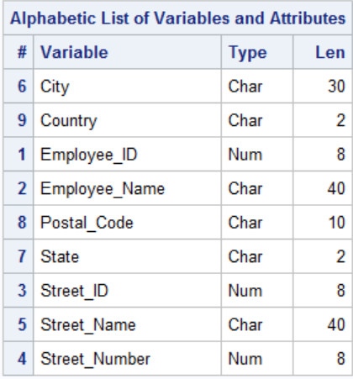
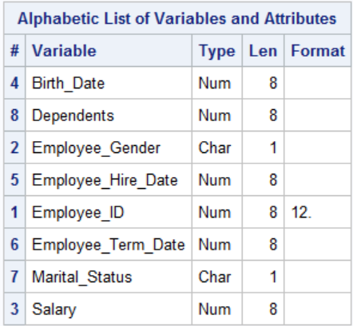
names and addresses.
Birth dates
Notes:
The two files
Note primary key

Slide 11
A stand alone query to get employee_id of all employees born in February
select Employee_ID
from orion.Employee_Payroll
where month(Birth_Date)=2

Slide 12
Embed stand alone query
proc sql;
select Employee_ID,
Employee_Name, City,
Country
from orion.Employee_Addresses
where Employee_ID in
(select Employee_ID
from orion.Employee_Payroll
where month(Birth_Date)=2)
order by 1
;
quit;

Slide 13
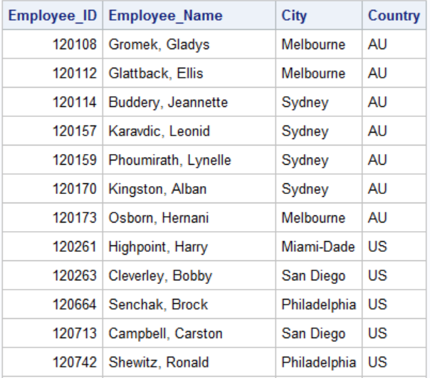

Slide 14
Example: Create a file with only studies that have both male and female participants

Slide 15
A stand alone query, find study number for those studies having female participants
proc sql;
select distinct study
from dpc.ipd_student
where male=0
;
quit;

Slide 16
Embed the stand alone query as a subquery
proc freq data=dpc.ipd_student;
tables study*male/norow nocol nopercent;
proc sql;
create table malefem as
select *
from dpc.ipd_student
where study in
(select distinct study
from dpc.ipd_student
where male=0)
;
quit;
proc freq data=malefem;
tables study*male/norow nocol nopercent;
run;

Slide 17
Example Missing values on the test data set, a problem in predictive analytics

Slide 18
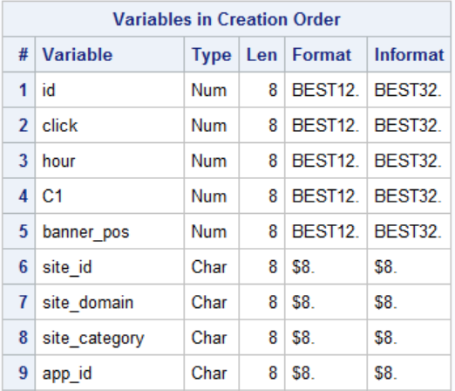
The data (Partial)
proc contents data=kag.train position;run;

Slide 19
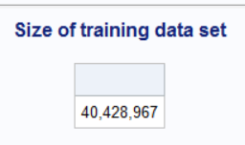
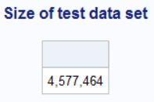
Count observations on train and test sets
libname kag "&path\clickthrough";
proc sql;
title "Size of training data set";
select count(*) format=comma10.
from kag.train
;
title "Size of test data set";
select count(*) format=comma10.
from kag.test
;
quit;
title;

Slide 20
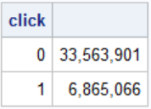
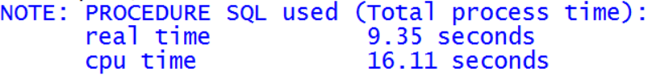
The dependent variable
proc sql;
select click,count(*) format= comma10.
from kag.train
group by click;
quit;

Slide 21
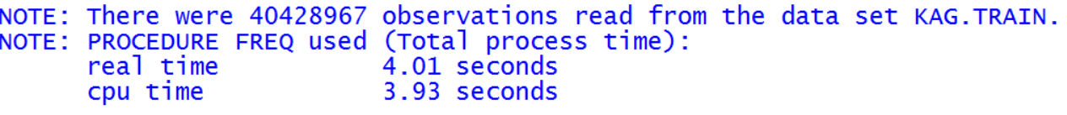
An aside, the same thing in PROC FREQ
proc freq data=kag.train;
tables click;
run;

Slide 22


Examine the number of app_ids on train and test data sets.
proc sql;
select count(distinct app_id) as num_on_train
from kag.train
;
select count(distinct app_id) as num_on_test
from kag.test
;
quit;

Slide 23

proc sql;
select count(distinct app_id) as not_on_train
from kag.test
where app_id not in
(select unique app_id from kag.train)
;
quit;

Slide 24

proc sql;
select count(*) as obs_not_on_train
from kag.test
where app_id not in
(select unique app_id from kag.train)
;
quit;

Slide 25
The next few examples uses an airline data base. The airline data base came from SAS and is used in the Advanced Programming Certification Prep Book. Many of the queries used in the following come from that book.

Slide 26
Example: Find jobcodes that have average salary greater then the overall average salary

Slide 27
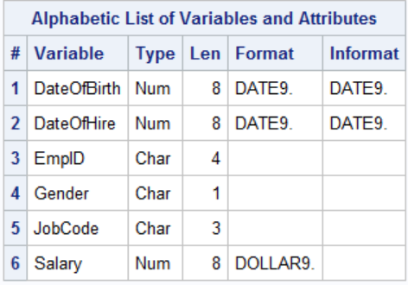
The payrollmaster table
proc contents data=train.payrollmaster;run;

Slide 28
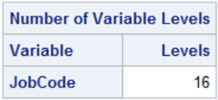
How many jobcodes?
proc freq data=train.payrollmaster nlevels;
tables jobcode/noprint;
run;

Slide 29
Example: Find jobcodes that have average salary greater then the overall average salary
/*single-value non correlated subquery*/
proc sql;
select jobcode,
avg(salary) as AvgSalary
format=dollar11.2
from train.payrollmaster
group by jobcode
having avg(salary) >
(select avg(salary) from
train.payrollmaster)
;
quit;

Slide 30
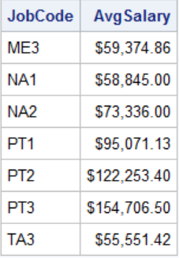

Slide 31
Example: List the employee id, last name, first name, city and state for all employees born in December

Slide 32
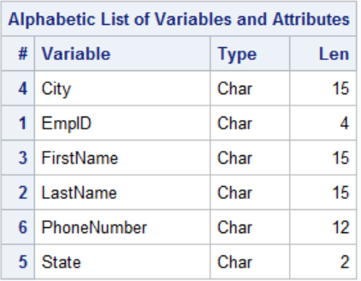

Slide 33
/*multiple value noncorrelated subquery*/
proc sql;
select empid,lastname,firstname,
city,state
from train.staffmaster
where empid in
(select empid
from train.payrollmaster
where month(dateofbirth)=12)
;
quit;

Slide 34
The ANY keyword with subqueries that return multiple values

Slide 35
List employee id, job code, and date of birth for level 1 or 2 flight attendants who are older than any level 3 flight attendants

Slide 36
A standalone query that selects dates of birth for all Flight Attendant 3s
select dateofbirth
from train.payrollmaster
where jobcode="FA3"

Slide 37
Embed the stand alone query as a subquery
/* any keyword*/
proc sql;
select empid,jobcode,dateofbirth
from train.payrollmaster
where jobcode in ("FA1","FA2")
and dateofbirth < any
(select dateofbirth
from train.payrollmaster
where jobcode="FA3")
;
quit;

Slide 38
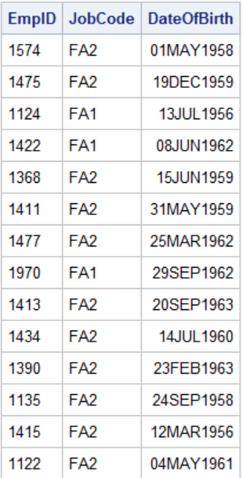

Slide 39
The ALL keyword

Slide 40
List employee id, jobcode, and date of birth for level 1 or level 2 flight attendants who are older than all level 3 flight attendants

Slide 41
proc sql;
select empid,jobcode,dateofbirth
from train.payrollmaster
where jobcode in ("FA1","FA2")
and dateofbirth < all
(select dateofbirth
from train.payrollmaster
where jobcode="FA3")
;
quit;

Slide 42
