Slide 1
2
Correlated Subqueries
Notes:
Difference – Subquery is not standalone this means something from the outer query is needed to evaluate the inner query

Slide 2
Correlated Subqueries
Cannot be evaluated independently
Require values to be passed to the inner query from the outer query
Are evaluated for each row in the outer query.

Slide 3
Example: Create a report listing the employee identifier and the first name followed by the last name for all managers in Australia.

Slide 4
Create a temporary table, Supervisors, containing Employee_ID and Country for all managers.
proc sql;
create table work.Supervisors as
select distinct Manager_Id as Employee_Id,
upcase(Country) as Country
from orion.Employee_Addresses as e,
orion.Staff as s
where e.Employee_Id=s.Manager_Id
and e.employee_id in
(120103,120104,120260,120262,120668,120672,120679,120735,
120736,120780,120782,120798,120800,121141,121143)
;
quit;
proc print data=supervisors;run;

Slide 5
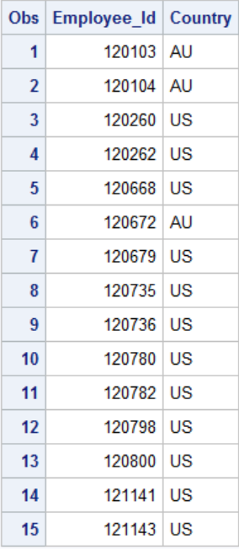

Slide 6
Example: Create a report listing the employee identifier and the first name followed by the last name for all managers in Australia.

Slide 7
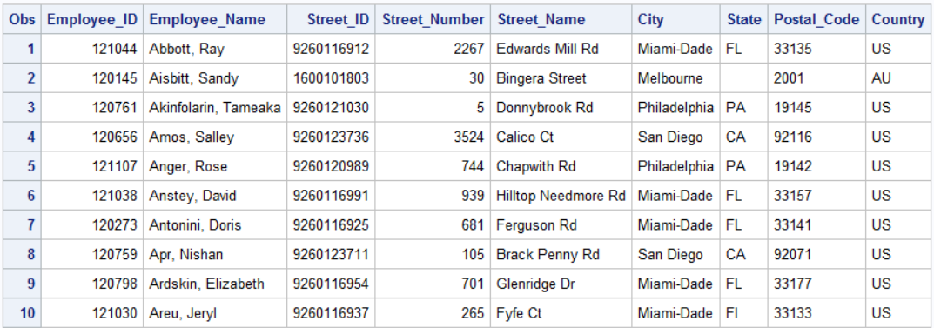
The table orion.Employee_Addresses contains Employee_Name for all employees, but the names are stored as Last, First.
proc print data=orion.employee_addresses (obs=10);run;

Slide 8
Use the SCAN() function to separate first and last names then concatenate the pieces into First, Last order.

Slide 9
The CATX Function
The CATX function concatenates the values in argument-1 through argument-n by stripping leading and trailing spaces, and inserting the value of argument-1 between each segment.
delimiter a character string that is used as a delimiter between concatenated arguments.
argument a character variable’s name, a character constant, or an expression yielding a character value.
CATX(delimiter,argument-1,argument-2<, ...argument-n>)

Slide 10
Now, use the scan function and a correlated subquery to add the names in correct order.
proc sql;
select Employee_ID,
catx(' ',scan(Employee_Name,2),
scan(Employee_Name,1)) as Manager_Name length=25
from orion.Employee_Addresses
where 'AU'=
(select Country
from Work.Supervisors
where Employee_Addresses.Employee_ID=
Supervisors.Employee_ID) ;
quit;
You must qualify each column with a table name.

Slide 11
Creating Table Aliases
proc sql;
select Employee_ID,
catx(' ',scan(Employee_Name,2),
scan(Employee_Name,1)) as Manager_Name length=25
from orion.Employee_Addresses as e
where 'AU'=
(select Country
from Work.Supervisors as s
where e.Employee_ID=s.Employee_ID)
;
quit;

Slide 12
Creating Table Aliases
proc sql;
select Employee_ID,
catx(' ',scan(Employee_Name,2),
scan(Employee_Name,1)) as Manager_Name length=25
from orion.Employee_Addresses e
where 'AU'=
(select Country
from Work.Supervisors s
where e.Employee_ID=s.Employee_ID)
;
quit;

Slide 13
Create a report showing Employee_ID and Job_Title columns of all sales personnel who did not make any sales.
The table orion.Sales contains Employee_ID and Job_Title columns for all sales personnel.
The table orion.Order_Fact holds information about all sales, and the Employee_ID column contains the employee identifier of the staff member who made the sale.

Slide 14
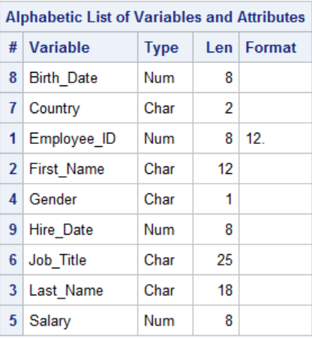
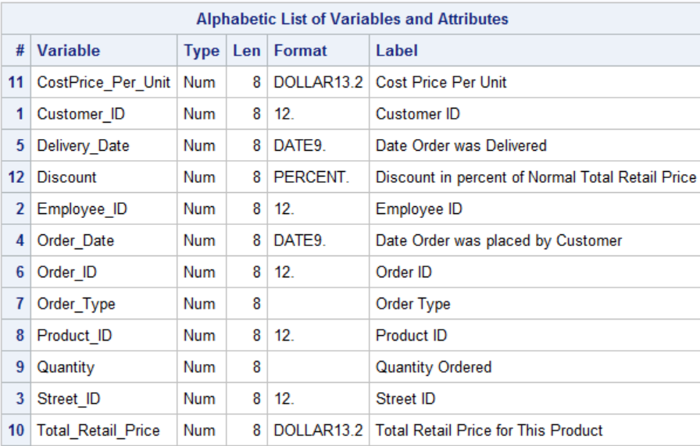

Slide 15
The EXISTS and NOT EXISTS Condition
The EXISTS condition tests for the existence of a set of values returned by the subquery.
The EXISTS condition is true if the subquery returns at least one row.
The NOT EXISTS condition is true if the subquery returns no data.

Slide 16
Correlated Subqueries
orion.Sales
(all Sales staff )
orion.Order_Fact
(all sales)
Sales made by Sales staff
Sales staff who made no sales
Sales made by non-Sales staff
...

Slide 17
Correlated Subqueries
orion.Sales
(all Sales staff )
These are the rows we want.
Sales staff who made no sales

Slide 18
Correlated Subqueries
The table orion.Sales contains the employee IDs, job titles, and other demographic information about the Orion Star Sales staff.
proc sql;
select Employee_ID, Job_Title
from orion.Sales
where not exists
(select *
from orion.Order_Fact
where Sales.Employee_ID=Order_Fact.Employee_ID);
quit;
The population of Sales staff
orion.Sales
...
Notes:
s104d06

Slide 19
Correlated Subqueries
The orion.Order_Fact table contains a row for each product sold to a customer.
proc sql;
select Employee_ID, Job_Title
from orion.Sales
where not exists
(select *
from orion.Order_Fact
where Sales.Employee_ID=Order_Fact.Employee_ID);
quit;
Staff who placed orders
orion.Order_Fact
...
Notes:
s104d06

Slide 20
Correlated Subqueries
Find Sales employees who exist here...
proc sql;
select Employee_ID, Job_Title
from orion.Sales
where not exists
(select *
from orion.Order_Fact
where Sales.Employee_ID= Order_Fact.Employee_ID);
…but do not exist here.
orion.Sales
orion.Order_Fact

Slide 21
Example: On the airline database, find the names of all navigators who are also managers

Slide 22
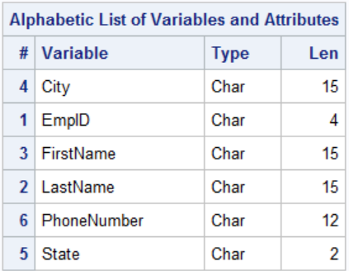
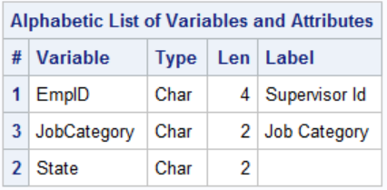
proc contents data=train.staffmaster;run;
proc contents data=train.supervisors;run;

Slide 23
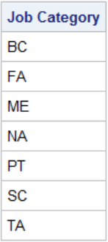
proc sql;
select distinct jobcategory
from train.supervisors
;
quit;

Slide 24
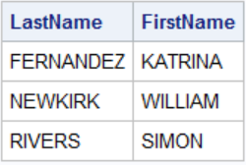
proc sql;
select lastname,firstname
from train.staffmaster as a
where "NA"=
(select jobcategory
from train.supervisors as b
where a.empid=
b.empid);
quit;

Slide 25
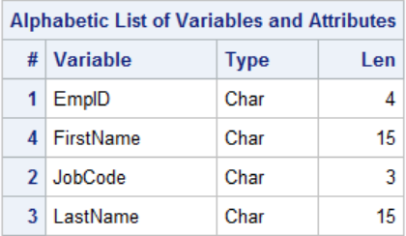
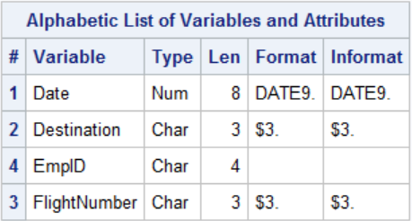
Find the names of flight attendants who have not been scheduled

Slide 26
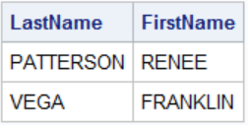
proc sql;
select lastname,firstname
from train.flightattendants as a
where not exists
(select *
from train.flightschedule as s
where a.empid=
s.empid);
quit;

