Slide 1
Match-Merge in the Data Step

Slide 2
Example Data
data htwt;
length id 8;
input height weight id @@;
datalines;
56.50 98 1 62.25 145 2 62.50 128 3 64.75 119 4
68.75 144 5 60.00 117 6 58.00 125 7
;
run;
data chol;
length id 8;
input chol id @@;
datalines;
234 1 172 2 248 3 215 4
145 5 281 6 335 7
;
run;
proc print data=htwt noobs;
run;
proc print data=chol noobs;
run;

Slide 3
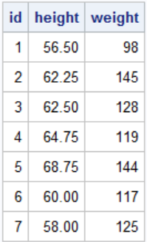

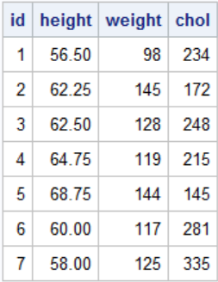
Match-Merging involves combining observations from two or more SAS data sets into a single observation in a new SAS data set.
data tot1;
merge htwt chol;
by id;
run;
proc print data=tot1 noobs;run;

Slide 4
Match-Merge in the data step requires: All data sets sorted on the by variable. The by variable exists and has the same name on all datasets being merged
proc sort data=htwt;
by id;
run;
proc sort data=chol;
by id;
run;
data tot1;
merge htwt chol;
by id;
run;
proc print data=tot1;
run;

Slide 5
data htwt;
input height weight id @@;
datalines;
56.50 98 1 62.25 145 2 62.50 128 3
64.75 119 4 68.75 144 5 60.00 117 6
63.00 156 9 63.00 134 10
;
run;
data chol;
input chol id @@;
datalines;
215 1 145 2 281 3 335 4 196 7
;
run;
proc print data=htwt noobs;
run;
proc print data=chol noobs;
run;
Match-Merge Different Number of Rows

Slide 6
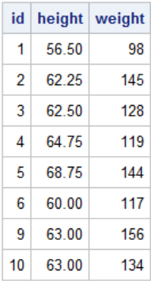

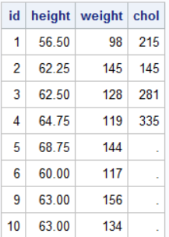
data tot4;
merge htwt(in=h) chol(in=c);
by id;
run;
proc print data=tot4 noobs;
run;

Slide 7
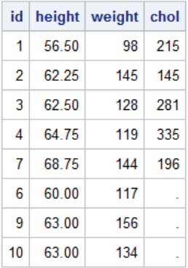
The forgotten by
data tot3;
merge htwt chol;
run;
proc print data=tottmp;
run;

Slide 8
in= Option
data tot5;
merge htwt(in=h) chol(in=c);
by id;
if h;
run;
proc print data=tot5 noobs;
run;

Slide 9
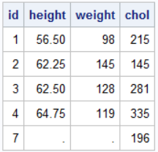
in= Option
data tot6;
merge htwt(in=h) chol(in=c);
by id;
if c;
run;
proc print data=tot6 noobs;
run;

Slide 10
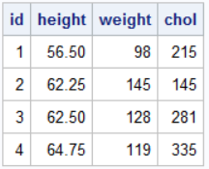
in= Option
data tot6;
merge htwt(in=h) chol(in=c);
if h and c;
run;
proc print data=tot6 noobs;
run;

Slide 11
Three Data Sets
data htwt;
length id 8;
input height weight id @@;
datalines;
56.50 98 1 62.25 145 2 62.50 128 3 64.75 119 4
68.75 144 5 60.00 117 6 63.00 156 9 63.00 134 10
;
run;
data chol;
length id 8;
input chol id @@;
datalines;
215 1 145 2 281 3 335 4 196 7
;
run;
data bp;
length id 8;
input dbp sbp id @@;
datalines;
83 125 1 73 108 4 71 108 5 79 116 6
89 170 7 80 120 8 70 108 9 79 123 10
;
run;
proc print data=htwt noobs;run;
proc print data=chol noobs;run;
proc print data=bp noobs;run;

Slide 12
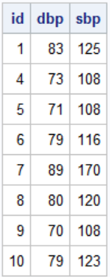

Slide 13
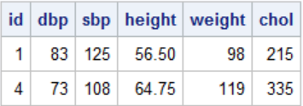
Match-merge three Data Sets
proc sort data=bp;by id;run;
proc sort data=htwt;by id;run;
proc sort data=chol;by id;run;
data tot6;
merge bp(in=b) htwt(in=h) chol(in=c);
by id;
if b and h and c;
run;
proc print data=tot6 noobs; run;

Slide 14
Data sets with the same variable – overlaying columns
data chol1 (keep=sbp height chol id);
length id 8;
set fram.frex4(obs=15 );
where sbp ne . and height ne . and chol ne .;
id=_n_;
run;
data chol2 (obs=15 keep= chol id);
call streaminit(12345);
do id=1 to 15;
chol=int(rand("normal",240,40));
output;
end;
run;
proc print data=chol1 noobs;run;
proc print data=chol2 noobs;run;

Slide 15
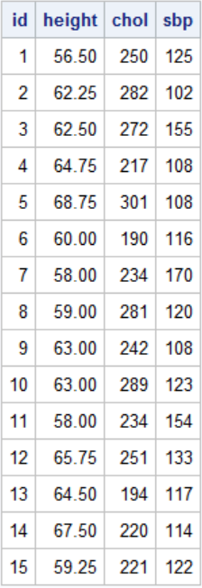
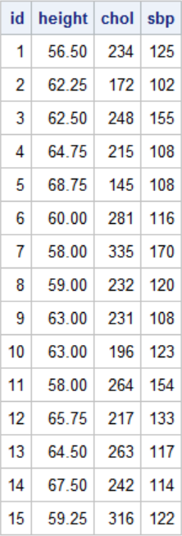

proc sort data=chol1;by id;run;
proc sort data=chol2;by id;run;
data totchol;
merge chol1 chol2;
by id;
run;
proc print data=totchol noobs;run;

Slide 16
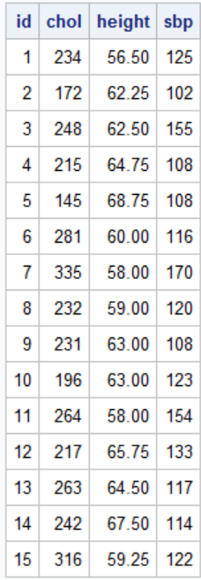
data totchol2;
merge chol2 chol1;
by id;
run;
proc print data=totchol2 noobs;run;

Slide 17
All data must be sorted on the by variable The by variable must have the same name on all data sets in the merge statement. Columns are overlaid Output controlled with in= option

