Slide 1
Appending and Concatenating Files
APPEND Procedure | DATA STEP SET Statement
Uses two data sets. | Uses any number of data sets.
Notes:
Proc Append
Uses all variables in the BASE= data set and assigns missing values to observations from the DATA= data set where appropriate. Cannot include variables found only in the DATA= data set.
SET Statement
Uses all variables and assigns missing values where appropriate.
With appending, the base data set was not read so the descriptor portion could not change. That is not the case with concatenating.

Slide 2
DATA dsname;
SET SAS-data-set1 SAS-data-set2 . . . ;
/* <SAS statements>*/
RUN;

Slide 3
Example -- five data sets
proc contents data=class.sbp1;run;
proc contents data=class.sbp2;run;
proc contents data=class.sbp3;run;
proc contents data=class.sbp4;run;
proc contents data=class.sbp5;run;

Slide 4
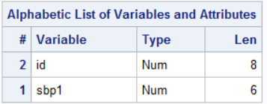
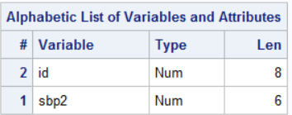
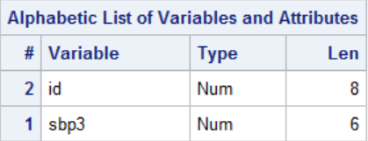
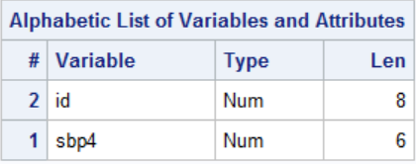

Notes:
Data are from a longitudinal study of over 5,000 participants
The variable is systolic blood pressure (there were many more variables)

Slide 5
How one formats the files for longitudinal data depends on what analysis one is doing.
Notes:
Sometimes one wants all data for an individual to be a row
Sometimes one wants a separate row for each measurement

Slide 6
Wide format – each row contains information for a single participant – variables are often numbered accordingly.
ID | SBP1 | SBP2 | SBP3 | SBP4 | SBP5

Slide 7
Long format – each row contains a single measurement and the time it was taken. So each participant has multiple rows on the file.
ID | 1 | SBP
ID | 2 | SBP
ID | 3 | SBP
ID | 4 | SBP
ID | 5 | SBO

Slide 8
Wide Format
proc sort data=class.sbp1 out=sbp1;by id;
proc sort data=class.sbp2 out=sbp2;by id;
proc sort data=class.sbp3 out=sbp3;by id;
proc sort data=class.sbp4 out=sbp4;by id;
proc sort data=class.sbp5 out=sbp5;by id;
data wide;
merge sbp1 sbp2 sbp3 sbp4 sbp5;
by id;
run;

Slide 9
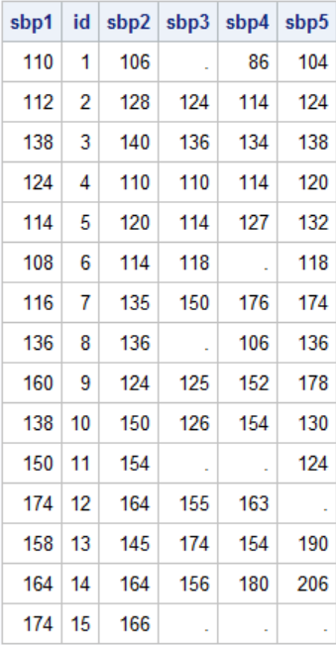

Slide 10
This would be the format for examining correlation among the measurements.
proc corr data=wide;
var sbp:;
run;

Slide 11
Long Format
data long (keep=id exam sbp);
set sbp1 (in=a rename=(sbp1=sbp))
sbp2 (in=b rename=(sbp2=sbp))
sbp3 (in=c rename=(sbp3=sbp))
sbp4 (in=d rename=(sbp4=sbp))
sbp5 (in=e rename=(sbp5=sbp));
if a then exam=1;
else if b then exam=2;
else if c then exam=3;
else if d then exam=4;
else exam=5;
run;
proc sort data=long;by id exam;run;
proc print data=long noobs;run;

Slide 12
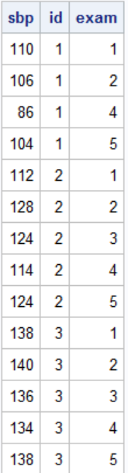
First 15 rows
This is the format required for numerous longitudinal analyses including “spaghetti” plots.

Slide 13
The SG Procs

Slide 14
Proc SGPLOT
proc sgplot data=long;
series x=exam y=sbp/group=id;
run;
proc sgplot data=long;
series x=exam y=sbp/group=id markers;
run;
proc sgplot data=long;
series x=exam y=sbp/group=id markers
markerattrs=(symbol=circlefilled);
run;
proc sgplot data=long;
series x=exam y=sbp/group=id markers
markerattrs=(symbol=circlefilled size=12)
lineattrs=(thickness=3);
run;
title "Spaghetti Plot for 15 Participants";
proc sgplot data=long;
series x=exam y=sbp/group=id markers
markerattrs=(symbol=circlefilled size=12)
lineattrs=(thickness=3);
run;
title;
title "Spaghetti Plot for 15 Participants";
proc sgplot data=long;
series x=exam y=sbp/group=id markers
markerattrs=(symbol=circlefilled size=12)
lineattrs=(thickness=3);
xaxis label="Measurement Number" labelattrs=(family=swiss weight=bold);
yaxis label="Systolic Blood Pressure" labelattrs=(family=swiss weight=bold);
run;
title;

