Slide 1
Combining Data Sets in the DATA step.
Vertically –SET statement (Proc Append)
Horizontally – MERGE statement

Slide 2
Combining Tables in SQL
Vertically -- Set operators
Horizontally -- Joins

Slide 3
Generate two data sets
data tmp1 tmp2;
call streaminit(54321);
do id=1 to 12;
chol=int(rand("Normal",240,40));
sbp=int(rand("Normal",120,20));
if id<6 then output tmp1;
else output tmp2;
end;
run;

Slide 4
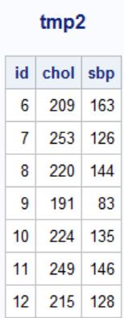
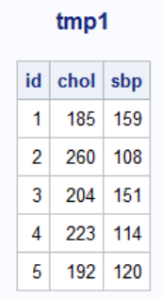
title "tmp1";
proc print data=tmp1 noobs;run;
title "tmp2";
proc print data=tmp2 noobs;run;
title "tmp1 inner join tmp2";

Slide 5
Combine Vertically

Slide 6
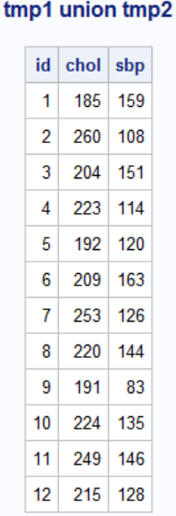
SQL uses set operators to combine tables vertically.
proc sql;
select * from tmp1
union
select * from tmp2
;
quit;
We will cover set operators after Joins.
Notes:
This produces results that can be compared to a DATA step concatenation.

Slide 7
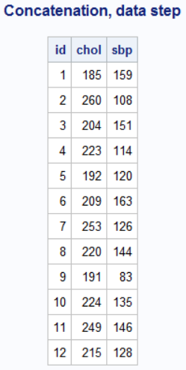
Data Step uses the set statement to combine tables vertically
title "Concatenation, data step";
data tot1;
set tmp1 tmp2;
run;
proc print data=tot1 noobs;run;
title;

Slide 8
2
Introduction to SQL Joins
  SQL Joins combine data from multiple tables horizontally .
  inner and outer SQL joins.
Notes:
Compare SQL joins to DATA step merges.

Slide 9
Inner joins
  Return only matching rows
  Maximum of 256 tables can be joined at the same time.

Slide 10
Example Data
data tmp1(keep=id chol sbp) tmp2(keep=id weight height);
call streaminit(54321);
do id=1,7,4,2,6;
chol=int(rand("Normal",240,40));
sbp=int(rand("Normal",120,20));
output tmp1;
end;
do id=2,1,5,7,3;
height=round(rand("Normal",69,5),.25);
weight=round(rand("Normal",160,10),.5);
output tmp2;
end;
run;
title "tmp1";
proc print data=tmp1 noobs;run;
title "tmp2";
proc print data=tmp2 noobs;run;
title "tmp1 inner join tmp2";

Slide 11
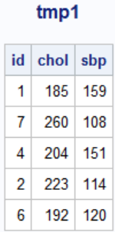
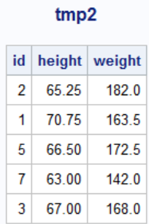
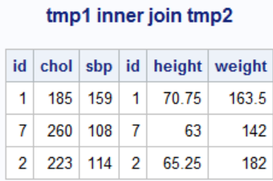
Combining Data from Multiple Tables
SQL uses joins to combine tables horizontally.
The tables are not sorted on id, the primary key
id appears twice, columns are not automatically overlayed
title "tmp1 inner join tmp2";
proc sql;
select * from tmp1,tmp2
where tmp1.id=tmp2.id
;
quit;
Notes:
This produces results that can be compared to a DATA step merge.

Slide 12
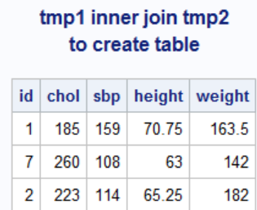
Combining Data from Multiple Tables
SQL uses joins to combine tables horizontally.
The tables are not required to be sorted on the key
proc sql;
create table tmp3 as
select * from tmp1,tmp2
where tmp1.id=tmp2.id
;
select * from tmp3
;
quit;
Notes:
This produces results that can be compared to a DATA step merge.

Slide 13
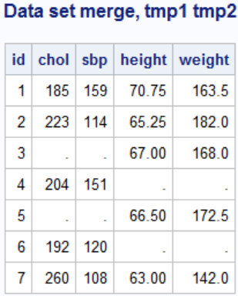
Combining Data from Multiple Tables
Simple data set merge gives a different result
The tables are not sorted on id, the primary key
proc sort data=tmp1;by id;run;
proc sort data=tmp2;by id;run;
data tot1;
merge tmp1 tmp2;
by id;
run;
Data step merge requires the data be sorted and have the same name for the by variable.
Notes:
This produces results that can be compared to a DATA step merge.

Slide 14
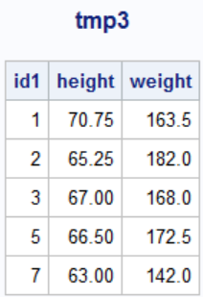
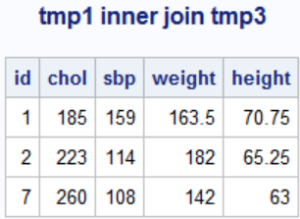
Combining Data from Multiple Tables
SQL uses joins to combine tables horizontally.
The primary key has different names on the two files
proc sql;
select tmp1.id,chol,sbp,weight,height
from tmp1,tmp3
where tmp1.id=tmp3.id1
;
quit;
Notes:
This produces results that can be compared to a DATA step merge.

Slide 15
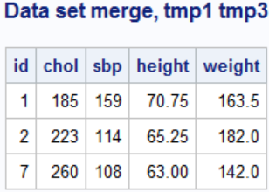
Combining Data from Multiple Tables
Data set merge takes a bit more code
The primary key has different names on the two files
proc sort data=tmp1;by id;run;
proc sort data=tmp3;by id1;run;
data tot1;
merge tmp1(in=one) tmp3(in=three rename=(id1=id));
by id;
if one and three;
run;
Notes:
This produces results that can be compared to a DATA step merge.

Slide 16
Outer Joins
  Can be performed on only two tables or views at a time.
  Return all matching rows, plus nonmatching rows from one or both tables
Left
Full
Right

