Slide 1
Inner Joins

Slide 2
Inner joins
Return only matching rows
Maximum of 256 tables can be joined at the same time.

Slide 3
A query that lists multiple tables in the FROM clause without a WHERE clause produces all possible combinations of rows from all tables -- Cartesian product.

Slide 4
data tmp1(keep=id chol sbp) tmp2(keep=id weight height);
call streaminit(54321);
do id=1,7,4,2,6;
chol=int(rand("Normal",240,40));
sbp=int(rand("Normal",120,20));
output tmp1;
end;
do id=2,1,5,7,3;
height=round(rand("Normal",69,5),.25);
weight=round(rand("Normal",160,10),.5);
output tmp2;
end;
run;
title "tmp1";
proc print data=tmp1 noobs;run;
title "tmp2";
proc print data=tmp2 noobs;run;
Notes:
The example data

Slide 5
Cartesian Product JOIN
title "Cartesian Product Join";
proc sql;
select * from tmp1,tmp2
;
quit;
title;

Slide 6
Cartesian Product – Beware the forgotten where clause
The number of rows in a Cartesian product is the product of the number of rows in the contributing tables.
5 x 5 = 25
1,000 x 1,000 = 1,000,000
100,000 x 100,000 = 10,000,000,000
A Cartesian product is rarely the desired result of a query.

Slide 7
Inner Joins
Inner join syntax resembles Cartesian product syntax, but a WHERE clause restricts which rows are returned.
title "Inner Join with WHERE clause";
proc sql;
select * from tmp1,tmp2
where tmp1.id=tmp2.id
;
quit;
title;
...

Slide 8
Inner Join with where clause that contains JOIN condition AND other conditions
title "Inner Join with WHERE clause";
title2 "And conditions other than join condition";
proc sql;
select * from tmp1,tmp2
where tmp1.id=tmp2.id and
weight<180
;
quit;
title;

Slide 9
General Form of an Inner Join
/*General form of inner join*/
PROC SQL;
SELECT column_1, …column_n
FROM table_1,table_2,...,table_n /*can be views*/
WHERE join_condition
AND other subsetting conditions
other clauses
;
QUIT;

Slide 10
Inner Joins -- Conceptually
Builds the Cartesian product of all the tables listed
Applies the WHERE clause to limit the rows returned

Slide 11
The WHERE clause includes join conditions and can contain other subsetting specifications.
Significant syntax changes from earlier queries:
The FROM clause references multiple tables.

Slide 12
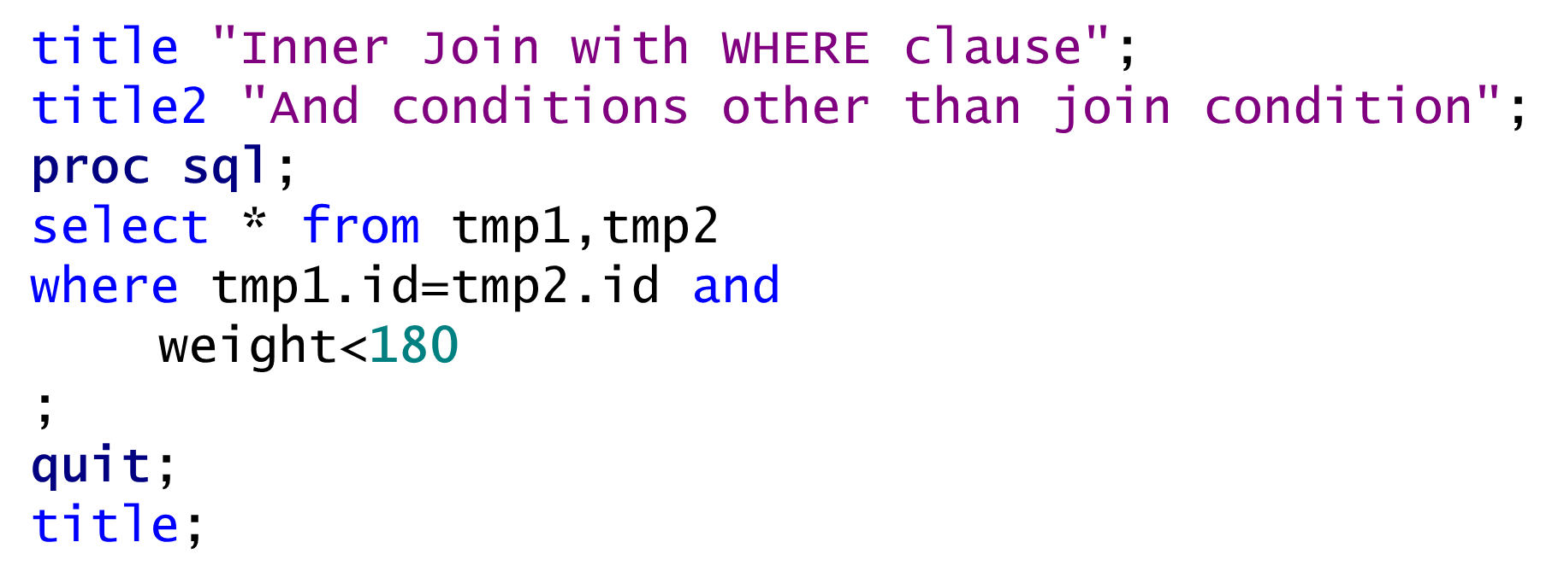
Tables do not have to be sorted before they are joined.

Slide 13
Columns are not overlayed.
One method of displaying the a column only once is to use a table qualifier in the SELECT list.

Slide 14
Modify Example Data
data tmp1(keep=id chol sbp) tmp2(keep=id weight height chol);
call streaminit(54321);
do id=1,7,4,2,6;
chol=int(rand("Normal",240,40));
sbp=int(rand("Normal",120,20));
output tmp1;
end;
do id=2,1,5,7,3;
height=round(rand("Normal",69,5),.25);
weight=round(rand("Normal",160,10),.5);
chol=int(rand("Normal",240,40));
output tmp2;
end;
run;
title "tmp1";
proc print data=tmp1 noobs;run;
title "tmp2";
proc print data=tmp2 noobs;run;

Slide 15
Inner Join
proc sql;
select *
from tmp1 as one,tmp2 as two
where one.id=two.id
;
quit;

Slide 16
Inner Join – specify which table to take the variables from
proc sql;
select one.id,one.chol,height,weight,sbp
from tmp1 as one,tmp2 as two
where one.id=two.id
;
quit;

Slide 17
Inner Join – use a data set option
proc sql;
select one.id, chol,height,weight,sbp
from tmp1 as one,tmp2(drop=chol) as two
where one.id=two.id
;
quit;

Slide 18
Modify Example Data
data tmp1(keep=id chol sbp) tmp2(keep=id weight height chol);
call streaminit(54321);
do id=1,7,4,2,6;
chol=int(rand("Normal",240,40));
sbp=int(rand("Normal",120,20));
if id=2 then chol=.;
output tmp1;
end;
do id=2,1,5,7,3;
height=round(rand("Normal",69,5),.25);
weight=round(rand("Normal",160,10),.5);
chol=int(rand("Normal",240,40));
output tmp2;
end;
run;
title "tmp1";
proc print data=tmp1 noobs;run;
title "tmp2";
proc print data=tmp2 noobs;run;

Slide 19
The coalesce function
data t;
input x1 x2 x3 @@;
x=coalesce(x1,x2,x3);
datalines;
1 2 3 . 2 3 . . 3
;
run;
proc print data=t noobs;run;

Slide 20
The coalesce function
proc sql;
select one.id, coalesce(one.chol,two.chol) ,
height,weight,sbp
from tmp1 as one,tmp2 as two
where one.id=two.id
;
quit;

Slide 21
Display the name, city, and birth month of all Australian employees in the Orion Star Data Base.
Australian Employees’ Birth Months
Birth
Name City Month
Last, First City Name 1

Slide 22
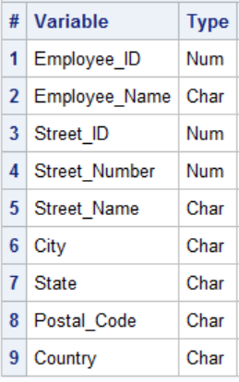
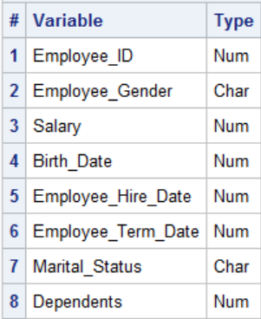
Employee_addresses (n=424)
Employee_payroll (n=424)

Slide 23
Inner Joins
proc sql;
title "Australian Employees' Birth Months";
select Employee_Name as Name format=$25.,
City format=$25.,
month(Birth_Date) 'Birth Month' format=3.
from orion.Employee_Payroll,
orion.Employee_Addresses
where Employee_Payroll.Employee_ID=
Employee_Addresses.Employee_ID
and Country='AU'
order by 3,City, Employee_Name;
quit;
title;
Notes:
s105d05

Slide 24
Join four nhanes3 datasets The permanent datasets: AdultDemographics, examsub2, labsub2, and mortsub

Slide 25
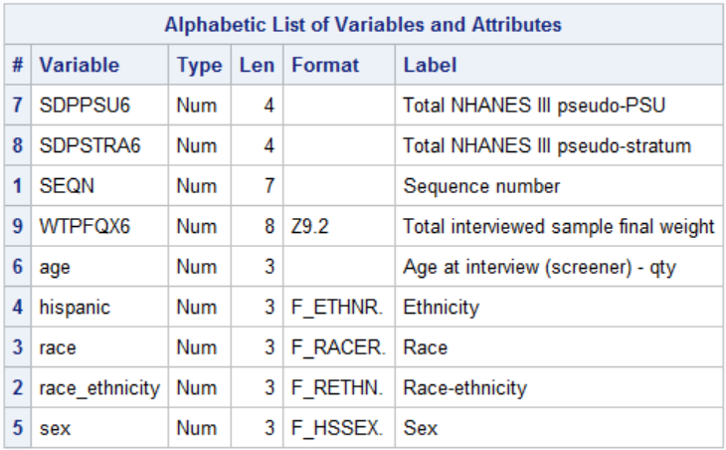
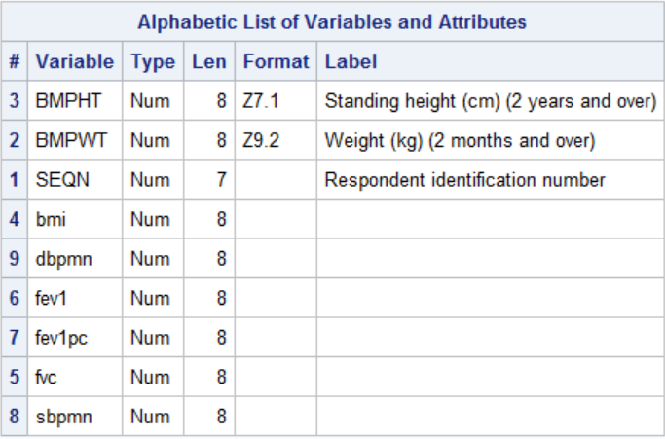

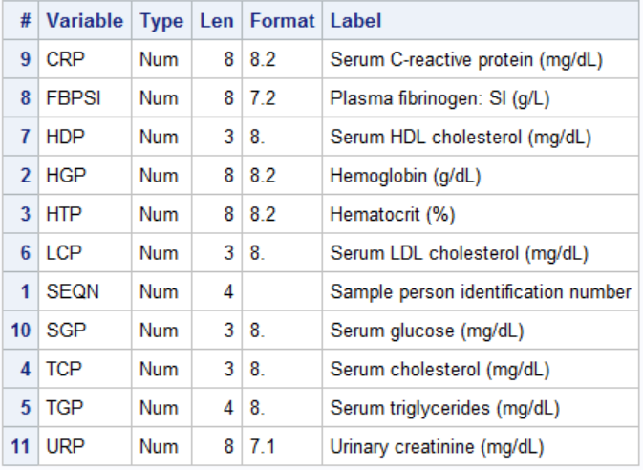
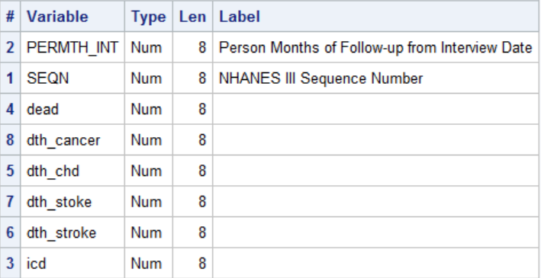

Slide 26
A note on the join condition
proc sql;
create table analysis as
select * from
nhanes3.adultdemographics as a,
nhanes3.examsub2 as e,
nhanes3.labsub2 as l,
nhanes3.mortsub2 as m
where a.seqn=e.seqn and e.seqn=l.seqn and
l.seqn=m.seqn;
quit;
proc means data=analysis;
run;

Slide 27
A note on the join condition
proc sql;
create table analysis as
select * from
nhanes3.adultdemographics as a,
nhanes3.examsub2 as e,
nhanes3.labsub2 as l,
nhanes3.mortsub2 as m
where a.seqn=e.seqn and a.seqn=l.seqn and
a.seqn=m.seqn;
quit;
proc means data=analysis;
run;

Slide 28
Inner Join Alternate Syntax
This syntax is common in SQL code produced by code generators such as SAS Enterprise Guide. The ON clause specifies the JOIN criteria; a WHERE clause can be added to subset the results.
SELECT column-1 <, …column-n>
FROM table-1 INNER JOIN
table-2
ON join-condition(s)
<other clauses>;

Slide 29
Inner Join Alternate Syntax
proc sql;
title "Australian Employees' Birth Months";
select Employee_Name as Name format=$25.,
City format=$25.,
month(Birth_Date) 'Birth Month' format=3.
from orion.Employee_Payroll
inner join
orion.Employee_Addresses
on Employee_Payroll.Employee_ID=
Employee_Addresses.Employee_ID
where Country='AU'
order by 3,City, Employee_Name;
quit;
Notes:
s105d06

Slide 30
An example from the airline data base List the employ id, last name, first name and job code for all employees.

Slide 31
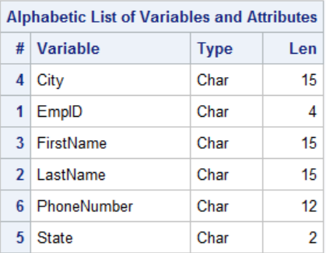
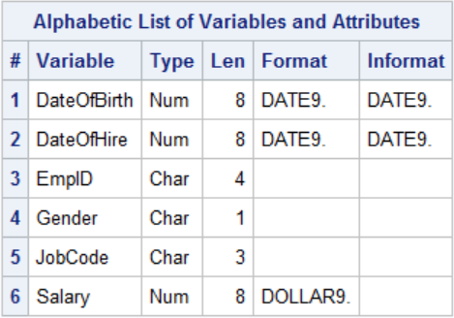
List the employ id, last name, first name and job code for all employees.

Slide 32
proc sql;
title "Employee Names and Job Codes";
select s.empid,lastname,firstname,jobcode
from train.staffmaster as s,
train.payrollmaster as p
where s.empid=p.empid;
title;
quit;

Slide 33
Use an inner join to display names, jobcodes, and ages of all employees who live in New York, sort by jobcode and age

Slide 34
names, jobcodes, and ages of all employees who live in New York, sort by jobcode and age

Slide 35
proc sql;
title "New Your Employees";
select substr(firstname,1,1)||"."|| lastname
as name,
jobcode,
int((today()-dateofbirth)/365.25) as age
from train.staffmaster as s,
train.payrollmaster as p
where s.empid=p.empid
and state="NY"
order by 2,3;
title;
quit;

Slide 36
Inner join with summary function
proc sql;
title "Average age of NY Employees";
select jobcode,
count(p.empid) as Employees,
avg(int((today()-dateofbirth)/365.25))
format 4.1 as AvgAge
from train.payrollmaster as p,
train.staffmaster as s
where p.empid=s.empid
and state="NY"
group by jobcode
order by jobcode;
title;
quit;

Slide 37
Creating tables from joins.

Slide 38
A query with inner join
proc sql;
title "Australian Employees' Birth Months";
select Employee_Name as Name format=$25.,
City format=$25.,
month(Birth_Date) 'Birth Month' format=3.
from orion.Employee_Payroll
inner join
orion.Employee_Addresses
on Employee_Payroll.Employee_ID=
Employee_Addresses.Employee_ID
where Country='AU'
order by 3,City, Employee_Name;
quit;

Slide 39
A table from a query with inner join
proc sql;
title "Australian Employees' Birth Months";
create table aussies as
select Employee_Name as Name format=$25.,
City format=$25.,
month(Birth_Date) 'Birth Month' format=3.
from orion.Employee_Payroll
inner join
orion.Employee_Addresses
on Employee_Payroll.Employee_ID=
Employee_Addresses.Employee_ID
where Country='AU'
order by 3,City, Employee_Name;
quit;
proc print data=aussies (obs=15);run;

Slide 40
Example, Create an analytic file for Nhanes 1999

Slide 41
The Nhanes 1999 data
libname nh9Mort "&path\nhanes1999\mortality\sas";
libname nh9ques "&path\nhanes1999\questionnaire\sas";
libname nh9lab "&path\nhanes1999\lab\sas";
libname nh9exam "&path\nhanes1999\exam\sas";
libname nh9demo "&path\nhanes1999\demographics\sas";
libname nh9diet "&path\nhanes1999\dietary\sas";

Slide 42
Concatenating Libnames and a handy use of SQL
libname nh9 (nh9demo nh9exam nh9lab nh9mort nh9ques);
proc sql;
describe table dictionary.tables
;
select memname,nvar,nobs
from dictionary.tables
where libname="NH9"
;
quit;

Slide 43
The data for creating the analytic file is on five different datasets.
proc contents data=nh9.mortality;
proc contents data=nh9.bloodpressure;
proc contents data=nh9.demographics;
proc contents data=nh9.bodymeasurements;
proc contents data=nh9.cholesterolhdl;
run;

Slide 44
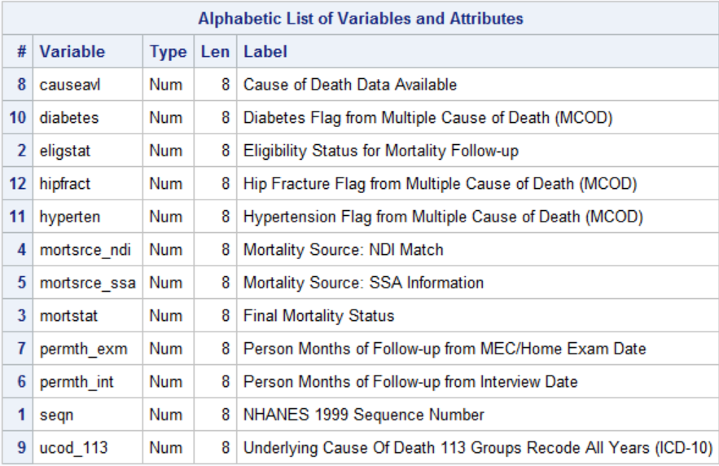
Mortality
Primary Key

Slide 45
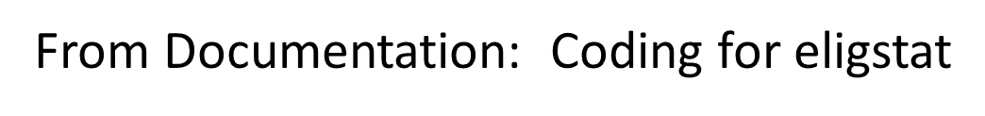
From Documentation: Coding for eligstat
1= Eligible
2 =Under age 18, not available for public release1
3 =Ineligible
0 Assumed alive
1 Assumed deceased

Slide 46
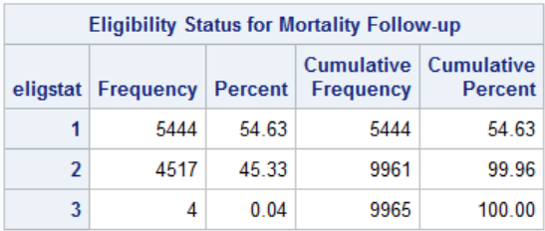
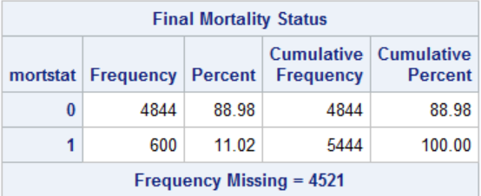
proc freq data=nh9.mortality;
tables eligstat mortstat;
run;

Slide 47
From Documentation:
Coding for eligstat
1= Eligible
2 =Under age 18, not available for public release1
3 =Ineligible
Coding for mortstat
0 Assumed alive
1 Assumed deceased

Slide 48
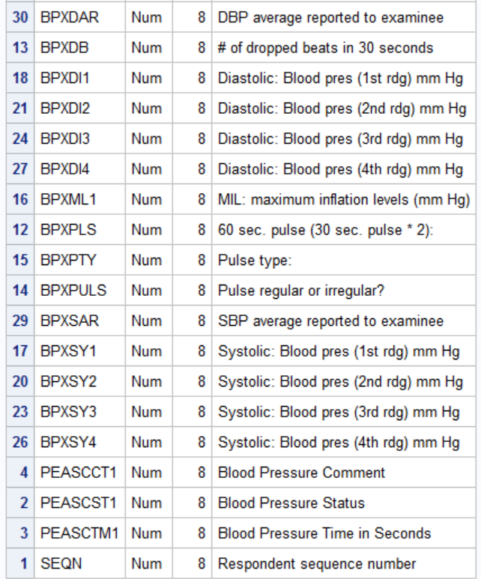
Blood Pressure (partial)
Primary Key

Slide 49
Check averages
proc sql inobs=100;
select mean(BPXSY1,BPXSY2,BPXSY3,BPXSY4),BPXSar
from nh9.bloodpressure
;
quit;

Slide 50
Calculate Averages
proc sql ;
create table newbp as
select mean(BPXSY1,BPXSY2,BPXSY3,BPXSY4) as mnsbp,
mean(BPXDI1,BPXDI2,BPXDI3,BPXDI4) as mndbp,
seqn
from nh9.bloodpressure
;
select n(mnsbp) "mnsbp",n(mndbp) "mndbp"
from newbp
;
quit;

Slide 51
Calculate averages with data step
data newbp(drop=bpxsy1-bpxsy4);
set nh9.bloodpressure(keep=seqn bpxsys1-bpxsys4);
mnsbp=mean(of BPXSY1-BPXSY4);
mndbp=mean(of BPXDI1-BPXDI4);
run;
proc means data=newbp;
run;

Slide 52
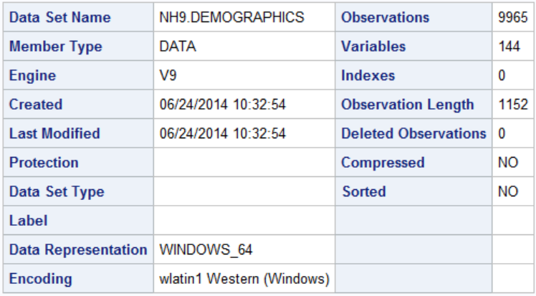
Demographics
Figure out which ones desired

Slide 53
proc means data=nh9.demographics;
var ri: seqn;
run;

Slide 54
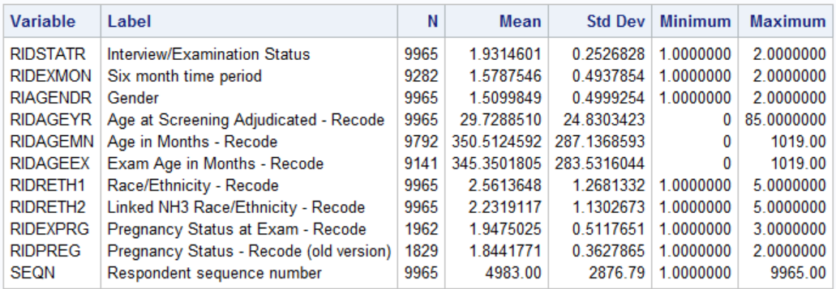
Primary Key

Slide 55
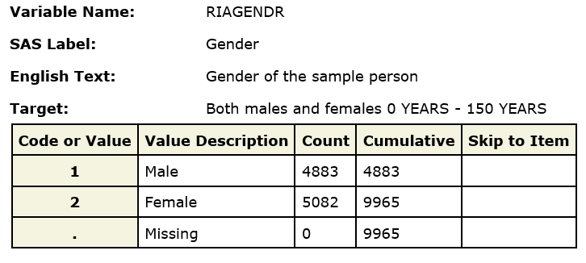
From Documentation

Slide 56
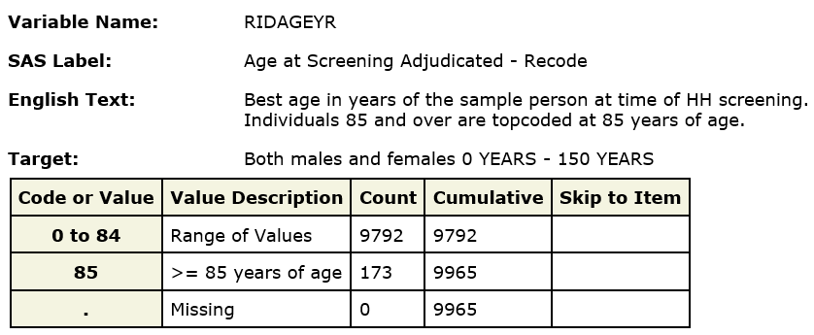
From Documentation

Slide 57
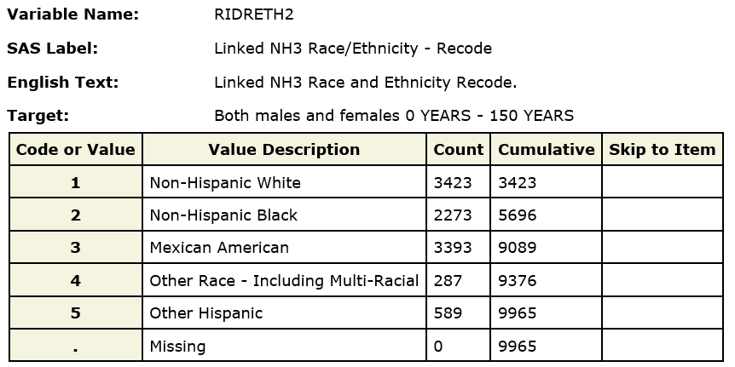
From Documentation

Slide 58
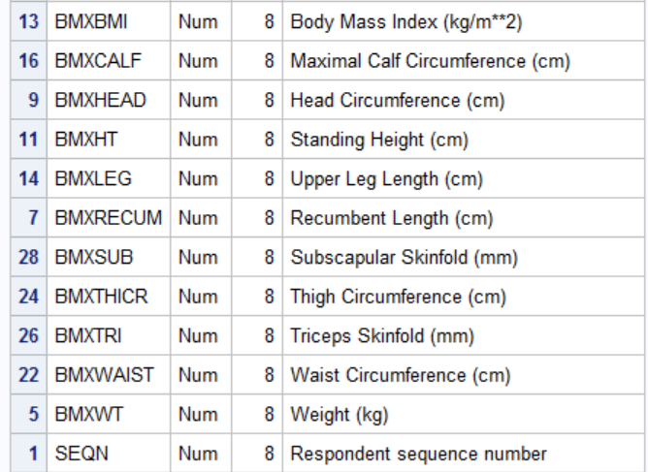
Bodymeasurements (partial)
Primary Key

Slide 59
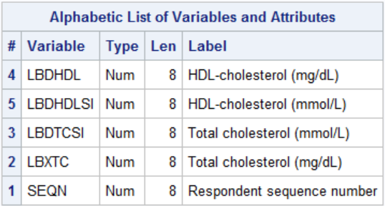
CholesterolHdl
Primary Key

Slide 60
Data | Variable(s) | Rename/recode
Mortality | mortstat | Dead (0,1)
Demographics | riagendr | Male(0,1)
 | RIDAGEYR | Age
 | RIDRETH2 | Race_ethn
Bodymeasurements | bmxbmi | bmi
Bloodpressure | BPXSY1-BPXSY4 | mnsbp
 | BPXDI1-BPXDI4 | mndbp
CholesterolHdl | LBDHDL | hdl
 | LBXTC | chol

Slide 61
Doing it in the data step
Create five (temporary) datasets
Sort and Merge

Slide 62
Create five datasets
data mort (drop=mortstat eligstat);
set nh9.mortality(keep=seqn eligstat mortstat permth_exm);
where eligstat eq 1;
dead=mortstat=1;
data newbp(drop=bpxsy1-bpxsy4 BPXDI1-BPXDI4);
set nh9.bloodpressure(keep=seqn bpxsy1-bpxsy4 BPXDI1-BPXDI4);
mnsbp=mean(of BPXSY1-BPXSY4);
mndbp=mean(of BPXDI1-BPXDI4);
data demog (drop=riagendr);
set nh9.demographics (keep=seqn ridageyr riagendr RIDRETH2);
male=riagendr=1;
rename ridageyr=age
ridreth2=race_ethn;
data chol;
set nh9.cholesterolhdl(keep= seqn LBDHDL LBXTC);
rename lbdhdl=hdl
lbxtc=chol;
data body;
set nh9.bodymeasurements(keep=seqn bmxbmi rename=(bmxbmi=bmi));
run;

Slide 63
Sort and Merge
proc sort data=mort;
by seqn;
proc sort data=newbp;
by seqn;
proc sort data=demog;
by seqn;
proc sort data=chol;
by seqn;
proc sort data=body;
by seqn;
data analysis;
merge mort(in=a) newbp(in=b) demog(in=c) chol(in=d) body(in=e);
by seqn;
if a and b and c and d and e;
run;

Slide 64
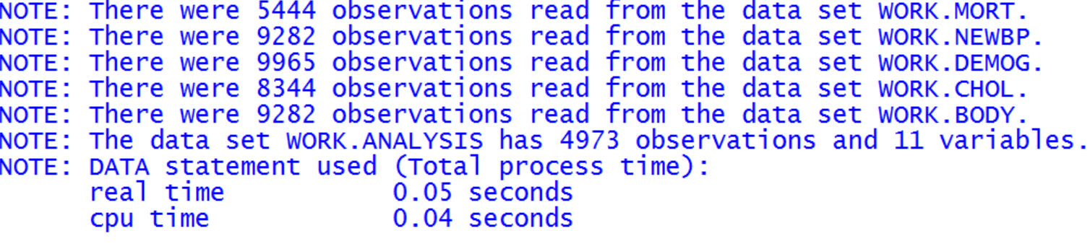

Slide 65
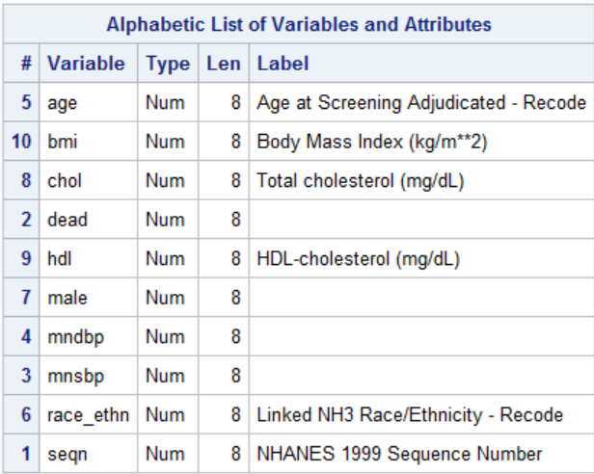
proc contents data=analysis;
run;

Slide 66
The same thing in Proc SQL

Slide 67
proc sql;
create table analysis as
select a.seqn,mortstat=1 as dead,permth_exm,
mean(BPXSY1,BPXSY2,BPXSY3,BPXSY4) as mnsbp,
mean(BPXDI1,BPXDI2,BPXDI3,BPXDI4) as mndbp,
riagendr=1 as male,
ridageyr as age,
ridreth2 as race_ethn,
lbdhdl as hdl,
lbxtc as chol,
bmxbmi as bmi
from nh9.mortality(keep=seqn eligstat mortstat permth_exm) a,
nh9.bloodpressure(keep=seqn bpxsy1-bpxsy4 BPXDI1-BPXDI4) b,
nh9.demographics (keep=seqn ridageyr riagendr RIDRETH2) c,
nh9.bodymeasurements(keep=seqn bmxbmi) d,
nh9.cholesterolhdl(keep= seqn LBDHDL LBXTC) e
where eligstat eq 1 and
a.seqn=b.seqn and
b.seqn=c.seqn and
c.seqn=d.seqn and
d.seqn=e.seqn
order by seqn
;
quit;

Slide 68
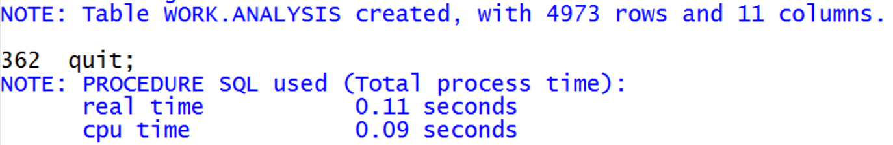

Slide 69
proc sql;
create table analysis as
select a.seqn,mortstat=1 as dead,
mean(BPXSY1,BPXSY2,BPXSY3,BPXSY4) as mnsbp,
mean(BPXDI1,BPXDI2,BPXDI3,BPXDI4) as mndbp,
riagendr=1 as male,
ridageyr as age,
ridreth2 as race_ethn,
lbdhdl as hdl,
lbxtc as chol,
bmxbmi as bmi
from nh9.mortality(keep=seqn eligstat mortstat) as a
inner join
nh9.bloodpressure(keep=seqn bpxsy1-bpxsy4 BPXDI1-BPXDI4) as b
on a.seqn=b.seqn
inner join
nh9.demographics (keep=seqn ridageyr riagendr RIDRETH2) as c
on a.seqn=c.seqn
inner join
nh9.bodymeasurements(keep=seqn bmxbmi) as d
on a.seqn=d.seqn
inner join
nh9.cholesterolhdl(keep= seqn LBDHDL LBXTC) as e
on a.seqn=e.seqn
where eligstat eq 1
order by seqn
;
quit;
proc means data=analysis;
run;

