Slide 1
Outer Joins
Inner joins returned only matching rows.
When you join tables, you might want to include nonmatching rows as well as matching rows.

Slide 2
Outer Joins
You can retrieve both nonmatching and matching rows using an outer join.
Outer joins include left, full, and right outer joins. Outer joins can process only two tables at a time.
Left
Full
Right

Slide 3
Inner Joins And Outer Joins
 | Inner Join | Outer Join
Table Limit | 256 | 2
Join Behavior | Returns matching rows only | Returns matching and nonmatching rows
Join Options | Matching rows only | LEFT, FULL, RIGHT
Syntax changes | Multiple tables in the FROM clause WHERE clause that specifies join criteria | ON clause that specifies join criteria

Slide 4
Outer Joins
SELECT column-1 <, …column-n>
FROM table-1
LEFT|RIGHT|FULL JOIN
table-2
ON join-condition(s)
<other clauses>;
Notes:
Outer join syntax is similar to the inner join alternate syntax.
The ON clause specifies the join criteria in outer joins.

Slide 5
Determining Left and Right
Consider the position of the tables in the FROM clause.
  Left joins include all rows from the first (left) table, even if there are no matching rows in the second (right) table.
  Right joins include all rows from the second (right) table, even if there are no matching rows in the first (left) table.
  Full joins include all rows from both tables, even if there are no matching rows.
Left table
Right table
FROM table-1 join-type table-2
ON join-condition(s);

Slide 6
Example Data
data tmp1(keep=id chol sbp)
tmp2(keep=id weight height)
tmp3(keep=id weight height chol);
call streaminit(54321);
do id=1,7,4,2,6;
chol=int(rand("Normal",240,40));
sbp=int(rand("Normal",120,20));
output tmp1;
end;
do id=2,1,5,7,3;
height=round(rand("Normal",69,5),.25);
weight=round(rand("Normal",160,10),.5);
output tmp2;
end;
do id=2,1,5,7,3;
height=round(rand("Normal",69,5),.25);
weight=round(rand("Normal",160,10),.5);
chol=int(rand("Normal",240,40));
output tmp3;
end;
run;
title "tmp1";proc print data=tmp1 noobs;run;
title "tmp2";proc print data=tmp2 noobs;run;
title "tmp3";proc print data=tmp3 noobs;run;
title;

Slide 7
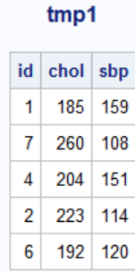
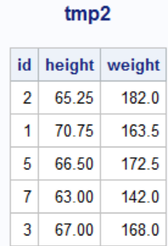
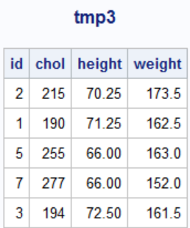

Slide 8
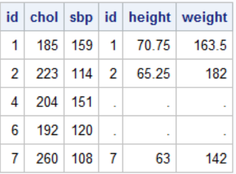
Left Join
proc sql;
select * from
tmp1 left join tmp2
on tmp1.id=tmp2.id
;
quit;

Slide 9
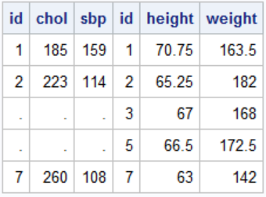
Right Join
proc sql;
select * from tmp1 right join tmp2
on tmp1.id=tmp2.id
;
quit;

Slide 10
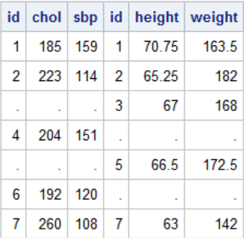
Full Join
proc sql;
select *
from tmp1 full join tmp2
on tmp1.id=tmp2.id
;
quit;

Slide 11
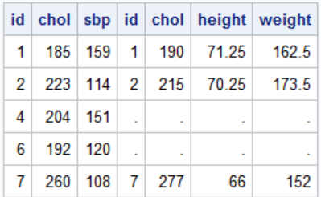
proc sql;
select *
from tmp1 left join tmp3
on tmp1.id=tmp3.id
;
quit;

Slide 12
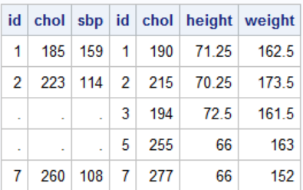
proc sql;
select *
from tmp1 right join tmp3
on tmp1.id=tmp3.id
;
quit;

Slide 13
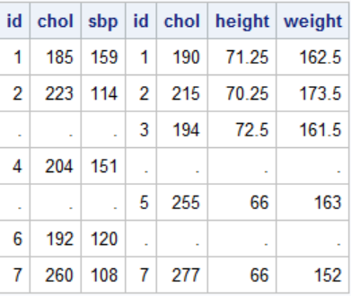
proc sql;
select * from tmp1 full join tmp3
on tmp1.id=tmp3.id
;
quit;

Slide 14
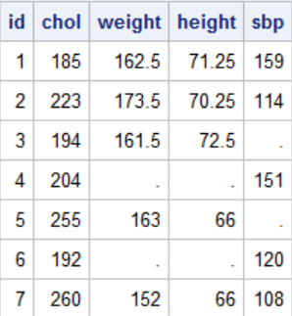
proc sql;
select coalesce(a.id,b.id) as id, coalesce(a.chol,b.chol) as chol,
weight,height,sbp
from tmp1 as a full join tmp3 as b
on tmp1.id=tmp3.id
;
quit;

Slide 15
Example using the Orion data base
List the employee ID and gender for all married employees. Include the names of any charities to which the employee donates via the company program.

Slide 16
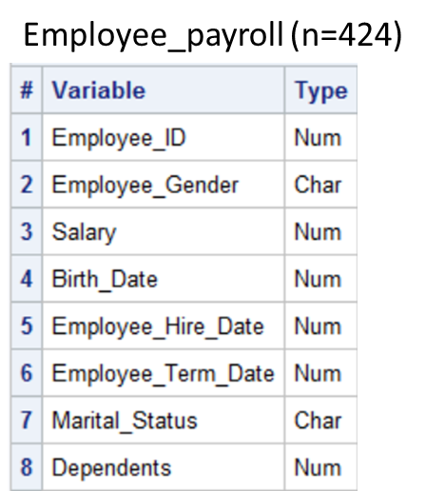
  The table orion.Employee_Payroll
  contains gender and marital status information.
...

Slide 17
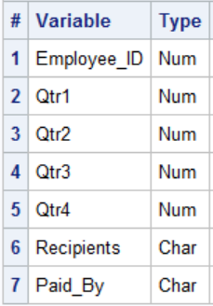
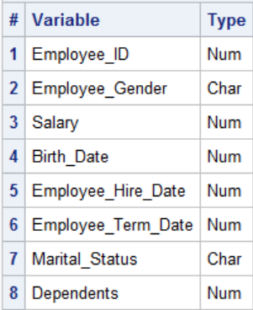
List the employee ID and gender for all married employees. Include the names of any charities to which the employee donates via the company program.
  The table orion.Employee_Donations contains records only for those employees who donate to a charity via the company program.
Employee_donations (n=124)
Employee_payroll (n=424)
...

Slide 18
List the employee ID and gender for all married employees. Include the names of any charities to which the employee donates via the company program.
Need the data for all married employees from orion.Employee_Payroll.
And want to include the charity names from the
orion.Employee_Donations table if Employee_ID matches.
  Left Join
Notes:
b. Left Join

Slide 19
Outer Joins
proc sql;
select Employee_payroll.Employee_ID,
Employee_Gender, Recipients
from orion.Employee_payroll
left join
orion.Employee_donations
on Employee_payroll.Employee_ID=
Employee_donations.Employee_ID
where Marital_Status="M"
;
quit;
Notes:
s105d10

Slide 20
Example from the airlines data base.
List all airlines flights scheduled in March
Include delay information (if it exists)

Slide 21
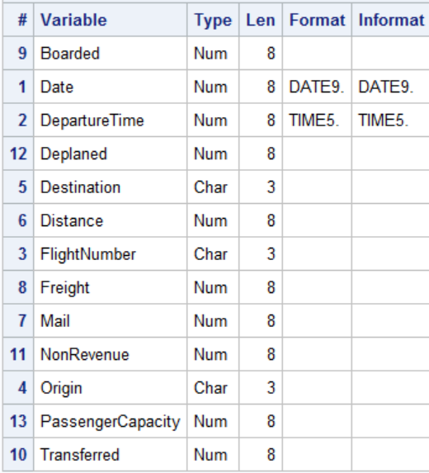
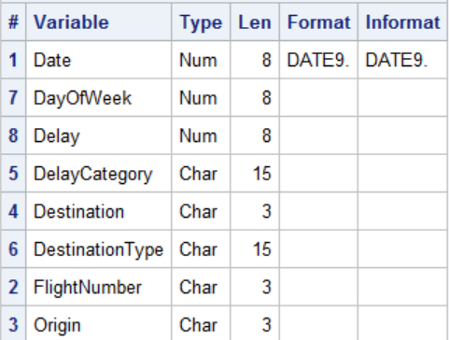
proc contents data=train.marchflights;run;
proc contents data=train.flightdelays;run;

Slide 22
proc sql;
title "All March flights";
select m.date,
m.flightnumber label="Left",
f.destination label="Right",
delay label="Delay in Minutes"
from (train.marchflights as m
left join
train.flightdelays as f
on m.date=f.date
and m.flightnumber=f.flightnumber)
order by delay;
title;
quit;

