Slide 1
Complex SQL Joins
2

Slide 2
In-Line Views
An in­line view is a temporary “virtual table” that exists only during query execution
Created by placing a query expression in a FROM clause where a table name would normally be used.

Slide 3
Create and use in-line views.
Use in-line views and subqueries to simplify coding

Slide 4
In-Line Views – Use as a virtual table in from clause.
proc sql;
select *
from
(in-line view query expression)
quit;

Slide 5
List all active Sales employees having annual salaries more than 5% lower than the average salary for everyone with the same job title.

Slide 6
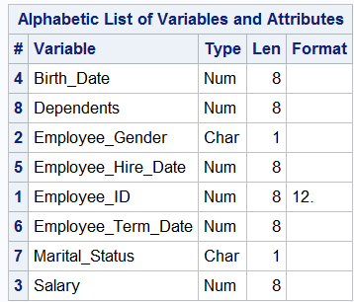
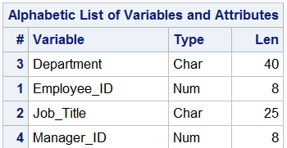
Employee_payroll
Employee_organization

Slide 7
First method -- Build separate tables and join them. First table is a table of average salaries by job title.
proc sql;
create table avgsalary as
select Job_Title,
avg(Salary) as Job_Avg format=comma7.
from orion.Employee_payroll as p,
orion.Employee_organization as o
where p.Employee_ID=o.Employee_ID
and not Employee_Term_Date
and o.Department="Sales"
group by Job_Title;
quit;

Slide 8
Now do Inner Join.
proc sql;
select Employee_Name, emp.Job_Title,
Salary format=comma7., Job_Avg format=comma7.
from avgsalary as job,
orion.Salesstaff as emp
where emp.Job_Title=job.Job_Title
and Salary < Job_Avg*.95
order by Job_Title, Employee_Name;
quit;

Slide 9
Second Method – First, Build a query to produce the aggregate averages.
proc sql;
title "Sales Department Average Salary";
title2 "By Job Title";
select Job_Title,
avg(Salary) as Job_Avg
format=comma7.
from orion.Employee_payroll as p,
orion.Employee_organization as o
where p.Employee_ID=o.Employee_ID
and not Employee_Term_Date
and o.Department="Sales"
group by Job_Title;
quit;
title;
Notes:
s105d13

Slide 10
In-Line Views
While we can create a table from the results of the query and join this table with the orion.Employee_payroll table and subset the appropriate rows to get the answer. This adds unnecessary I/O.
In SQL, you can use the query as an in-line view

Slide 11
Using a query in the FROM clause in place of a table causes the query output to be used as an in-line view.
proc sql;
title "Employees with salaries less than";
title2 "95% of the average for their job";
select Employee_Name, emp.Job_Title,
Salary format=comma7., Job_Avg format=comma7.
from (select Job_Title,
avg(Salary) as Job_Avg format=comma7.
from orion.Employee_payroll as p,
orion.Employee_organization as o
where p.Employee_ID=o.Employee_ID
and not Employee_Term_Date
and o.Department="Sales"
group by Job_Title) as job,
orion.Salesstaff as emp
where emp.Job_Title=job.Job_Title
and Salary < Job_Avg*.95
order by Job_Title, Employee_Name;
quit;
title;
Notes:
s105d14

Slide 12
Use the flight delays data set to calculate some summary statistics by destination: Average delay, maximum delay and the probability of delay

Slide 13
The flight delays data.
proc contents data=train.flightdelays;run;
proc print data=train.flightdelays (obs=100);
run;

Slide 14
Calculate Average Delay and probability of delay by destination in two steps.
proc sql;
title "Flight destinations and delays";
create table delays as
select destination,
avg(delay) as average,
max(delay) as max,
sum(delay>0) as late,
sum(delay<=0) as early
from train.flightdelays
group by destination
order by average;
select destination,
average format=3.0 label="Average Delay",
max format=3.0 label="Maximum Delay",
late/(late+early) as prob format=5.2
label="Probability of Delay"
from delays;
title;
quit;

Slide 15
Embed first step in an in-line query.
proc sql;
title "Flight destinations and delays";
select destination,
average format=3.0 label="Average Delay",
max format=3.0 label="Maximum Delay",
late/(late+early) as prob format=5.2
label="Probability of Delay"
from (select destination,
avg(delay) as average,
max(delay) as max,
sum(delay>0) as late,
sum(delay<=0) as early
from train.flightdelays
group by destination)
order by average;
title;
quit;

Slide 16
In 2003, Top Sports launched a premium line of sleeping bags called Expedition Zero, which was sold through Orion Star.
The CEO of Top Sports wants to send a letter of thanks to the manager of each employee who sold Expedition Zero sleeping bags in 2003, with a $50 reward certificate (in U.S. dollars) to be presented by the manager to the employee.
Prepare a list of the managers’ names and the cities in which they are located.

Slide 17
Planning the Query
Step 1
Identify the employees who sold Expedition Zero merchandise in 2003.
Find the employee identifier for the managers of these employees
Obtain the managers’ names and city information.
Step 2
Step 3

Slide 18
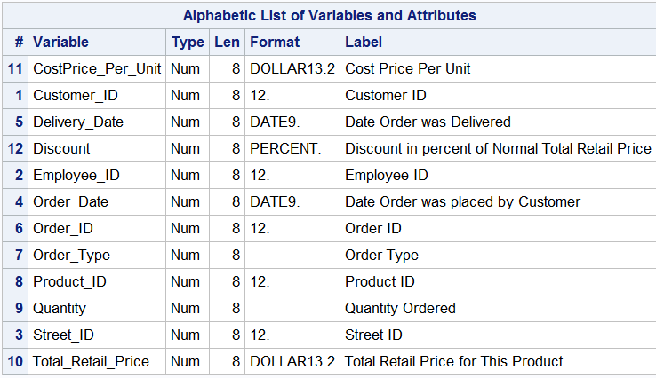
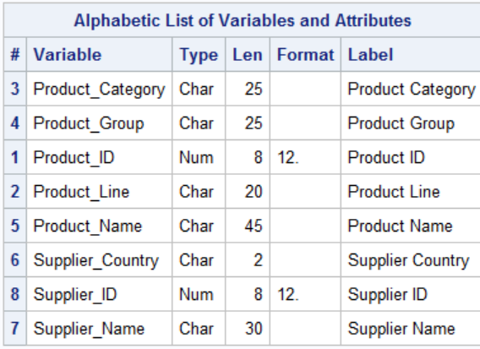
Step 1
Get employee IDs for employees who sold Expedition Zero merchandise in 2003.
Order_fact
Product_dim

Slide 19
Select the employee’s identifier (Employee_ID)from
the results of joining the Order_Fact and Product_Dim tables on Product_ID, where Product_Name contains Expedition Zero.
Exclude Internet orders (Employee_ID NE 99999999).

Slide 20
Step 1
proc sql;
select distinct Employee_ID
from orion.Order_Fact as o,
orion.Product_Dim as p
where o.Product_ID=p.Product_ID
and year(Order_Date)=2003
and Product_Name contains
'Expedition Zero'
and Employee_ID ne 99999999;
quit;
Notes:
s105d15

Slide 21
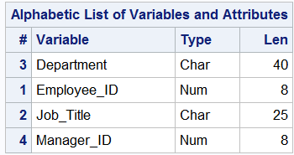
Step 2
Find the employee identifier for the managers of these employees.
Employee_organization
Select the manager’s identifier (Manager_ID) from the results of joining the Employee_Organization table with the first query’s results on Employee_ID.

Slide 22
Step 2
Write a query to obtain the manager ID of the employee’s manager.
select Manager_ID
from orion.Employee_Organization as o,
(<Step 1 query results>) as ID
where o.Employee_ID=ID.Employee_ID;
Employee_ID
120145
120732

Slide 23
Step 2
Write a query to obtain the manager ID of the employee’s manager.
proc sql;
select Manager_ID
from orion.Employee_Organization as o,
(select distinct Employee_ID
from orion.Order_Fact as o,
orion.Product_Dim as p
where o.Product_ID=p.Product_ID
and year(Order_Date)=2003
and Product_Name
contains 'Expedition Zero'
and Employee_ID ne 99999999) as ID
where o.Employee_ID=ID.Employee_ID;
quit;
Notes:
s105d16

Slide 24
Step 3
Write a query to obtain the managers’ names and city information.
proc sql;
select Employee_Name format=$25. as Name, City
from orion.Employee_Addresses
where Employee_ID in
(<Step 2 query results>);
Manager_ID
120145
120732

Slide 25
Step 3
proc sql;
select Employee_Name format=$25. as Name, City
from orion.Employee_Addresses
where Employee_ID in
(select Manager_ID
from orion.Employee_Organization as o,
(select distinct Employee_ID
from orion.Order_Fact as o,
orion.Product_Dim as p
where o.Product_ID=p.Product_ID
and year(Order_Date)=2003
and Product_Name contains
'Expedition Zero'
and Employee_ID ne 99999999) as ID
where o.Employee_ID=ID.Employee_ID);
quit;

Slide 26
Coding the Complex Query – A multiway join
proc sql;
select distinct Employee_Name format=$25. as Name, City
from orion.Order_Fact as of,
orion.Product_Dim as pd,
orion.Employee_Organization as eo,
orion.Employee_Addresses as ea
where of.Product_ID=pd.Product_ID
and of.Employee_ID=eo.Employee_ID
and ea.Employee_ID=eo.Manager_ID
and Product_Name contains 'Expedition Zero'
and year(Order_Date)=2003
and eo.Employee_ID ne 99999999
;
quit;

Slide 27
Using the airlines data base, list the names of supervisors for the crew on the flight to Copenhagen on March 4, 2000. Supervisors live in the same state as crew and there is only one supervisor for each job and category

Slide 28
proc contents data=train.flightschedule;run;

Slide 29
Query 1 identify crews for CPH flight
proc sql;
select empid
from train.flightschedule
where date="04mar2000"d and destination="CPH";
quit;

Slide 30
Get the job categories and states, make query one a subquery from staffmaster and payrollmaster tables

Slide 31
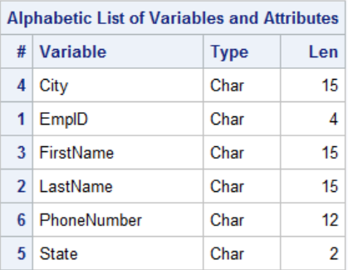
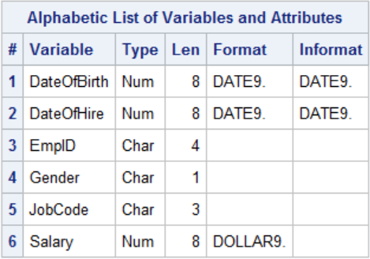

Slide 32
The first two letters of jobcode contain the job category.
proc print data=train.payrollmaster (obs=25);run;

Slide 33
/*query 2 –get the job categories and states, make query one a subquery */
proc sql;
select substr(jobcode,1,2) as JobCategory,state
from train.staffmaster as s,train.payrollmaster as p
where s.empid=p.empid and s.empid in
(select empid
from train.flightschedule
where date="04mar2000"d and destination="CPH");
quit;

Slide 34
Now find the supervisors on the supervisors file.
proc contents data=train.supervisors;run;
proc print data=train.supervisors;run;

Slide 35
/*make query 2 an inline view in query 3*/
proc sql;
select empid
from train.supervisors as m,
(select substr(jobcode,1,2) as JobCategory,state
from train.staffmaster as s,train.payrollmaster as p
where s.empid=p.empid and s.empid in
(select empid
from train.flightschedule
where date="04mar2000"d and destination="CPH")) as c
where m.jobcategory=c.jobcategory
and
m.state=c.state;
quit;

Slide 36
/*make query 3 a subquery to query 4 to get names*/
proc sql;
select firstname,lastname
from train.staffmaster
where empid in
(select empid
from train.supervisors as m,
(select substr(jobcode,1,2) as JobCategory,state
from train.staffmaster as s,train.payrollmaster as p
where s.empid=p.empid and s.empid in
(select empid
from train.flightschedule
where date="04mar2000"d and destination="CPH")) as c
where m.jobcategory=c.jobcategory
and
m.state=c.state);
quit;

Slide 37
/*use traditional sas programming*/
/*find the crew*/
proc sort data=train.flightschedule (drop=flightnumber)
out=crew (keep=empid);
where destination="CPH" and
date="04mar2000"d;
by empid;
run;

Slide 38
/*find the state and job code for crew*/
proc sort data=train.payrollmaster
(keep=empid jobcode) out=payroll;
by empid;
run;
proc sort data=train.staffmaster
(keep=empid state firstname lastname)
out=staff;
by empid;
run;
data st_cat(keep=state jobcategory);
merge crew (in=one)
staff
payroll;
by empid;
if one;
jobcategory=substr(jobcode,1,2);
run;

Slide 39
/* find supervisor id*/
proc sort data=st_cat;
by jobcategory state;
run;
proc sort data=train.supervisors
out=superv;
by jobcategory state;
run;
data super (keep=empid);
merge st_cat(in=s)
superv;
by jobcategory state;
if s;
run;

Slide 40
/*find names of supervisors*/
proc sort data=super;
by empid;
run;
data names (drop=empid);
merge super (in=super)
staff (keep=empid firstname lastname);
by empid;
if super;
run;
proc print data=names noobs uniform;
run;

Slide 41
/*same problem using a multiway join*/
proc sql;
select distinct e.firstname,e.lastname
from train.flightschedule as a,
train.staffmaster as b,
train.payrollmaster as c,
train.supervisors as d,
train.staffmaster as e
where a.date="04mar2000"d and
a.destination="CPH" and
a.empid=b.empid and
a.empid=c.empid and
d.jobcategory=substr(c.jobcode,1,2) and
d.state=b.state and
d.empid=e.empid;
quit;

