Slide 1
3
Views

Slide 2
What Is a PROC SQL View?
  A stored query
  Contains no actual data
  Extracts underlying data each time that it is used -- accesses the most current data
  Can be referenced in SAS programs in the same way as a data table
  Cannot have the same name as a data table stored in the same SAS library.

Slide 3
Creating a View
General form of the CREATE VIEW statement:
The CREATE VIEW statement differs from the CREATE TABLE statement in that a view is always created from the results of a query. Methods that create empty tables without extracting data are not appropriate for creating views.
CREATE VIEW view-name AS
query-expression;

Slide 4
Example
Tom Zhou is a sales manager who needs access to current personnel information for his reports, in particular name, job title, salary, and years of service.
He asked for access to personnel data so that he can generate reports.
Tom should not be allowed access to personnel data for any employee that he does not directly supervise.

Slide 5
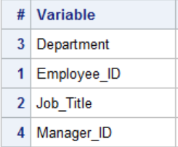
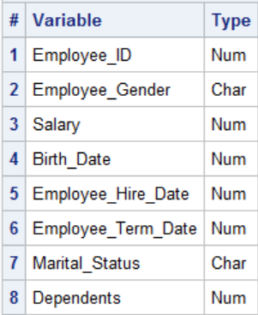
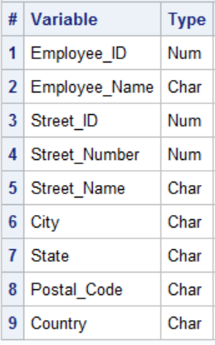
The necessary data can be obtained from these tables:
Employee_organization (n=424)
Employee_payroll (n=424)
Employee_addresses (n=424)

Slide 6
Creating a View
proc sql;
create view orion.Tom_Zhou as
select Employee_Name as Name format=$25.0,
Job_Title as Title format=$15.0,
Salary 'Annual Salary' format=comma10.2,
int((today()-Employee_Hire_Date)/365.25)
as YOS 'Years of Service'
from orion.Employee_Addresses as a,
orion.Employee_Payroll as p,
orion.Employee_Organization as o
where a.Employee_ID=p.Employee_ID and
o.Employee_ID=p.Employee_ID and
Manager_ID=120102;/*Tom Zhou’s id*/
quit;
Notes:
Instructor note: The formatting and order of this code is important to make later comparisons to the output of DESCRIBE VIEW easier to perform.

Slide 7
proc contents data=orion.tom_zhou;
run;

Slide 8
Using a View
proc sql;
title "Tom Zhou's Direct Reports";
title2 "By Title and Years of Service";
select *
from orion.Tom_Zhou
order by Title desc, YOS desc;
quit;
title;

Slide 9
Describe view -- outputs stored query to log
proc sql;
describe view orion.Tom_Zhou;
quit;

Slide 10
Views: Advantages
  Avoid storing copies of large data tables
  Avoid a frequent refresh of data table copies.
  When the underlying data changes, a view uses the most current data
  Pull together data from multiple database tables and multiple libraries or databases
  Simplify complex queries
  Prevent other users from inadvertently altering the query code

Slide 11
Views: Disadvantages
  Because views access the most current data in changing tables, the results might be different each time that you access the view.
  Views can require significant resources each time that they execute. With a view, you save disk storage space at the cost of extra CPU and memory usage.
  When accessing the same data several times in a program, use a table instead of a view. This ensures consistent results from one step to the next and can significantly reduce the resources that are required.

Slide 12
A problem with views (stored queries) Embedded libnames.

Slide 13
libname test 'c:\tmp';
proc sql;
create table test.staff as
select *
from orion.staff
;
quit;

Slide 14
Two-Level Table Names in Views
Create a permanent view, Level_II, in c:\tmp, using the libref test :
libname test 'c:\tmp';
proc sql;
create view test.Level_II as
select Employee_ID, Gender,Job_Title as Title
from test.Staff
where scan(Job_Title,-1) ='II'
and Emp_Term_Date is missing
;
quit;

Slide 15
Two-Level Table Names in Permanent Views
Several weeks later, you remember creating the Level_II view and decide that it is the perfect source to use for the current reporting project.

Slide 16
A program
libname test clear;
libname orion "c:\tmp";
proc sql;
select *
from orion.Level_II;
quit;

Slide 17
Two-Level Table Names in Permanent Views
proc sql;
create view test.Level_II as
select Employee_ID, Gender,Job_Title as Title
from test.Staff
where scan(Job_Title,-1) ='II'
and Emp_Term_Date is missing
;
quit;
libname test clear;
libname orion "c:\tmp";
proc sql;
select *
from orion.Level_II;
quit;
There is no test libref assigned.

Slide 18
Two-Level Table Names in Permanent Views
You can use two techniques to address this issue when you reference permanent tables in views:
  ANSI method:
  Omit the libref -- use a single-level table name.
  SAS enhancement:
  Embed the LIBNAME statement with a USING clause.

Slide 19
Two-Level Table Names in Permanent Views
ANSI Method: Omit the libref.
libname test 'c:\tmp';
proc sql;
create view test.Level_II as
select Employee_ID, Gender,Job_Title as Title
from Staff
where scan(Job_Title,-1) ='II'
and Emp_Term_Date is missing;
quit;
This method works as long as the view and table are stored in the same location.
When a view is not stored in the same location as its source tables (co-located), it doesn’t work
...

Slide 20
Two-Level Table Names in Permanent Views
ANSI Example: Omit the libref.
libname test 'c:\tmp';
proc sql;
create view test.Level_II as
select Employee_ID, Gender,Job_Title as Title
from Staff
where scan(Job_Title,-1) ='II'
and Emp_Term_Date is missing;
quit;
A SAS programmer might
interpret this as a reference
to the table work.Staff.
...
Notes:
At view execution, PROC SQL interprets this as the following:
"Look in the location where the Level_II view is stored for a table named Staff."

Slide 21
Two-Level Table Names in Permanent Views
SAS Enhancement: Embed the LIBNAME statement with a USING clause.
The scope of the embedded libref is local to the view, and it will not conflict with an identically named libref in the SAS session.
CREATE VIEW proc-sql-view AS query-expression <USING LIBNAME-clause<, …LIBNAME-clause>>;

Slide 22
Two-Level Table Names in Permanent Views
Example: Embed the LIBNAME statement with a USING clause.
The path defined in an embedded LIBNAME statement might not be valid if the view is executed on a different operating system.
libname test 'c:\test';
proc sql;
create view test.Level_II as
select Employee_ID, Gender,Job_Title as Title
from orion.Staff
where scan(Job_Title,-1) ='II'
and Emp_Term_Date is missing
using libname orion 'c:\tmp';
quit;
When the view test.Level_II executes, the libref orion always refers to the location c:\test'.

Slide 23
Re-create the view -- use an embedded LIBNAME statement to make it portable.
Tom can then copy the view to any location that he chooses and use it to create his reports.

Slide 24
Making a View Portable
proc sql;
create view orion.Tom_Zhou as
select Employee_Name as Name format=$25.0,
Job_Title as Title format=$15.0,
Salary "Annual Salary" format=comma10.2,
int((today()-Employee_Hire_Date)/365.25)
as YOS 'Years of Service'
from orion.Employee_Addresses as a,
orion.Employee_Payroll as p,
orion.Employee_Organization as o
where a.Employee_ID=p.Employee_ID and
o.Employee_ID=p.Employee_ID and
Manager_ID=120102
using libname orion “c:\users\dlm1\dropbox\SAS\sasdata\sql";
;
quit;

Slide 25
General Guidelines for Using Views
  Avoid ORDER BY clauses in view definitions, which force data sorting each time that the view is referenced.
  When you create a permanent view with permanent tables in the FROM clause, use a USING clause to specify the location of the libraries to make your view portable.

