Slide 1
5
The EXCEPT Operator
Unique rows from the first result set that are not found in the second result set are selected.

Slide 2
Example data sets Step 1
data t1(drop=i) t2(drop=i rename=(z=w));
call streaminit(54321);
do i= 1 to 3;
x=int(rand("uniform")*5);
z=int(rand("uniform")*5);
output t1;
output t2;
end;
do i= 4 to 6;
x=int(rand("uniform")*5);
z=int(rand("uniform")*5);
output t1;
x=int(rand("uniform")*6);
z=int(rand("uniform")*6);
output t2;
end;
run;

Slide 3
Step 2 -- Add a duplicate to each file.
data t1;
set t1 end=done;
output;
if done then output;
run;
data t2;
set t2 end=done;
output;
if _n_=1 then output;
run;

Slide 4


Display the example data sets.
title "t1";
proc sql;
select * from t1;
quit;
title "t2";
proc sql;
select * from t2;
quit;
title;

Slide 5

proc sql;
select *
from t1
except
select *
from t2
;
quit;
Unique rows from the first table that are not found in the second table are selected.
Columns are matched by position and must be the same data type.
Column names in the final result set are determined by the first result set.

Slide 6

proc sql;
select *
from t1
except corr
select *
from t2;
quit;
CORR – overlays by name and removes columns not on both tables

Slide 7

proc sql;
select *
from t1
except all
select *
from t2
;
quit;
ALL – does not remove duplicate rows (not allowed in outer union)
Notes:
ALL provides better performance since the extra pass through the data (to delete duplicates) isn’t necessary.

Slide 8

proc sql;
select *
from t1
except corr all
select *
from t2;
quit;

Slide 9
Flow Diagram: EXCEPT Operator
EXCEPT
CORR
Yes
Remove nonmatching columns.
No
ALL
No
Yes
Remove duplicate rows.
Remove matching rows.
End

Slide 10

Create a report that displays the employee identification number and job title of the non-Sales staff employees.
The orion.Employee_organization table contains information about all current Orion Star employees.
The orion.Sales table contains information about current Sales employees only.

Slide 11
Create a report that displays the employee identification number and job title of the employees who are not Sales staff.
proc sql;
select Employee_ID, Job_Title
from orion.Employee_organization
except all
select Employee_ID, Job_Title
from orion.Sales;
quit;

Slide 12
What’s wrong?
proc sql;
select count(*) 'No. Non-Sales Employees'
from (select *
from orion.Employee_organization
except all
select *
from orion.Sales);
quit;
Notes:
s106d04a

Slide 13


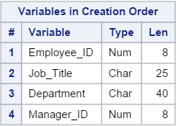
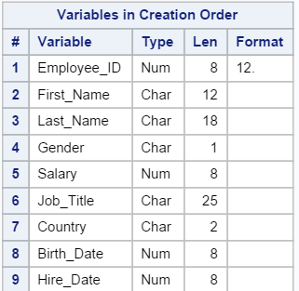
proc contents data=orion.Employee_organization position;
title 'ORION.Employee_organization';
run;
title;
proc contents data=orion.Sales position;
title 'ORION.Sales';
run;
title;

Slide 14
proc sql;
select count(*) 'No. Non-Sales Employees'
from (select *
from orion.Employee_organization
except all corr
select *
from orion.Sales);
quit;

