Slide 1
5
The OUTER UNION Operator
  All rows from both result sets, unique as well as non-unique, are selected.
  Columns are not overlaid.

Slide 2


data t1(drop=i) t2(drop=i rename=(z=w));
call streaminit(13453);
do i= 1 to 3;
x=int(rand("uniform")*5);
z=int(rand("uniform")*5);
output t1;
output t2;
end;
do i= 4 to 6;
x=int(rand("uniform")*5);
z=int(rand("uniform")*5);
output t1;
x=int(rand("uniform")*5);
z=int(rand("uniform")*5);
output t2;
end;
run;
data t1;
set t1 end=done;
output;
if done then output;
run;
data t2;
set t2 end=done;
output;
if _n_=1 then output;
run;
title "t1";
proc print data=t1 noobs;run;
title "t2";
proc print data=t2 noobs;run;
title;

Slide 3
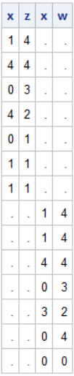
/*outer union*/
proc sql;
select *
from t1
outer union
select *
from t2
;
quit;

Slide 4

/*outer union corr*/
proc sql;
select *
from t1
outer union corr
select *
from t2
;
quit;

Slide 5
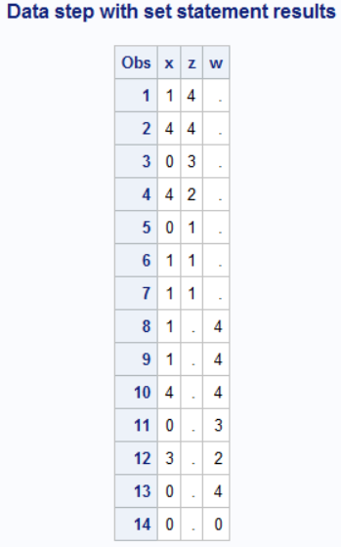
data tot;
set t1 t2;
run;
title "Data step with set statement results";
proc print data=tot;run;

Slide 6
The ALL Option is not allowed

Slide 7
Write a query to display the employee ID numbers,
job titles, and salaries for all Administrative staff.
The data is in four separate data sets with identical structures.

Slide 8
Write a query to display the employee ID numbers, job titles, and salaries for all Administrative staff.
The data is in four separate data sets
with identical structures:
  work.Admin_I
  work.Admin_II
  work.Admin_III
  work.Admin_IV
Notes:
There are no data sets that contain specific job titles for the Admin employees. Therefore, there is a step in the s106d14 program that creates the four WORK tables that are needed for this example.

Slide 9
Create Admin datasets
data work.Admin_I work.Admin_II work.Admin_III work.Admin_IV;
set orion.staff(keep=Employee_ID Job_Title Salary
where=(Job_Title contains 'Secretary' or
Job_Title contains 'Office A'));
level=scan(Job_Title,-1,' ');
if level = 'I' then output work.Admin_I;
else if level='II' then output work.Admin_II;
else if level='III' then output work.Admin_III;
else output Admin_IV;
drop level;
run;

Slide 10
This is, I think, a bit more tedious in SQL
proc sql;
create table admin_i as
select Employee_ID ,Job_Title, Salary,scan(Job_Title,-1,' ') as level
from orion.staff
where
(Job_Title contains 'Secretary' or
Job_Title contains 'Office A') and calculated level="I";
quit;

Slide 11
The OUTER UNION Operator with CORR
The OUTER UNION operator with the CORR keyword
proc sql;
select *
from work.Admin_I
outer union corr
select *
from work.Admin_II
outer union corr
select *
from work.Admin_III
outer union corr
select *
from work.Admin_IV;
quit;
Notes:
There are no data sets that contain specific job titles for the Admin employees. Therefore, there is a step in the s106d14 program that creates the four WORK tables that are needed for this example.

Slide 12
SQL Set Operators versus the DATA Step
Key Points | SQL | DATA Step
Number of tables processed simultaneously | Limited to two tables | Not limited by SAS; limited only by system resources.
Column handling | Depends on the SET operator and keywords | All columns from all data sets are included in output data set(s), unless specified using data set options or program logic.
Duplicate row handling | Depends on the SET operator and keywords | All rows are output unless specified using data set options or program logic.
Notes:
Use the techniques discussed in the "Additional PROC SQL Features" chapter to benchmark different techniques.

