Slide 1
3
Macro Storage

Slide 2
Two ways to store macros for re-use.
Use stored compiled macros to make macros available to a SAS program.
Use the autocall facility to make macros available to a SAS program.
Notes:
Stored compiled macros and the autocall facility are essentially two ways of doing the same thing. Both techniques allow us to store macros and make them conveniently and permanently available to any SAS session without the need to manually submit a macro definition before we can call the macro. Each technique has its own advantages and features, which are summarized at the end of this section.

Slide 3
Review: Produce a list of session-compiled macros stored in the default temporary catalog, work.sasmacr.
proc catalog cat=work.sasmacr;
contents;
title "My Temporary Macros";
quit;
title;

Slide 4
Stored Compiled Macros
The MSTORED system option enables storage of compiled macros in a permanent library.
The SASMSTORE= system option designates a permanent library to store compiled macros.
libref points to an allocated SAS data library.
OPTIONS MSTORED SASMSTORE=libref ;

Slide 5
Stored Compiled Macros
macro definition for permanent stored compiled macros:
The STORE option stores the compiled macro in the library indicated by the SASMSTORE= system option.
%MACRO macro-name / STORE;
macro-text
%MEND macro-name;

Slide 6
Stored Compiled Macros
Example: Store the CALC macro in a permanent library.
options mstored sasmstore=tmp;
%macro calc / store;
proc means data=orion.order_fact &stats;
var &vars;
run;
%mend calc;

Slide 7
Call the CALC macro in a new SAS session.
options mstored sasmstore=tmp;
%let stats=min max;
%let vars=quantity;
%calc

Slide 8
The Autocall Facility

Slide 9
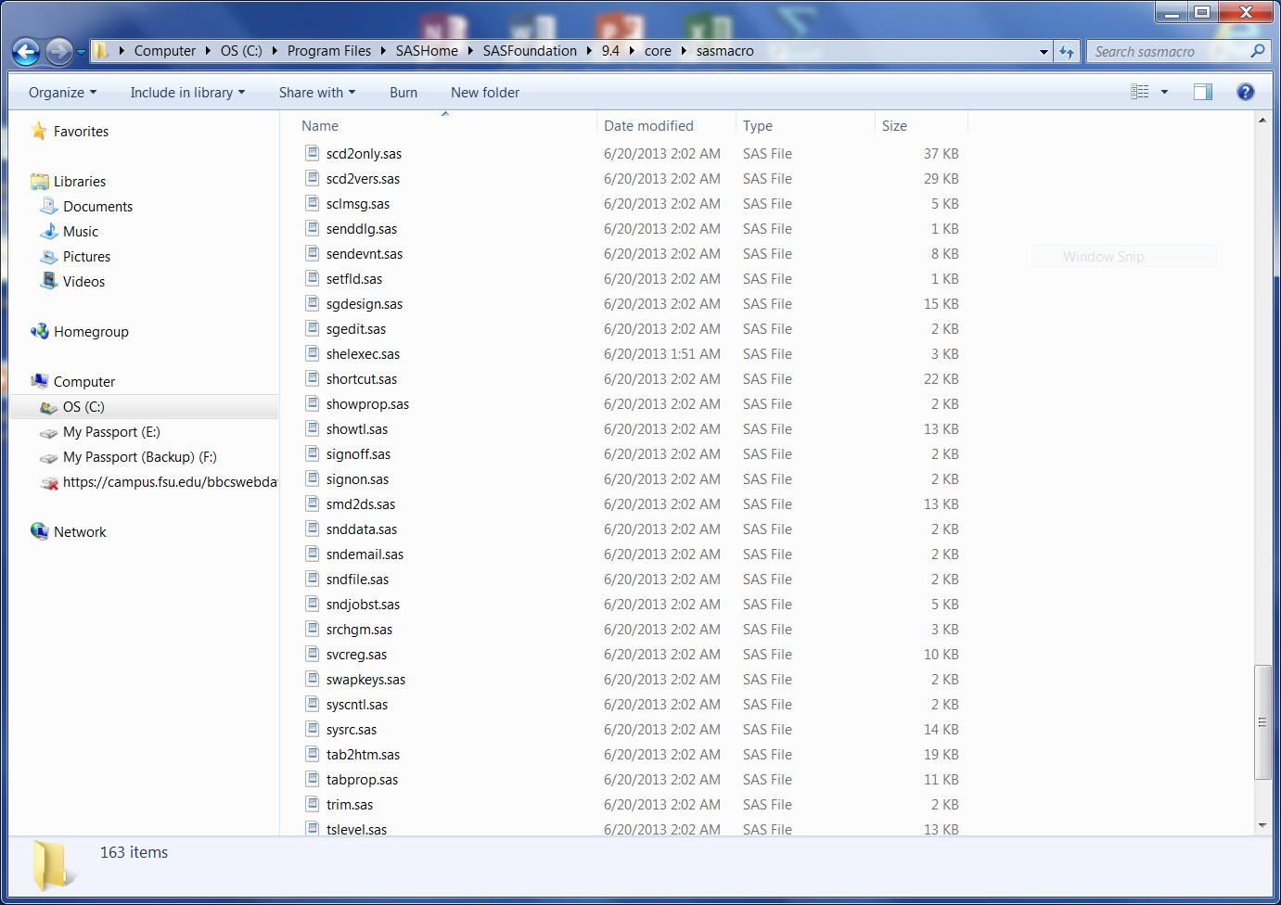
The Autocall Facility
SAS software includes an autocall library of utility macros.
Notes:
This makes for a good live demo outside SAS using Windows Explorer.

Slide 10
The Autocall Facility
An autocall library is a collection of external files that contain macro definition source code.
You can make macros accessible to your SAS session or job by concatenating your own autocall library or your organization's autocall library (or both) with the autocall library supplied with SAS software.

Slide 11
Defining an Autocall Library
To define an autocall library:
Specify the MAUTOSOURCE SAS system option.
Use the SASAUTOS= SAS system option to identify autocall library locations.

Slide 12
Autocall Facility System Options
The MAUTOSOURCE option controls autocall facility availability.
General form of the MAUTOSOURCE|NOMAUTOSOURCE option:
The default setting is MAUTOSOURCE.
OPTIONS MAUTOSOURCE;
OPTIONS NOMAUTOSOURCE;

Slide 13
Autocall Facility System Options
The SASAUTOS= system option specifies the location of autocall macros.
General form of the SASAUTOS= system option:
OPTIONS SASAUTOS=(library-1,...,library-n);
The values of library-1 through library-n are references to source libraries containing macro definitions.
You specify a source library by doing one of the following:
Placing its name in quotation marks
Pointing to it with a fileref

Slide 14
Autocall Facility System Options
Concatenate the autocall library supplied by SAS with your personal autocall library and/or your organization's autocall library.
Windows:
options mautosource sasautos=('c:\tmp',sasautos);
UNIX:
options mautosource sasautos=('/workshop','!SASROOT/sasautos');
z/OS:
options mautosource sasautos=('my.macros',sasautos);
The reserved fileref SASAUTOS is assigned to the autocall library supplied by SAS.

Slide 15
The Autocall Facility in Windows or UNIX
In a Windows or UNIX environment, save each macro definition as a separate file within the directory specified in the SASAUTOS= option.
Ensure that:
Filenames have a .sas extension.
The filename and the macro name match.
UNIX filenames are lowercase.

Slide 16
The Autocall Facility in z/OS
In a z/OS environment, save each macro definition as a separate member of the partitioned data set specified in the SASAUTOS= option.
The member name and the macro name must match.
A JCL DD statement with a DDname of SASAUTOS can allocate an autocall library.

Slide 17
Accessing Autocall Macros
With the autocall facility in effect, you can call any macro in the autocall library. If you call a macro that was not previously compiled, the macro facility:
Searches the autocall library for a member with the same name as the called macro
Issues an error message if the member is not found
Executes the macro source statements to compile the macro if the member is found
Calls the macro

Slide 18
Accessing Autocall Macros
Is a compiled macro available?
Yes
Execute the
compiled macro
No
Does the macro exist in an autocall library?
No
WARNING: Apparent invocation of macro not resolved
Yes
Execute the source statements to compile the macro
Execute the
compiled macro

Slide 19
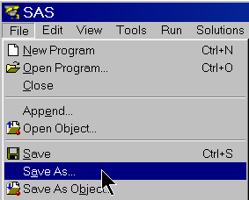
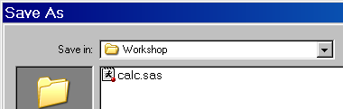
The Autocall Facility
Example: Save the CALC macro in an autocall library as calc.sas.
Step 1:
Step 2:
Step 3:
options mautosource sasautos=('c:\tmp',sasautos);
%macro calc;
proc means data=orion.order_item &stats;
var &vars;
run;
%mend calc;
continued...

Slide 20
The Autocall Facility
Step 4: Call the CALC macro in a new SAS session.
options mautosource sasautos=('c:\tmp',sasautos);
%let stats=min max;
%let vars=quantity;
%calc

Slide 21
Macro Storage Advice
Advantages of stored compiled macros:
You avoid re-compiling lengthy macro source code.
Macro source code can be protected or hidden.
Advantages of autocall macros:
They are available cross-platform.
Macro source code can be edited in any text editor without invoking SAS.
If none of the above considerations apply, use whichever technique is preferred in your organization or whichever technique you prefer.

