Slide 1
4
Creating Macro Variables in the DATA Step

Slide 2
Create macro variables during DATA step execution.
Describe the difference between the SYMPUTX routine and the %LET statement.

Slide 3
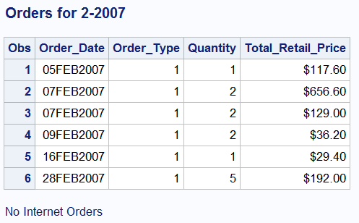
The DATA Step Interface
Automate production of the report below, with the footnote indicating the number of internet orders. Internet orders have an Order_Type of 3.

Slide 4
The DATA Step Interface, First Try
%let month=2;
%let year=2007;
data orders;
keep order_date order_type quantity total_retail_price;
set orion.order_fact end=final;
where year(order_date)=&year and month(order_date)=&month;
if order_type=3 then Number+1;
if final then do;
put Number=;
if Number=0 then do;
%let foot=No Internet Orders;
end;
else do;
%let foot=Some Internet Orders;
end;
end;
run;
proc print data=orders;
title "Orders for &month-&year";
footnote "&foot";
run;
Notes:
This is a "decoy" program that does not work because, as learned in chapter one, macro language statements, such as %let, are routed to the macro processor, not the DATA step compiler, during word-scanning time. While the %let statement can "legally" be placed anywhere, placing it in a DATA step does not magically transform it into a DATA step statement. Same would be true of a title statement, which can also be placed anywhere, but can never be a DATA step statement.

Slide 5
The DATA Step Interface
Symbol Table
month | 2
year | 2007
Word scanning begins. Macro triggers are encountered.
%let month=2;
%let year=2007;
data orders;
keep order_date order_type quantity total_retail_price;
set orion.order_fact end=final;
where year(order_date)=&year and month(order_date)=&month;
if order_type=3 then Number+1;
if final then do;
put Number=;
if Number=0 then do;
%let foot=No Internet Orders;
end;
else do;
%let foot=Some Internet Orders;
end;
end;
run;
...

Slide 6
The DATA Step Interface
Compiling begins. Macro variable references are resolved.
data orders;
keep order_date order_type quantity total_retail_price;
set orion.order_fact end=final;
where year(order_date)=2007 and month(order_date)=2;
if order_type=3 then Number+1;
if final then do;
put Number=;
if Number=0 then do;
%let foot=No Internet Orders;
end;
else do;
%let foot=Some Internet Orders;
end;
end;
run;
Symbol Table
month | 2
year | 2007
...

Slide 7
The DATA Step Interface
Symbol Table
month | 2
year | 2007
foot | No Internet Orders
The macro trigger is passed to the macro processor.
data orders;
keep order_date order_type quantity total_retail_price;
set orion.order_fact end=final;
where year(order_date)=2007 and month(order_date)=2;
if order_type=3 then Number+1;
if final then do;
put Number=;
if Number=0 then do;
%let foot=No Internet Orders;
end;
else do;
%let foot=Some Internet Orders;
end;
end;
run;
...
Notes:
DATA step compilation is momentarily interrupted.

Slide 8
The DATA Step Interface
Symbol Table
month | 2
year | 2007
foot | No Internet Orders
The macro variable FOOT is assigned.
data orders;
keep order_date order_type quantity total_retail_price;
set orion.order_fact end=final;
where year(order_date)=2007 and month(order_date)=2;
if order_type=3 then Number+1;
if final then do;
put Number=;
if Number=0 then do;
end;
else do;
%let foot=Some Internet Orders;
end;
end;
run;
...
Notes:
Notice that, after the %let statement is acted on by macro processor, the macro processor "throws it in the trash can". It's gone. It is certainly not sent to the DATA step compiler, which is a good thing, because the DATA step compiler would have no idea what to do with it.

Slide 9
The DATA Step Interface
Symbol Table
month | 2
year | 2007
foot | Some Internet Orders
The macro trigger overwrites the previous value.
data orders;
keep order_date order_type quantity total_retail_price;
set orion.order_fact end=final;
where year(order_date)=2007 and month(order_date)=2;
if order_type=3 then Number+1;
if final then do;
put Number=;
if Number=0 then do;
end;
else do;
%let foot=Some Internet Orders;
end;
end;
run;
month | 2
year | 2007
foot | Some Internet Orders
...

Slide 10
The DATA Step Interface
The compile phase is complete. Ready for execution.
data orders;
keep order_date order_type quantity total_retail_price;
set orion.order_fact end=final;
where year(order_date)=2007 and month(order_date)=2;
if order_type=3 then Number+1;
if final then do;
put Number=;
if Number=0 then do;
end;
else do;
end;
end;
run;
month | 2
year | 2007
foot | Some Internet Orders
Nothing in this DATA step
affects the value of FOOT.
It remains
Some Internet Orders.
Notes:
Similarly, the 2nd %let statement, after the macro processor acts on it, is "thrown in the trash can". The DATA step above is what was sent to, and seen by, the DATA step compiler. All along, the DATA step was compiling. The DATA executes only when the run statement is encountered.

Slide 11
The SYMPUTX Routine
The SYMPUTX routine assigns to a macro variable any value available to the DATA step during execution time.
It can create macro variables with:
static values
dynamic (data dependent) values
dynamic (data dependent) names
Symbol Table
DATA step variables
DATA step expressions
character literals
SYMPUTX
Notes:
The SYMPUTX routine is a true DATA step statement.

Slide 12
The SYMPUTX Routine
The SYMPUTX routine is an executable DATA step statement.
macro-variable is assigned the character value of text.
If macro-variable already exists, its value is replaced.
Literal values in either argument must be enclosed in quotation marks.
CALL SYMPUTX(macro-variable, text);
Notes:
Argument 1 can be any character literal, variable, or expression that resolves to a legal macro variable name.
Argument 2 can be any character or numeric constant, variable, or expression. Character literals are quoted.

Slide 13
The SYMPUTX Routine
No macro
triggers within
DO groups
%let month=2;
%let year=2007;
data orders;
keep order_date order_type quantity total_retail_price;
set orion.order_fact end=final;
where year(order_date)=&year and month(order_date)=&month;
if order_type=3 then Number+1;
if final then do;
put Number=;
if Number=0 then do;
call symputx('foot', 'No Internet Orders');
end;
else do;
call symputx('foot', 'Some Internet Orders');
end;
end;
run;
Fixed macro
variable name
Fixed macro
variable value
Notes:
In this case, both arguments to the SYMPUTX routine are character literals. Therefore, both arguments are quoted.

Slide 14
%let month=2;
%let year=2007;
data orders;
keep order_date order_type quantity total_retail_price;
set orion.order_fact end=final;
where year(order_date)=&year and month(order_date)=&month;
if order_type=3 then Number+1;
if final then do;
put Number=;
if Number=0 then do;
call symputx('foot', 'No Internet Orders');
end;
else do;
call symputx('foot', 'Some Internet Orders');
end;
end;
run;
proc print data=orders;
title "Orders for &month-&year";
footnote "&foot";
run;

Slide 15
The SYMPUTX Routine
You can copy the current value of a DATA step variable into a macro variable by using the name of a DATA step variable as the second argument to the SYMPUTX routine.
A maximum of 32,767 characters can be assigned to the receiving macro variable.
Values of numeric variables are automatically converted to character using the BEST12. format.
Leading and trailing blanks are automatically removed from both arguments.
CALL SYMPUTX('macro-variable', DATA-step-variable);

Slide 16
The SYMPUTX Routine
%let month=1;
%let year=2007;
data orders;
keep order_date order_type quantity total_retail_price;
set orion.order_fact end=final;
where year(order_date)=&year and month(order_date)=&month;
if order_type=3 then Number+1;
if final then call symputx('num', Number);
run;
proc print data=orders;
title "Orders for &month-&year";
footnote "&num Internet Orders";
run;
Notes:
Since argument 2 is a numeric variable, the SYMPUTX routine converts it to character, as stated on the previous slide. No conversion note is written to the log.

Slide 17
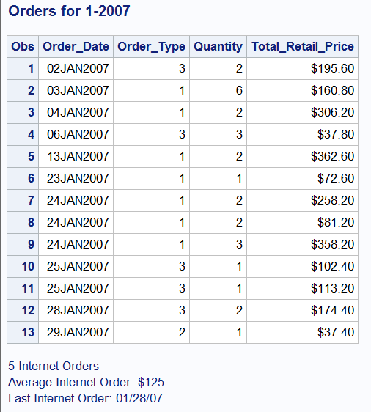
Further enhance the footnotes.
Notes:
The dataset is sorted by Order_Date.

Slide 18
The SYMPUTX Routine
You can use DATA step functions and expressions in the SYMPUTX routine's second argument to:
format data values
perform arithmetic operations on numeric data
manipulate character data
CALL SYMPUTX('macro-variable',expression);

Slide 19
%let month=1;
%let year=2007;
data orders (drop=last_order);
retain last_order 0;
keep order_date order_type quantity total_retail_price;
set orion.order_fact end=final;
where year(order_date)=&year and month(order_date)=&month;
if order_type=3 then do;
Number+1;
sumprice+total_retail_price;
if order_date>last_order then last_order=order_date;
end;
if final then do;
call symputx('num', Number);
call symputx('avg',put(sumprice/number,dollar8.));
call symputx("last",put(last_order,mmddyy8.));
end;
run;
proc print data=orders;
title "Orders for &month-&year";
footnote "&num Internet Orders";
footnote2 "Average Internet Order: &avg";
footnote3 "Last Internet Order: &last";
run;
title;footnote;

Slide 20
Passing Values between Steps
Example: Based on user-selected time periods, dynamically compute statistics and include in titles.
Notes:
Previous examples stored the result of DATA step calculations into macro variables. What if you wanted to store the result of PROC step calculations into macro variables? The SYMPUTX routine is, of course, not valid in a proc step.

Slide 21
%let start=01Jan2007;
%let stop=31Dec2007;
proc means data=orion.order_fact noprint;
where order_date between "&start"d and "&stop"d;
var total_retail_price;
output out=stats n=count mean=avg;
run;
data _null_;
set stats;
call symputx('num_orders',count);
call symputx('avg_order',put(avg,dollar8.2));
run;
%put Number of orders: &num_orders;
%put Average price of orders: &avg_order;

Slide 22
Passing Values between Steps
%let start=01Jan2007;
%let stop=31Dec2007;
proc means data=orion.order_fact noprint;
where order_date between "&start"d and "&stop"d;
var total_retail_price;
output out=stats n=count mean=avg;
run;
data _null_;
set stats;
call symputx('Num_orders',count);
call symputx('Avg_order',avg);
run;
%put Number of orders: &num_orders;
%put Average order price: &avg_order;
Notes:
Use a 3-step approach. 1) Output proc step statistics to a dataset. 2) Read that dataset in a DATA _NULL_ step and create macro variables, 3) which can be referenced in the next step. The proc means step and the DATA step use the same input dataset.
Ordinarily, we would apply the desired format, such as dollar4., to a macro variable's value using the PUT function in the SYMPUTX routine's 2nd argument. However, in this case, the REF= option on the VBAR3D statement requires a standard numeric value without dollar signs or commas. In this case, the dollar format is applied with %sysfunc in the footnote statement. PUTN is used because PUT is not available to %sysfunc.

Slide 23
title "All orders between &start and &stop";
title2 "Number of orders: &num_orders";
title3 "Average order: &avg_order";
proc print data=orion.order_fact ;
where order_date between "&start"d and "&stop"d;
var customer_id order_date order_id total_retail_price;
run;
title;

