Slide 1
A macro to create p-value plots.

Slide 2
Probability Integral Transform

Slide 3
%let numobs=10000;
data normp;
call streaminit(757351);
do i=1 to &numobs;
x=rand("normal");
p=1-cdf("normal",x);
output;
end;
run;
proc print data=normp;run;
ods select histogram cdfplot;
proc univariate data=normp;
var x p;
histogram x;
cdfplot p;
run;

Slide 4
Probability Integral Transform

Slide 6
%let numobs=10000;
data expons;
call streaminit(757351);
do i=1 to &numobs;
x=rand("uniform");
exp=-2*log(x);
output;
end;
run;
*proc print data=expons;run;
ods select histogram;
proc univariate data=expons;
histogram exp/exponential;
run;

Slide 7
P-value Plots

Slide 9
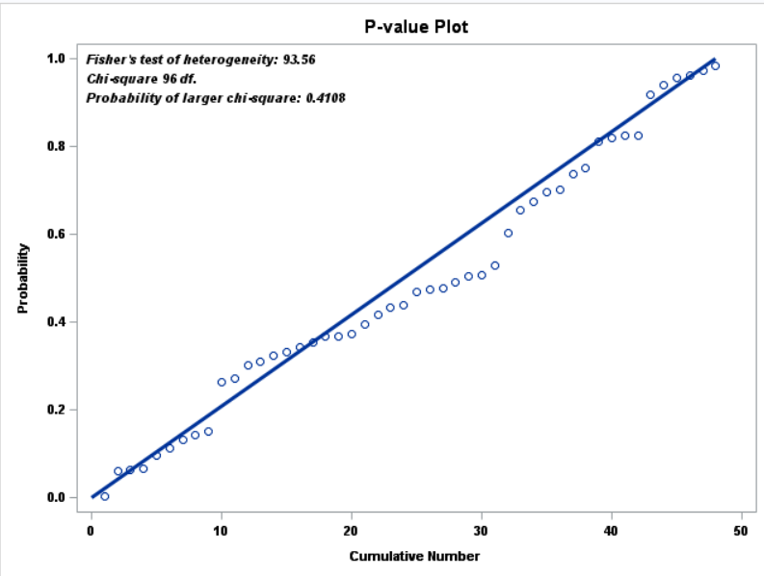

Slide 10
Some data -- 48 tests of proportional hazards assumption.
proc print data=tmp.zphdietvars;
run;

Slide 11
%let data=tmp.zphdietvars;
%let prob=probt;
proc sort data=&data out=_tmp;
by descending &prob;
data _tmp;
retain cumn 0 chisq 0;
set _tmp end=done;
pstar=1-&prob;
chisq=chisq-2*log(&prob);
cumn+1;
if done then do;
call symputx("Numobs",_n_);
call symputx("Fisher",put(chisq,7.2),"g");
df=2*_n_;
pchi=1-cdf("chisquare",df,chisq);
call symputx("ProbChi",put(pchi,6.4),"g");
call symputx("df",df,"g");
end;
label pstar="Probability"
cumn="Cumulative Number";
run;

Slide 12
data xxxx;
maxprob=1;
maxn=&numobs;
run;
data _tmp;
set _tmp xxxx;
run;

Slide 13
proc sgplot data=_tmp noautolegend;
title "P-value Plot";
scatter x=cumn y=pstar;
inset "Fisher's test of heterogeneity: &fisher" "Chi-square &df df."
"Probability of larger chi-square: &probchi.“ /TEXTATTRS=(Family=Arial Size=8
Style=Italic Weight=Bold);
xaxis labelattrs=(Family=Arial Size=8 Weight=Bold)
valueattrs=(Family=Arial Size=8 Weight=Bold);
yaxis labelattrs=(Family=Arial Size=8 Weight=Bold)
valueattrs=(Family=Arial Size=8 Weight=Bold);
vector x=maxn y=maxprob /noarrowheads lineattrs=(thickness=3);
run;
title;

Slide 14
%macro pvalueplot(prob=,data=);
proc sort data=&data out=_tmp;
by descending &prob;
data _tmp;
retain cumn 0 chisq 0;
set _tmp end=done;
pstar=1-&prob;
chisq=chisq-2*log(&prob);
cumn+1;
if done then do;
call symputx("Numobs",_n_);
call symputx("Fisher",put(chisq,7.2),"g");
df=2*_n_;
pchi=1-cdf("chisquare",df,chisq);
call symputx("ProbChi",put(pchi,6.4),"g");
call symputx("df",df,"g");
end;
label pstar="Probability"
cumn="Cumulative Number";
data xxxx;
maxprob=1;
maxn=&numobs;
run;
quit;
data _tmp;
set _tmp xxxx;
run;
proc sgplot data=_tmp noautolegend;
title "P-value Plot";
scatter x=cumn y=pstar;
inset "Fisher's test of heterogeneity: &fisher" "Chi-square &df df."
"Probability of larger chi-square: &probchi."/TEXTATTRS=(Family=Arial Size=8
Style=Italic Weight=Bold);
xaxis labelattrs=(Family=Arial Size=8 Weight=Bold)
valueattrs=(Family=Arial Size=8 Weight=Bold);
yaxis labelattrs=(Family=Arial Size=8 Weight=Bold)
valueattrs=(Family=Arial Size=8 Weight=Bold);
vector x=maxn y=maxprob /noarrowheads lineattrs=(thickness=3);
run;
title;
%mend;

Slide 15
The program:
%pvalueplot(prob=probt,data=tmp.zphdietvars)

