Slide 1
4
Indirect References to Macro Variables

Slide 2
  Reference macro variables indirectly.
  Create a series of macro variables using
  the SYMPUTX routine.

Slide 3
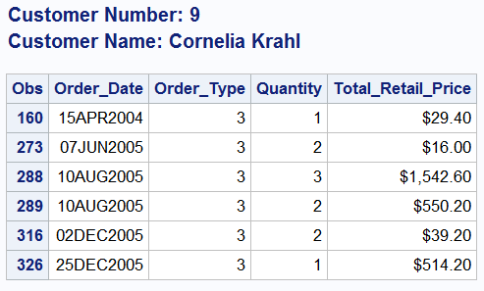
Table Lookup Application
Create an order history for a given customer. Report titles should display customer name and number.

Slide 4
Table Lookup Application
Step 1: Hardcode the program, including customer name and number.
proc print data=orion.order_fact;
where customer_ID=9;
var order_date order_type quantity total_retail_price;
title1 "Customer Number: 9";
title2 "Customer Name: Cornelia Krahl";
run;
title;footnote;

Slide 5
Table Lookup Application
%let custID=9;
proc print data=orion.order_fact;
where customer_ID=&custID;
var order_date order_type quantity total_retail_price;
title1 "Customer Number: &custID";
title2 "Customer Name: Cornelia Krahl";
run;
title

Slide 6
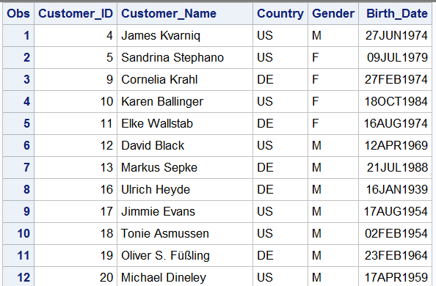
Table Lookup Application
The orion.customer data set contains customer names and ID numbers. Customer ID numbers are unique.

Slide 7
Table Lookup Application
Step 3: Add a DATA step to create a macro variable with the customer's name. Reference the macro variable in TITLE2.
%let custID=9;
data _null_;
set orion.customer;
where customer_ID=&custID;
call symputx('name', Customer_Name);
run;
proc print data=orion.order_fact;
where customer_ID=&custID;
var order_date order_type quantity total_retail_price;
title1 "Customer Number: &custID";
title2 "Customer Name: &name";
run;
same
statement

Slide 8
How many rows are selected by the DATA _null_ step WHERE statement
%let custID=9;
data _null_;
set orion.customer;
where customer_ID=&custID;
call symputx('name', Customer_Name);
run;
proc print data=orion.order_fact;
where customer_ID=&custID;
var order_date order_type quantity total_retail_price;
title1 "Customer Number: &custID";
title2 "Customer Name: &name";
run;
Notes:
Important to understand that only one row is selected, hence the one and only Customer_Name from the selected row is stored into the single macro variable named NAME.

Slide 9
Table Lookup Application
To select all customers, eliminate the WHERE statement from the DATA step.
%let custID=9;
data _null_;
set orion.customer;
call symputx('name', Customer_Name);
run;
proc print data=orion.order_fact;
where customer_ID=&custID;
var order_date order_type quantity total_retail_price;
title1 "Customer Number: &custID";
title2 "Customer Name: &name";
run;

Slide 10
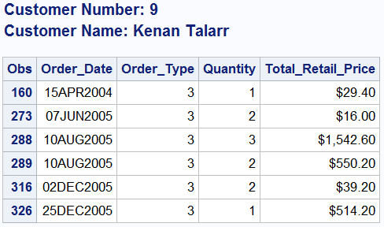
What’s the problem?

Slide 11

Table Lookup Application
Because only one macro variable is created by the SYMPUTX routine, its value is overwritten with each iteration of the DATA step. Unique macro variable names are required.
Notes:
This program is identical to the program on the previous slide. It is critical for students to understand the problem described above. A series of macro variables, with unique names, is required.

Slide 12
Creating a Series of Macro Variables
Derive unique macro variable names by appending the Customer_ID number to a fixed prefix.
Symbol Table
Variable Value
NAME4 James Kvarniq
NAME5 Sandrina Stephano
NAME9 Cornelia Krahl
.
.
.
Prefix
Customer_ID
Notes:
A pictorial representation of the desired outcome. Customer_ID is a variable in the orion.customer dataset. The prefix NAME was arbitrarily chosen. VALUE can be derived from the Customer_Name variable in the orion.customer dataset.

Slide 13
Creating a Series of Macro Variables
To create a series of macro variables, use the SYMPUTX routine with a DATA step variable or expression in argument1.
expression1 evaluates to a character value that is a valid
macro variable name, unique to each
execution of the routine.
expression2 is the value to assign to each macro variable.
CALL SYMPUTX(expression1,expression2);

Slide 14
Creating a Series of Macro Variables
Step 4: Create a series of macro variables to store customer names.
data _null_;
set orion.customer;
call symputx('name'||left(Customer_ID),customer_Name);
run;
%put _user_;
Notes:
As we learned, the symputx routine automatically removes leading and trailing blanks from both arguments. So why is the LEFT function needed? It's important to understand that Customer_ID is a numeric variable. (Not the best choice, but that's the way it is.) Automatic conversion to character using the BEST12. format results in a right-justified Customer_ID, with a conversion note written to the log. The symputx routine doesn NOT remove imbedded blanks from either argument, so the LEFT function is necessary to remove leading blanks from Customer_ID as it is concatenated after the prefix NAME.

Slide 15
Creating a Series of Macro Variables
You can now reference the correct name without
rerunning the DATA step.
Symbol Table
Variable Value
CUSTID 9
NAME4 James Kvarniq
NAME5 Sandrina Stephano
NAME9 Cornelia Krahl
. .
. .
. .
%let custID=9;
proc print data=orion.order_fact;
where customer_ID=&custID;
var order_date order_type quantity total_retail_price;
title1 "Customer Number: &custID";
title2 "Customer Name: &name9";
run;
Notes:
OK. We solved our efficiency problem. We stored every customer name into its own macro variable and never need to run the DATA step again. We have a single-step production program now. Just the proc print step. Perfect! Or is it? Watch the troubled looks on your students' faces as they observe this solution. They'll knock the ball out of the park on the upcoming poll.

Slide 16
What is the disadvantage of this program?
%let custID=9;
proc print data=orion.order_fact;
where customer_ID=&custID;
var order_date order_type quantity total_retail_price;
title1 "Customer Number: &custID";
title2 "Customer Name: &name9";
run;
To improve this program so that only one change is required, use an indirect reference.
Notes:
Type answer here

Slide 17
Indirect References to Macro Variables
Because the CUSTID macro variable matches part of the name of a NAME macro variable, the CUSTID macro variable can indirectly reference a NAME macro variable.
Symbol Table
Variable Value
CUSTID 9
NAME4 James Kvarniq
NAME5 Sandrina Stephano
NAME9 Cornelia Krahl
. .
. .
. .

Slide 18
Indirect References to Macro Variables
The Forward Rescan Rule
  Multiple ampersands preceding a name token denote an indirect reference.
  The macro processor will rescan an indirect reference, left to right, from the point where multiple ampersands begin.
  Two ampersands (&&) resolve to one ampersand (&).
  Scanning continues until no more references can be resolved.
Notes:
Tell students to memorize the 3rd bullet and they've got it.

Slide 19
Indirect References to Macro Variables
Step 5: Use an indirect reference.
%let custID=9;
proc print data=orion.order_fact;
where customer_ID=&custID;
var order_date order_type quantity total_retail_price;
title1 "Customer Number: &custID";
title2 "Customer Name: &&name&custID";
run;
title;
Notes:
The solution above may look odd at first, but the diagrams on the next two slides make it clear. Students may ask if more than two ampersands are ever required. Three ampersands can be used when the value of one macro variable matches the exact name of another macro variable. That comes up far less often than the above case. The need for any more than three ampersands would be extremely rare. If students ask how it would work, just refer them back to the forward rescan rule on the previous slide.

Slide 20
Indirect References to Macro Variables
The indirect reference causes a second scan.
reference
&&name&custID
1st scan
&name9
2nd scan
Cornelia Krahl

Slide 21
Indirect References to Macro Variables
The CUSTID macro variable is an indirect reference
to a NAME macro variable.
Scan sequence:
&&name&custID &name9 Cornelia Krahl
Symbol Table
Variable Value
CUSTID 9
NAME4 James Kvarniq
NAME5 Sandrina Stephano
NAME9 Cornelia Krahl
. .
. .
. .

Slide 22
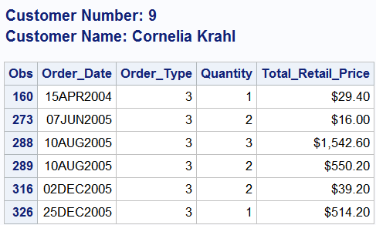
Indirect References to Macro Variables

