Slide 1
Survival Distributions

Slide 2
pdf

Slide 3
Hazard function
also sometimes called:
conditional failure rate
intensity function
force of mortality
instantaneous death rate

Slide 4
Interpreting the hazard
it is intuitively appealing to think in terms of the hazard function -- nice modeling possibilities develop.

Slide 5
The Cumulative Hazard

Slide 6
Relationships among Survivor Functions

Slide 7
The exponential distribution.

Slide 8
The exponential in survival

Slide 9
Simulate exponential survival times
%let obs=1000;
%let seed=54321;
%let hazard=.1;
data surv;
call streaminit(&seed);
do PatientID = 1 to &obs;
t = rand("expon")*(1/&hazard);/* hazard rate = 0.01 */
output;
end;
run;

Slide 10
PROC LIFETEST
proc lifetest data=surv;
time t;
ods select Quartiles Means;
run;

Slide 11
So far, T is just a (positive valued) random variable.
proc univariate data=surv;
var t;
histogram t/exponential;
run;

Slide 12
Censoring

Slide 13
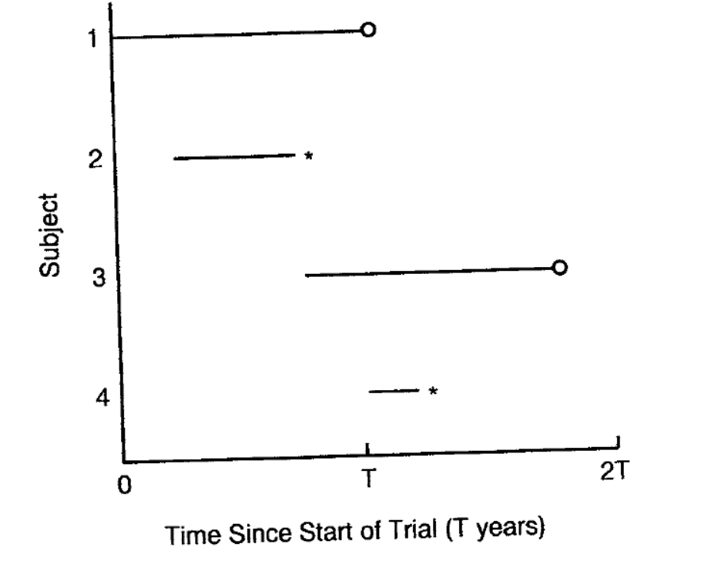
Staggered entry, right truncation, “observation time”

Slide 14
Censoring
%let obs=100;
%let seed=54321;
%let hazard=.01;
%let censoring=.001;/*hazard rate for censoring process*/
data Censor(keep= id t Censored);
call streaminit(&seed);
EndTime = 365; /* end of study period */
do PatientID = 1 to 100;
tEvent = rand("exponential")*(1/&Hazard);
c = rand("exponential")*(1/&Censoring);
t = min(tEvent, c, EndTime);
Censored = (c < tEvent | tEvent > EndTime);
output;
end;
run;

Slide 15
PROC LIFETEST with censoring
proc lifetest data=Censor plots=(survival(atrisk CL));
time t*Censored(1);
ods select Quartiles Means CensoredSummary SurvivalPlot;
run;

