Slide 1
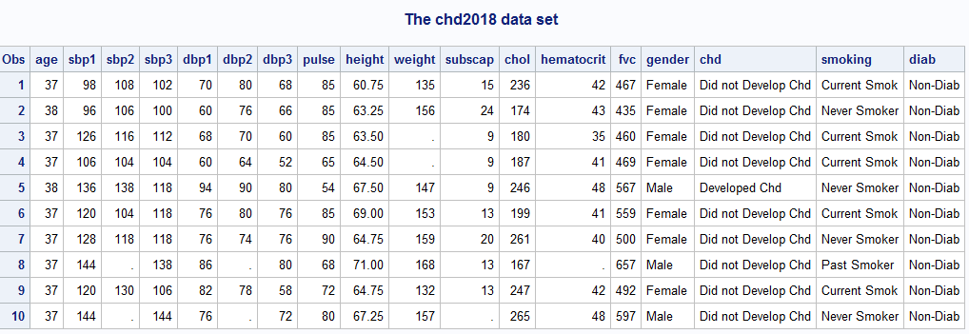
The Data Step in SAS
SAS files (tables, data sets) are created or changed using a data step.
SAS files consist of:
Observations (records, rows) containing information on a single object.
Each row contains information on variables pertaining to the single object.

Slide 2
SAS datasets are divided into two parts.
Descriptor Portion – provides information on the data set and is viewed with PROC CONTENTS.
Data Portion – contains the actual data and is viewed using PROC PRINT

Slide 3
Accessing the descriptor portion.
libname s5238 "d:\dropbox\sas\sasdata\5238";
proc contents data=s5238.chd2018;run;
The location of the data set is specified with a libname statement.

Slide 4
Accessing the data portion.
proc print data=s5238.chd2018 (obs=100);
var chd gender sbp1 chol;
run;
The var statement is not required. If not given all variables are presented.
The obs= option (in parentheses) after the data set name is a data set option.

Slide 5
The data step is most often used to create a new data set.
By reading a SAS data set (with or without subsetting) by reading an existing SAS Data set(s).
Through programming (e.g. simulation).
Putting multiple datasets together (concatenating, appending, merging)

Slide 6
How the data step works.
One observation at a time, one statement at a time.
Program Data Vector

Slide 7
data analysis;
set s5238.chd2018(keep=sbp1 chol);
run;
proc print data=work.analysis(obs=10);run;
Program Data Vector (PDV)
sbp1 (num 8) | chol (num 8)
. | .

Slide 8
The where statement
data analysis(drop=gender);
set s5238.chd2018(keep=gender sbp1 chol);
where gender="Male";
run;
proc print data=analysis(obs=7);
run;
Program Data Vector (PDV)
gender (char 8) | sbp1 (num 8) | chol (num 8)
 | . | .

Slide 9
Assignment Statements
data arith;
input htin wtlb chol;
htm=.0254*htin;/*1 inches = 0.0254 meters*/
wtkg=.45359237*wtlb;/*1 pound = 0.45359237 kilograms*/
bmi=wtkg/htm**2;
cholmmol=chol*0.02586;/*1 mg/dl = 0.02586 mmol/l*/
datalines;
56.50 98 234
62.25 145 172
62.50 128 248
64.75 119 215
68.75 144 145
;
run;
proc print data=arith;run;

Slide 10
Loops
data normals;
call streaminit(1735171); /* set random number seed */
do i = 1 to 1000;
z = rand("Normal"); /* z ~ N[0,1] */
output;
end;
run;
ods select histogram qqplot;
proc univariate data=normals ;
var z;
histogram z/normal;
qqplot z;
run;

