Slide 1
Reasons to review the linear model
It is probably the most used and most easily understood statistical model.
Understand it’s limitations for binary outcomes.

Slide 2
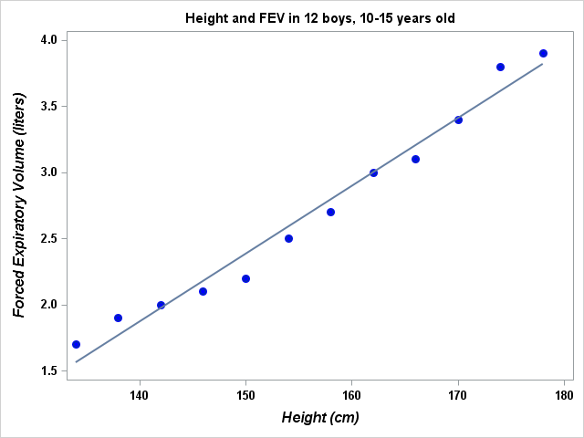

Slide 4
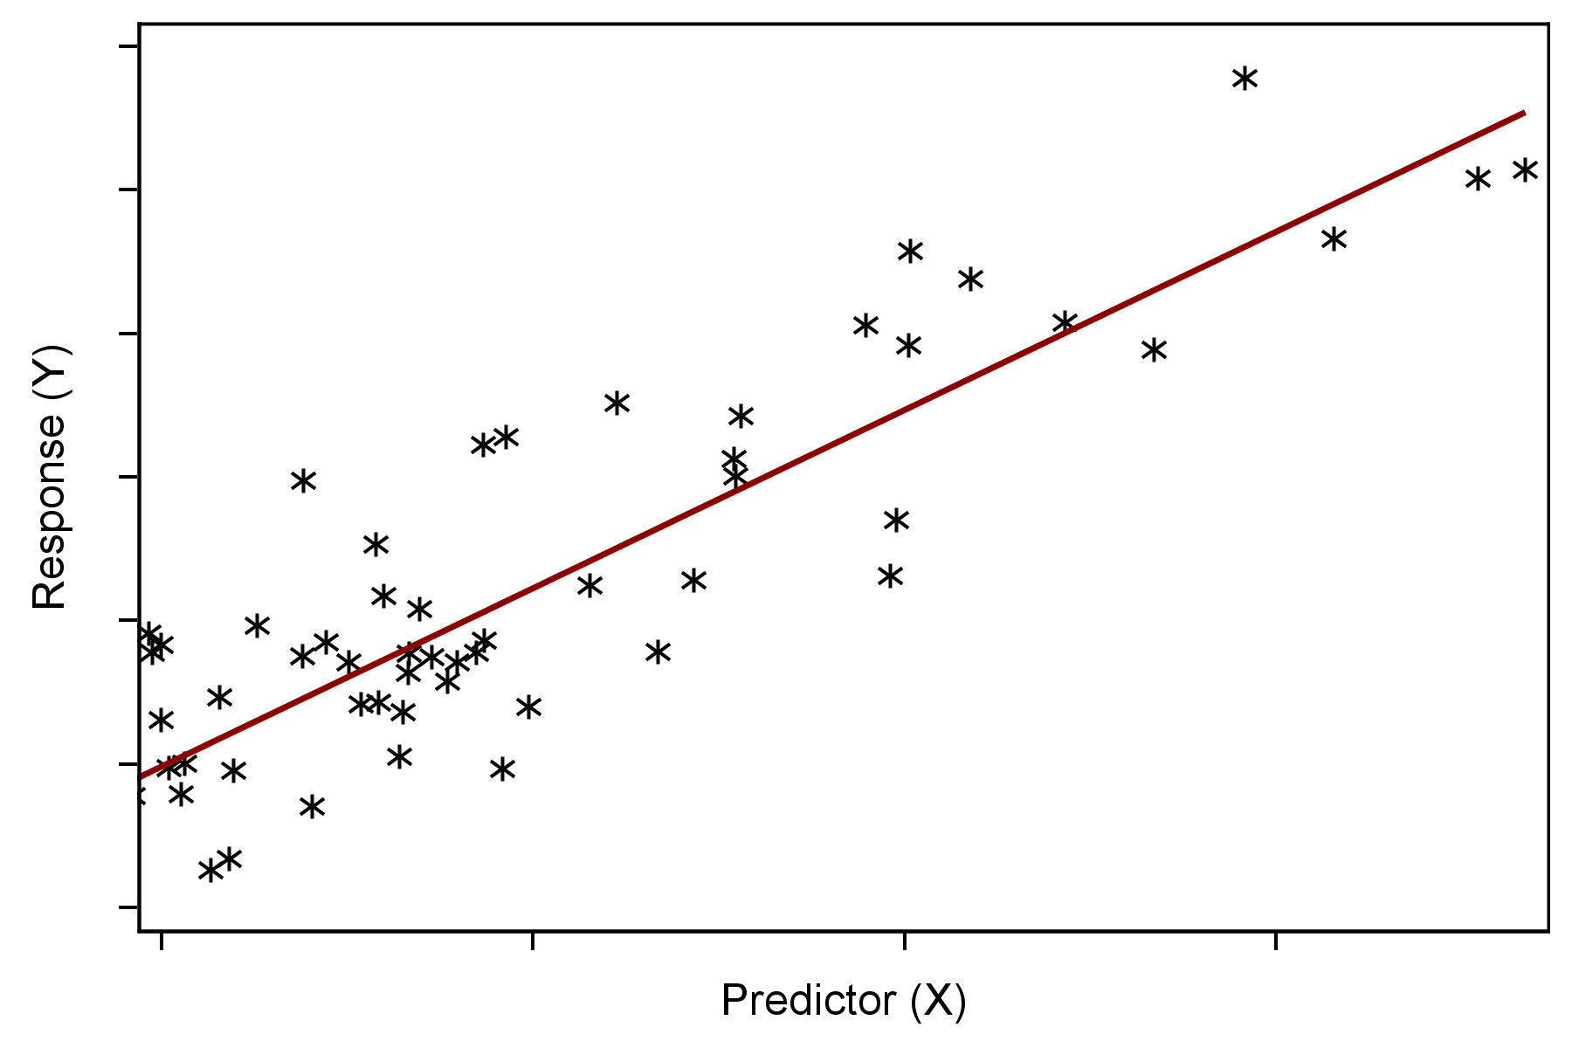
Assumptions of Simple Linear Regression
Unknown Relationship
Y = β₀ + β₁X

Slide 5
The Method of Least Squares

Slide 7
The equation of a straight line:

Slide 9
The Method of Least Squares

Slide 12
Assumptions (only necessary for inference)

Slide 14
Vector/Matrix approach to least squares

Slide 19
The multivariate linear model.

Slide 20
The simple linear regression model.

Slide 21
The multiple linear regression model.

Slide 22
The Method of Least Squares
Data
Assumption
Total Squared “Error”

Slide 24
A few statistical things

Slide 25
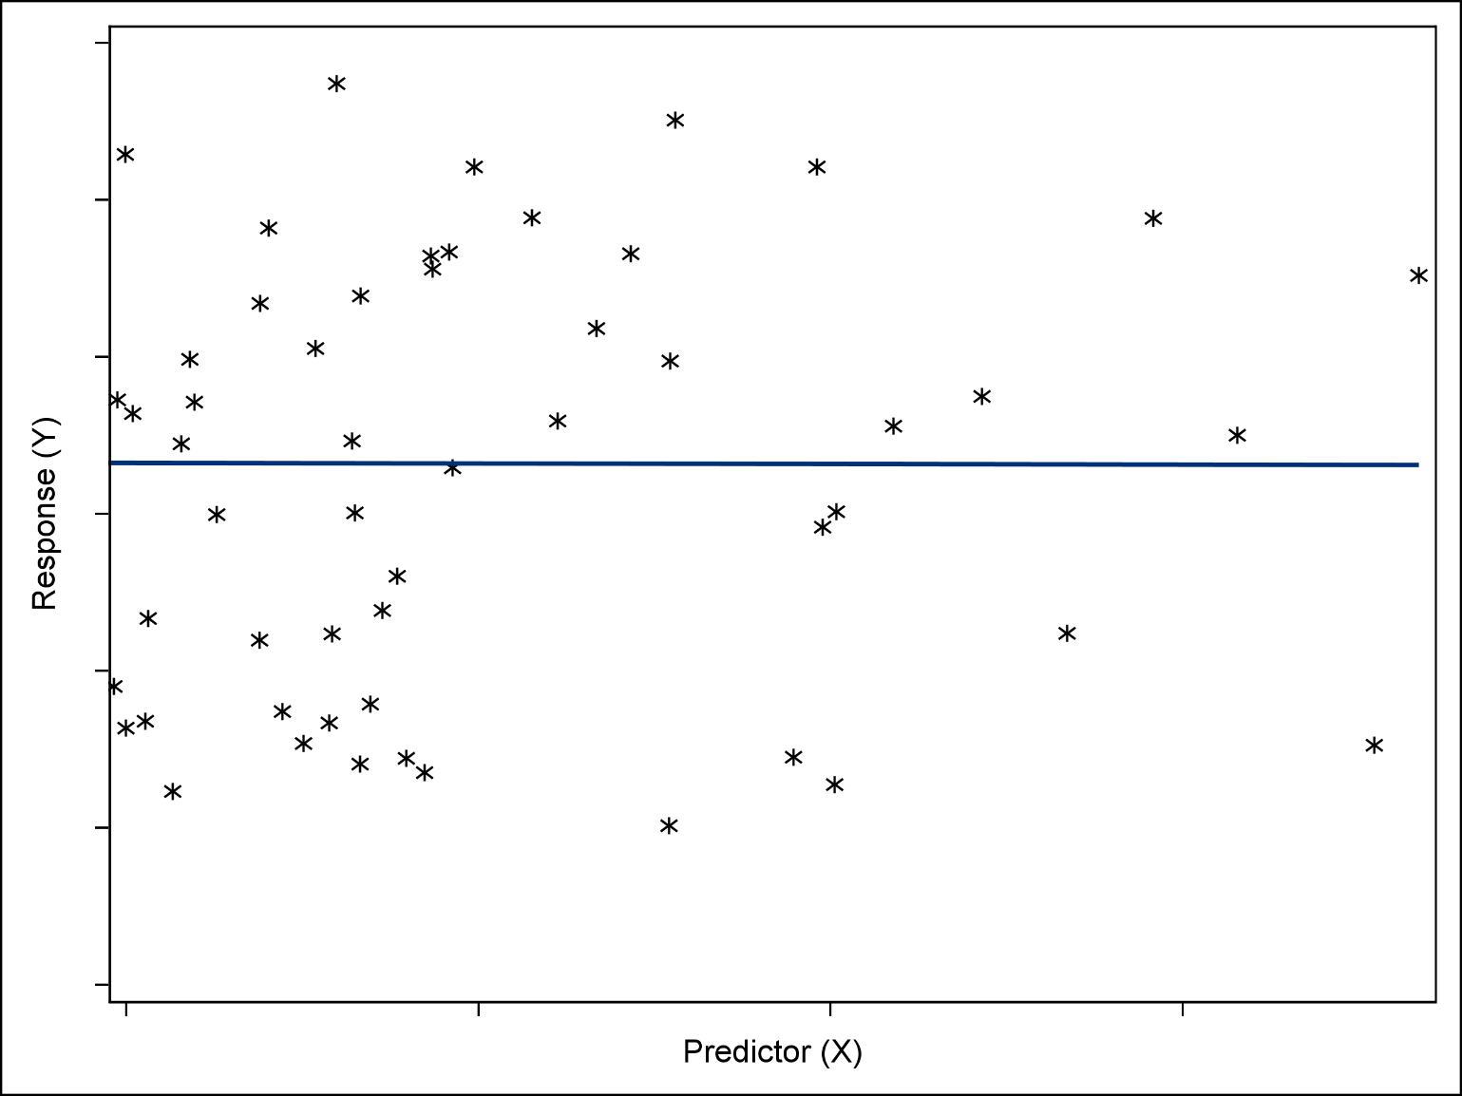
The Baseline (Null) Model
¯
Y

Slide 26
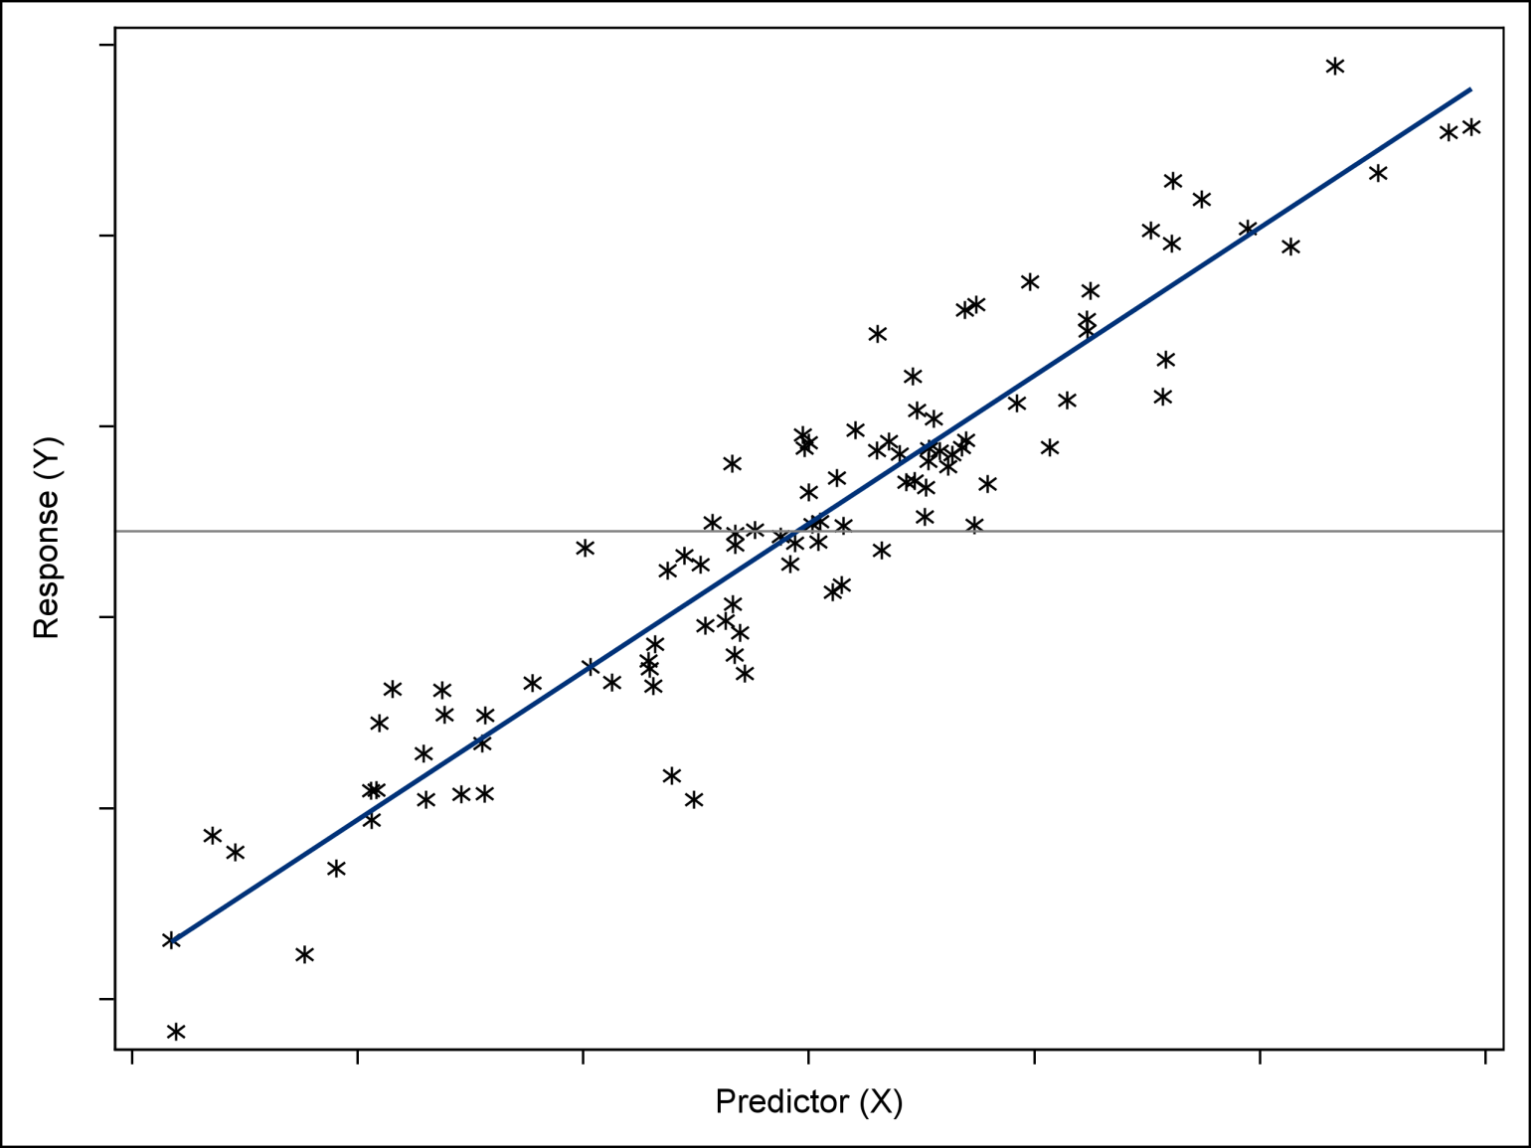
Explained versus Unexplained Variability
¯
Y
^
^
^
Y = β₀ + β₁X
*

Slide 27
SST = SSR + SSE

Slide 28
Linear Regression with Proc Reg

Slide 29
title "Height and FEV in 12 boys, 10-15 years old";
data fev1ht;
input height fev @@;
label fev="Forced Expiratory Volume (liters)"
height="Height (cm)";
datalines;
134 1.7 158 2.7 138 1.9 162 3.0 150 2.2 174 3.8
142 2.0 166 3.1 146 2.1 170 3.4 154 2.5 178 3.9
;
proc sql;
select *
from fev1ht
order by height
;
quit;
title;

Slide 30
proc sgplot data=fev1ht;
scatter y=fev x=height;
run;

Slide 31
title "Height and FEV in 12 boys, 10-15 years old";
proc sgplot data=fev1ht;
scatter y=fev x=height/
markerattrs=(color=blue symbol=CircleFilled size=10);
reg y=fev x=height;
xaxis LABELATTRS=(Color=Black Family=Arial Size=12
Style=Italic Weight=Bold) valueattrs=(size=10pt weight=bold);
yaxis LABELATTRS=(Color=Black Family=Arial Size=12
Style=Italic Weight=Bold) valueattrs=(size=10pt weight=bold);
run;
title;

Slide 33
proc reg data=fev1ht plots=none;
model fev=height;
quit;

Slide 34
proc reg data=fev1ht noprint outest=betas;
model fev=height;
quit;
proc sql;
select mean(fev) into : mnfev
from fev1ht;
select intercept,height into : a, : b
from betas;
quit;
%put &mnfev &a &b;

Slide 35
data tmp (keep=totalssq modelssq errorssq);
set fev1ht end=eod;
fevhat=&a+&b*height;/*predicted FEV*/
fevresid=fev-fevhat;/* residual FEV*/
residsq=fevresid**2;
errorssq+residsq;
totalssq+(fev-&mnfev)**2;
if eod then do;
modelssq=totalssq-errorssq;
output;
Aend;
run;
proc print data=tmp;
run;

