Slide 1
The Logistic Function

Slide 2
The logistic function.

Slide 3
Graph the function
data logistic;
do z=-8 to 8 by .25;
fz=1/(1+exp(-z));
output;
end;
run;
proc sgplot data=logistic;
series x=z y=fz/lineattrs=(color=red thickness=2);
xaxis values=(-8 to 8 by 1) grid;
yaxis values=(0 to 1 by .1) grid;
run;

Slide 4
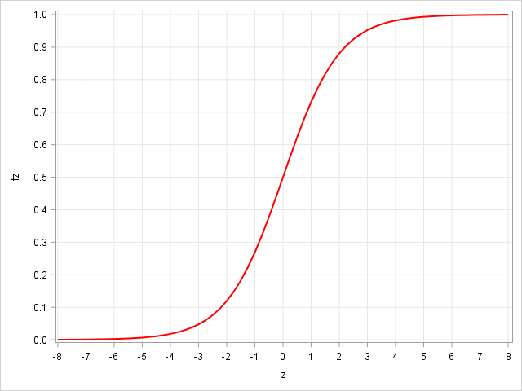

Slide 6
%let b0=-6;
%let b1=.10;
data logistic;
do x=0 to 125;
prob=exp(&b0+&b1*x)/(1+exp(&b0+&b1*x));
logit=log(prob/(1-prob));
output;
end;
run;
proc sgplot data=logistic;
series x=x y=prob;
refline 0 .5 1 /axis=y;
run;

Slide 7
%let b0=6;
%let b1=-.10;
data logistic;
do x=0 to 125;
prob=exp(&b0+&b1*x)/(1+exp(&b0+&b1*x));
logit=log(prob/(1-prob));
output;
end;
run;
proc sgplot data=logistic;
series x=x y=prob;
refline 0 .5 1 /axis=y;
run;

Slide 8
title;
%let b0=-2;
%let b1=0;
data logistic;
do x=0 to 125;
prob=exp(&b0+&b1*x)/(1+exp(&b0+&b1*x));
output;
end;
run;
proc sgplot data=logistic;
series x=x y=prob;
run;

