Slide 1
The logit transform

Slide 2
%let b0=-6;
%let b1=.10;
data logistic;
do x=0 to 125;
prob=exp(&b0+&b1*x)/(1+exp(&b0+&b1*x));
logit=log(prob/(1-prob));
output;
end;
run;
proc sgplot data=logistic;
series x=x y=logit;
run;

Slide 3
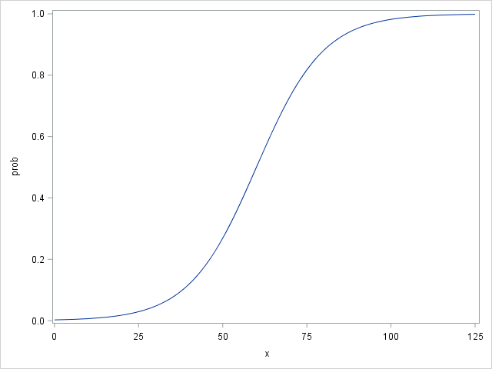
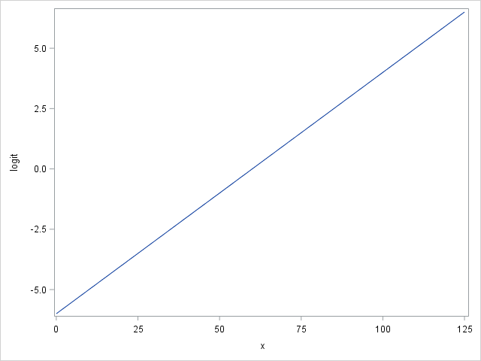
Logit
Transform

