Slide 1
Newton’s Method for finding the zero of a function.

Slide 2
Suppose we want to find the "zero" of some function
Make an initial "guess"
Improve this guess using known properties of the function.
Replace the initial guess with this improved approximation
Continue the process until we are satisfied with the answer

Slide 3
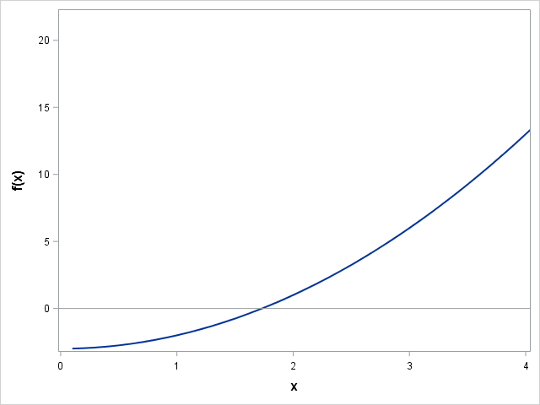

Slide 4
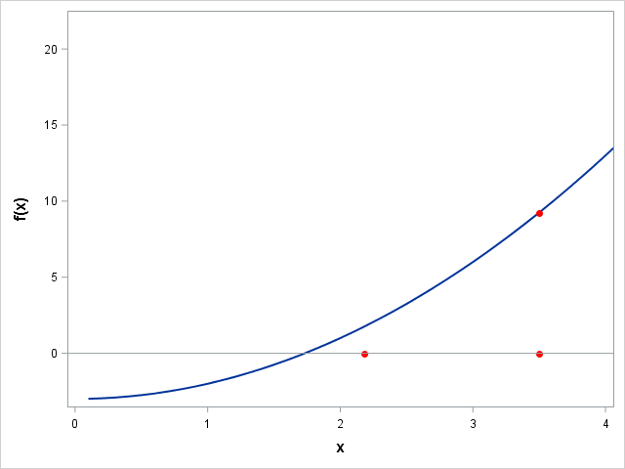

Slide 8
Two requirements of numerical approximations
What should be our initial value?
When should we stop the iterative process?

Slide 9
Newton’s method for finding the zero of a function. Example, finding the square root of 3.

Slide 10
/*simplest version, just do 100 iterations*/
data newton;
* do newton's method solution of x**2-3=0;
x =4; *starting value;
do iter=1 to 100;
fx=x**2-3; *function ;
fxpr=2*x; *derivative;
x1=x-fx/fxpr; *get new estimate;
output;
x=x1; * latest estimate before interation;
end;
proc print data=newton;run;

Slide 11
/*a slightly better version*/
data newton;
* do newton's method solution of x**2-3=0;
x =4; *starting value;
x1=0;
do iter=1 to 100 until (abs(diff) lt 1e-5);
fx=x**2-3; *function ;
fxpr=2*x; *derivative;
x1=x-fx/fxpr; *get new estimate;
output;
diff=x1-x;
x=x1; * latest estimate before interation;
end;
proc print data=newton;run;

Slide 12
/*a slightly better version*/
data newton;
* do newton's method solution of x**2-3=0;
x =4; *starting value;
do iter=1 to 100 until (abs(diff) lt 1e-5);
fx=x**2-3; *function ;
fxpr=2*x; *derivative;
x1=x-fx/fxpr; *get new estimate;
output;
diff=x1-x;
x=x1; * latest estimate before iteration;
end;
proc print data=newton;run;

Slide 13
/*alternative covergence criteria*/
data newton;
* do newton's method solution of x**2-3=0;
x =4; *starting value;
x1=0;
do iter=1 to 100 until (abs(fx) lt 1e-5);
fx=x**2-3; *function ;
fxpr=2*x; *derivative;
x1=x-fx/fxpr; *get new estimate;
output;
x=x1; * latest estimate before iteration;
end;
proc print data=newton;run;

Slide 14
/*a more general version*/
%let num=3;
%let init=4;
%let converge=1e-5;
data newton;
* do newton's method solution of x**2-num=0;
x =&init; *starting value;
do iter=1 to 100 until (abs(fx) lt &converge);
fx=x**2-&num; *function ;
fxpr=2*x; *derivative;
x1=x-fx/fxpr; *get new estimate;
output;
x=x1; * latest estimate before iteration;
end;
proc print data=newton;run;

Slide 15
Function with bad starting value (x=0)
data f;
do x=-2 to 2 by .1;
fx=x**3-2x+2;
output;
end;
label fx="f(x)" x="x";
run;
proc sgplot data=f;
series x=x y=fx/lineattrs=(thickness=3);
refline 0/axis=y;
run;

