Slide 1
Preprocessing, Part 2
Missing Data
Multi-collinearity
Complete Separation
Quasi-Complete Separation

Slide 2
Missing Data

Slide 3
The default method for treating missing values in most modeling software including SAS is complete-case analysis.
In complete-case analysis, only those cases without any missing values for any variables in the model.

Slide 4
How big a problem is missing data?

Slide 5
data expected;
do probmiss=.005 to .01 by .001;
do n=10,50,100,200;
exp=(1-probmiss)**n;
output;
end;
end;
label n="Number of Variables"
probmiss="Probability of Missing"
exp="Expected proportion, complete cases";
run;
proc sgplot data=expected;
series x=probmiss y=exp/group=n;
refline .25 .5 /axis=y;
run;
title;

Slide 6
Portions Copyright © 2001 SAS Institute Inc., Cary, NC, USA. All Rights Reserved. Reproduced with permission of SAS Institute Inc., Cary, NC, USA. SAS Institute Inc. makes no warranties with respect to these materials and disclaims all liability therefor.

Slide 7
The problem with complete-case analysis is scoring new cases.

Slide 8
New Missing Values – The problem of “scoreability”.
Fitted Model:
New Case:
Predicted Value:

Slide 9
Imputation -- possibilities
Mean or Median Substitution
Mean or Median Substitution – Stratified
Natural groups
Statistically Formed Groups (clusters)
Regression
Multiple Imputation (PROC MI)

Slide 10
A simple strategy for continuous predictors.
Create missing indicators and treat them as new input variables in the analysis.
Use median imputation (perhaps stratified) for numeric inputs. Fill the missing value of x_{j} with the median of the complete cases for that variable.

Slide 11
Some caveats
If a very large percentage of values are missing (>50%) -- omit it from the analysis.
If a very small percentage of the values are missing (<1%), then the missing indicator is of little value.

Slide 12
This strategy satisfies two of the most important considerations in predictive modeling: efficient scorability and capturing the relationship of missingness with the target.
A new case is easily scored; first replace the missing values with the medians from the development data and then apply the prediction model.

Slide 13
A simple strategy for categorical predictors.
If a reasonable number of unknowns, create a new level representing missing (unknown).
If a small number of unknowns:
delete observations
assign most likely category
assign randomly to categories

Slide 14
Some notes (from a SAS document on predictive modeling)
There is a large statistical literature concerning different missing value imputation methods, including discussions of the demerits of mean and median imputation and missing indicators (Donner 1982, Jones 1997).
Most of the advice is based on considerations that are peripheral to predictive modeling.

Slide 15
Missing values in chd2018_a

Slide 16
%clearall
proc sql;
select name into : varnames separated by " "
from dictionary.columns
where memname="CHD2018_A" and
libname="A"
;
quit;
%put &varnames;
data pcmissing;
set a.chd2018_a;
array x{*} &varnames;
do i=1 to dim(x);
nummiss=nmiss(of x{*});
end;
run;
proc freq data=pcmissing;
tables nummiss;
run;

Slide 17
%clearall
proc sql;
select name into : varnames separated by " "
from dictionary.columns
where memname="CHD2018_A" and
libname="A"
;
quit;
%put &varnames;
proc means data=a.chd2018_a noprint;
var &varnames;
output out=pcmissing(drop=_type_) nmiss=;
run;
data pcmissing(drop=i);
set pcmissing;
array x{*} &varnames;
do i=1 to dim(x);
x{i}=x{i}/_freq_*100;
end;
run;
proc print data=pcmissing noobs;
run;

Slide 19
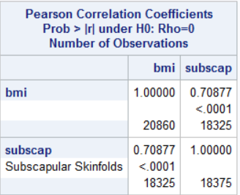
Subscapular skinfolds?
proc corr data=a.chd2018_a;
var bmi subscap;
run;
Not done in most clinical settings.

Slide 20
Add subscapular skinfold to the drop list and re-run.
%clearall;
libname a "d:\dropbox\chd2018\_data";
data a.chd2018_a (drop=c_chd c_diab gender c_smoking
sbp1-sbp3 dbp1-dbp3 weight height fvc
subscap);
set s5238.chd2018(rename=(chd=c_chd diab=c_diab smoking=c_smoking));
chd=c_chd="Developed Chd";
diab=c_diab="Diabetic";
select (c_smoking);
when ("Never Smoker") smoking=0;
when ("Past Smoker") smoking=1;
when ("Current Smok") smoking=2;
otherwise smoking=.;
end;
male=gender="Male";
sbp=mean(of sbp1-sbp3);
dbp=mean(of dbp1-dbp3);
bmi=(weight/height**2)*703;
fvcht=fvc/height;
run;
proc contents data=a.chd2018_a;
run;
proc means data=a.chd2018_a;
var fvcht;
run;

Slide 21
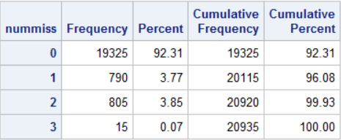
%clearall
proc sql;
select name into : varnames separated by " "
from dictionary.columns
where memname="CHD2018_A" and
libname="A"
;
quit;
%put &varnames;
data pcmissing;
set a.chd2018_a;
array x{*} &varnames;
do i=1 to dim(x);
nummiss=nmiss(of x{*});
end;
run;
proc freq data=pcmissing;
tables nummiss;
run;

Slide 22
%clearall
proc sql;
select name into : varnames separated by " "
from dictionary.columns
where memname="CHD2018_A" and
libname="A"
;
quit;
%put &varnames;
proc means data=a.chd2018_a noprint;
var &varnames;
output out=pcmissing(drop=_type_) nmiss=;
run;
data pcmissing(drop=i);
set pcmissing;
array x{*} &varnames;
do i=1 to dim(x);
x{i}=x{i}/_freq_*100;
end;
run;
proc print data=pcmissing noobs;
run;

Slide 23
%clearall;
data tmp;
set a.chd2018_a(keep=male chd chol hematocrit);
hem_miss=hematocrit=.;
chol_miss=chol=.;
run;
proc freq data=tmp;
tables male*(hem_miss chol_miss)/chisq nocol nopercent;
run;

Slide 24
Add missing indicators for chol and hematocrit.
data a.chd2018_a;
set a.chd2018_a;
mi_chol=chol=.;
mi_hem=hematocrit=.;
run;
proc means data=a.chd2018_a;
run;

Slide 25
Median Imputation by Gender
proc sort data=a.chd2018_a;
by male;
run;
proc stdize data=a.chd2018_a method=median reponly out=a.chd2018_a;
by male;
var pulse chol hematocrit bmi fvcht;
run;
proc means data=a.chd2018_a;
run;

Slide 26
Make sure these steps are on the creation program.
%clearall;
libname a "d:\dropbox\chd2018\_data";
data a.chd2018_a (drop=c_chd c_diab gender c_smoking
sbp1-sbp3 dbp1-dbp3 weight height fvc
subscap);
set s5238.chd2018(rename=(chd=c_chd diab=c_diab smoking=c_smoking));
chd=c_chd="Developed Chd";
diab=c_diab="Diabetic";
select (c_smoking);
when ("Never Smoker") smoking=0;
when ("Past Smoker") smoking=1;
when ("Current Smok") smoking=2;
otherwise smoking=.;
end;
male=gender="Male";
sbp=mean(of sbp1-sbp3);
dbp=mean(of dbp1-dbp3);
bmi=(weight/height**2)*703;
fvcht=fvc/height;
run;
/*add indicators for missingness*/
data a.chd2018_a;
set a.chd2018_a;
mi_chol=chol=.;
mi_hem=hematocrit=.;
run;
/*do median imputation by gender*/
proc sort data=a.chd2018_a;
by male;
run;
proc stdize data=a.chd2018_a method=median reponly out=a.chd2018_a;
by male;
var pulse chol hematocrit bmi fvcht;
run;
proc means data=a.chd2018_a;
run;

Slide 27
A closer look at smoking

Slide 28
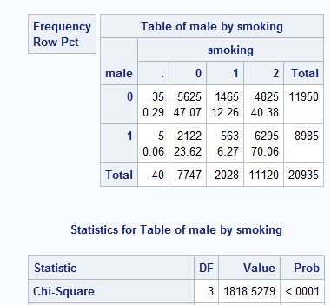
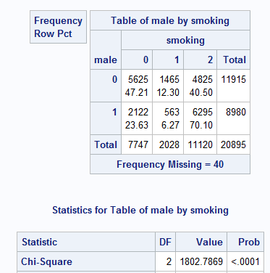
Missing smoking by gender.
proc freq data=a.chd2018_a;
tables male*smoking/missing nocol nopercent chisq;
run;

Slide 29
%clearall
data table;
call streaminit(765731);
do i=1 to 100000;
x1=rand("table",.472,.123)-1;/*female*/
x2=rand("table",.236,.0627)-1;/*male*/
output;
end;
run;
proc freq data=table;
tables x1 x2;
run;

Slide 30
Randomly assign smoking status when missing.
%clearall
data a.chd2018_a;
set a.chd2018_a;
if not male and smoking=. then smoking=rand("table",.472,.123)-1;/*female*/
else if male and smoking=. then smoking=rand("table",.236,.0627)-1;/*male*/
run;
proc freq data=a.chd2018_a;
tables male*smoking/nocol nopercent;
run;
proc means data=a.chd2018_a;
run;

Slide 31
Make sure this step is on the creation program.
%clearall;
libname a "d:\dropbox\chd2018\_data";
data a.chd2018_a (drop=c_chd c_diab gender c_smoking
sbp1-sbp3 dbp1-dbp3 weight height fvc
subscap);
set s5238.chd2018(rename=(chd=c_chd diab=c_diab smoking=c_smoking));
chd=c_chd="Developed Chd";
diab=c_diab="Diabetic";
select (c_smoking);
when ("Never Smoker") smoking=0;
when ("Past Smoker") smoking=1;
when ("Current Smok") smoking=2;
otherwise smoking=.;
end;
male=gender="Male";
sbp=mean(of sbp1-sbp3);
dbp=mean(of dbp1-dbp3);
bmi=(weight/height**2)*703;
fvcht=fvc/height;
run;
/*add indicators for missingness*/
data a.chd2018_a;
set a.chd2018_a;
mi_chol=chol=.;
mi_hem=hematocrit=.;
run;
/*do median imputation by gender*/
proc sort data=a.chd2018_a;
by male;
run;
proc stdize data=a.chd2018_a method=median reponly out=a.chd2018_a;
by male;
var pulse chol hematocrit bmi fvcht;
run;
/*randomly distribute unknown smoking status*/
data a.chd2018_a;
set a.chd2018_a;
if not male and smoking=. then smoking=rand("table",.472,.123)-1;/*female*/
else if male and smoking=. then smoking=rand("table",.236,.0627)-1;/*male*/
run;

