Slide 1
Categorical Data, Combining Cells

Slide 2
Combining cells. Based on subject matter.

Slide 3
proc freq data=a.chd2018_a;
tables smoking*chd/nocol nopercent chisq;
run;
Tobacco Control: Reversal of Risk After Quitting Smoking (IARC Handbooks of Cancer Prevention in Tobacco Control) 1st Edition

Slide 4
Combining Categories, Greenacre’s Method

Slide 5
Ideally, subject-matter considerations should be used to collapse levels (reduce the dimension) of categorical inputs. This is not always practical in predictive modeling.
A simple data-driven method for collapsing levels of contingency tables was developed by Greenacre (1988, 1993). The levels (rows) are hierarchically clustered based on the reduction in the chi-squared test of association between the categorical variable and the target.

Slide 6
At each step, the two levels that give the least reduction in the chi-squared statistic are merged. The process is continued until the reduction in chi-squared drops below some threshold (for example, 99%).
This method will quickly throw rare categories in with other categories that have similar marginal response rates. While this method is simple and effective, there is a potential loss of information because only univariate associations are considered.

Slide 7
%clearall
proc freq data=a.chd2018_a;
tables smoking*chd/nocol nopercent chisq;
run;
data tmp;
set a.chd2018_a;
currsmok=smoking=2;
currpast=smoking ne 0;
currnever=smoking ne 1;
run;
proc freq data=tmp;
tables currsmok*chd currpast*chd
currnever*chd/nocol nopercent chisq;
run;

Slide 8
%clearall
data a.chd2018_a(drop=smoking);
set a.chd2018_a;
currsmok=smoking=2;
run;

Slide 9
%clearall;
libname a "d:\dropbox\chd2018\_data";
data a.chd2018_a (drop=c_chd c_diab gender c_smoking
sbp1-sbp3 dbp1-dbp3 weight height fvc
subscap);
set s5238.chd2018(rename=(chd=c_chd diab=c_diab smoking=c_smoking));
chd=c_chd="Developed Chd";
diab=c_diab="Diabetic";
select (c_smoking);
when ("Never Smoker") smoking=0;
when ("Past Smoker") smoking=1;
when ("Current Smok") smoking=2;
otherwise smoking=.;
end;
male=gender="Male";
sbp=mean(of sbp1-sbp3);
dbp=mean(of dbp1-dbp3);
bmi=(weight/height**2)*703;
fvcht=fvc/height;
run;
/*add indicators for missingness*/
data a.chd2018_a;
set a.chd2018_a;
mi_chol=chol=.;
mi_hem=hematocrit=.;
run;
/*do median imputation by gender*/
proc sort data=a.chd2018_a;
by male;
run;
proc stdize data=a.chd2018_a method=median reponly out=a.chd2018_a;
by male;
var pulse chol hematocrit bmi fvcht;
run;
/*randomly distribute unknown smoking status*/
data a.chd2018_a;
set a.chd2018_a;
if not male and smoking=. then smoking=rand("table",.472,.123)-1;/*female*/
else if male and smoking=. then smoking=rand("table",.236,.0627)-1;/*male*/
run;
/*combine past and never smokers*/
%clearall
data a.chd2018_a(drop=smoking);
set a.chd2018_a;
currsmok=smoking=2;
run;
proc means data=a.chd2018_a;
run;

Slide 10
Combining cells, quasi-complete separation.

Slide 11
Quasi-Complete Separation
0
1
D_{A}
D_{B}
D_{c}
D_{D}
A
28
7
1
0
0
0
0
1
0
0
0
0
1
0
0
0
0
1
B
16
0
C
94
11
D
23
21

Slide 12
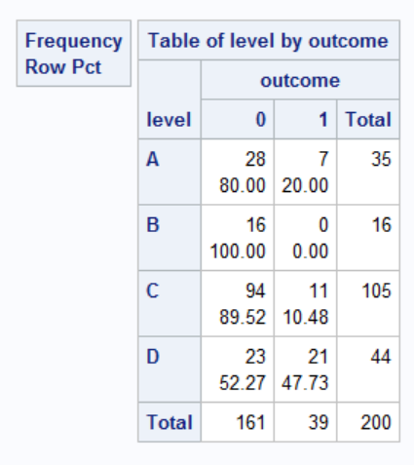
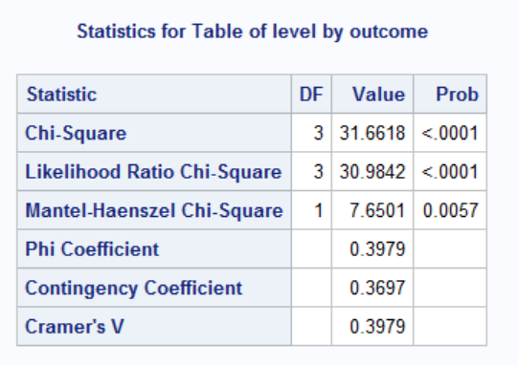
data cluster;
input level $ outcome num @@;
datalines;
A 0 28 B 0 16 C 0 94 D 0 23
A 1 7 B 1 0 C 1 11 D 1 21
;
proc freq data=cluster;
tables level*outcome/nocol nopercent chisq;
weight num;
run;

Slide 13
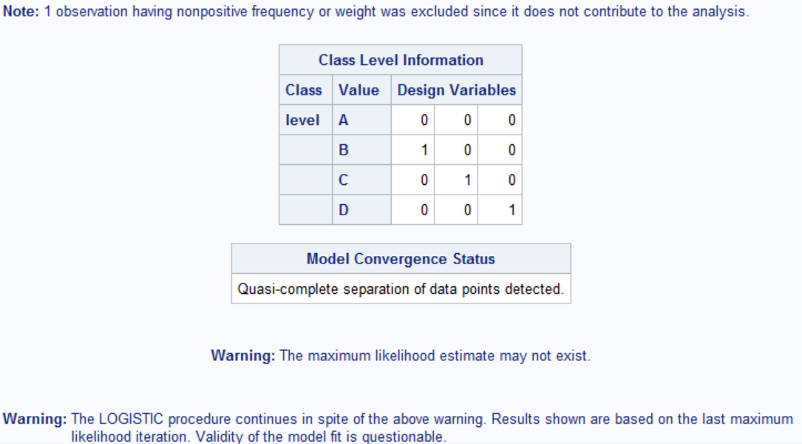
proc logistic;
class level(param=ref ref="A");
model outcome=level;
freq num;
run;

Slide 14
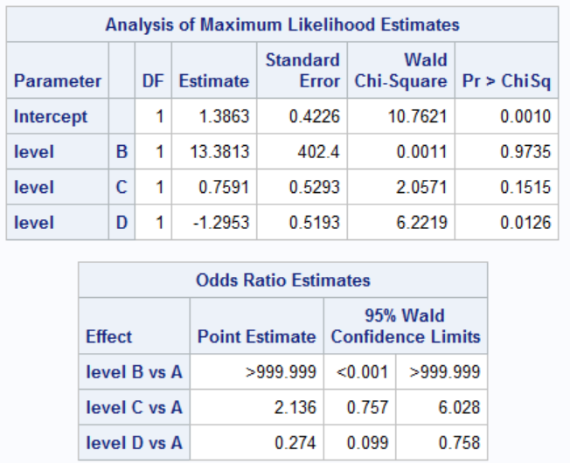

Slide 15
Clustering Levels
0
1
A
28
7
B
16
0
C
94
11
D
23
21
Merged:
χ² =
31.7
100%
...

Slide 16
%let m1=A;
%let m2=B;
data new;
set cluster;
if level="&m1" or Level="&m2" then newlevel="&m1.+&m2";
else newlevel=level;
proc freq data=new;
tables newlevel*outcome/norow nocol nopercent chisq;
weight num;
run;

Slide 17
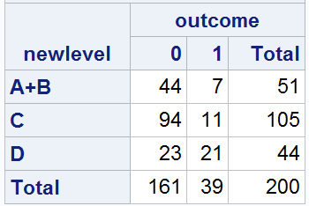
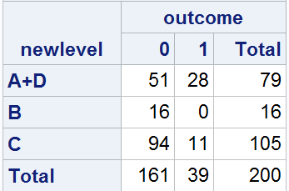
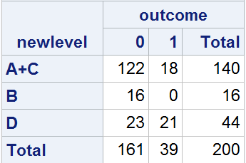
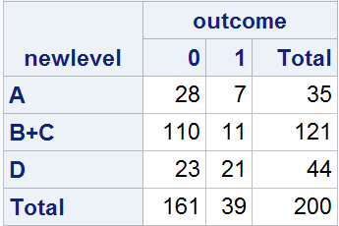

Slide 18
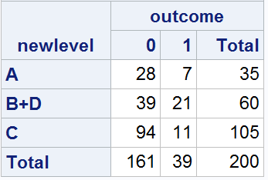
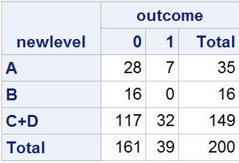

Slide 19
Clustering Levels
0
1
0
1
A
28
7
28
7
B
16
0
110
11
C
94
11
23
21
D
23
21
Merged:
B & C
χ² =
31.7
30.7
100%
97%
...

Slide 20
Clustering Levels
0
1
0
1
A
28
7
0
1
28
7
B
16
0
138
18
110
11
C
94
11
23
21
23
21
D
23
21
Merged:
B & C
A & BC
χ² =
31.7
30.7
28.6
100%
97%
90%
...

Slide 21
Clustering Levels
0
1
0
1
A
28
7
0
1
28
7
0
1
B
16
0
138
18
110
11
161
39
C
94
11
23
21
23
21
D
23
21
Merged:
B & C
A & BC
ABC & D
χ² =
31.7
30.7
28.6
0
100%
97%
90%
0%

Slide 22
Clustering Levels of Categorical Inputs with Proc Cluster
The levels of a categorical input can be clustered using Greenacre’s method (1988, 1993) in PROC CLUSTER.
PROC CLUSTER was designed for general clustering applications, but with some simple pre-processing of the data, it can be made to cluster levels of categorical variables.
Notes:
This demonstration illustrates using the FREQ statement and METHOD=WARD in PROC CLUSTER to perform level clustering. Much of the work is automatic when using the Output Delivery System.

