Slide 1
Multivariate Logistic Model

Slide 5
Normal equations, univariate

Slide 6
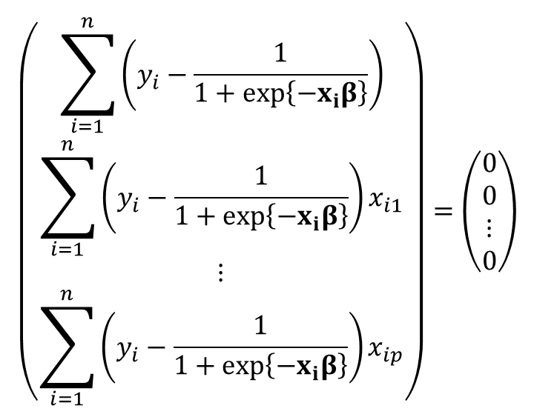
Normal equations, multivariate case.
$$\begin{matrix} \\ \left(\begin{matrix}\sum_{i=1}^{n}{\left(y_{i}−\frac{1}{1+exp\left\{−x_{i}β\right\}}\right)} \\ \sum_{i=1}^{n}{\left(y_{i}−\frac{1}{1+exp\left\{−x_{i}β\right\}}\right)x_{i1}} \\ ⋮ \\ \sum_{i=1}^{n}{\left(y_{i}−\frac{1}{1+exp\left\{−x_{i}β\right\}}\right)x_{ip}}\end{matrix}\right)=\left(\begin{matrix}0 \\ 0 \\ ⋮ \\ 0\end{matrix}\right)\end{matrix}$$

Slide 7
Specifying multivariate model, PROC LOGISTIC
%clearall
proc logistic data=a.chd2018_a descending;
model chd=age sbp chol currsmok;
run;

Slide 8
A few things

Slide 9
Confounding, an example.

Slide 10
ods select parameterestimates;
proc logistic data=a.chd2018_a;
model chd10yr(event="1")=sbp;
run;
ods select parameterestimates;
proc logistic data=a.chd2018_a;
model chd10yr(event="1")=age;
run;

Slide 11
ods select statistics ttests;
proc ttest data=a.chd2018_a nobyvar;
class chd;
var age sbp;
run;
proc corr data=a.chd2018_a nosimple;
var age sbp;
run;

Slide 12
ods select parameterestimates;
proc logistic data=a.chd2018_a;
model chd10yr(event="1")=sbp;
run;
ods select parameterestimates;
proc logistic data=a.chd2018_a;
model chd10yr(event="1")=age;
run;
ods select parameterestimates;
proc logistic data=a.chd2018_a;
model chd10yr(event="1")=age sbp;
run;

Slide 13
Likelihood Ratio Test.

Slide 14
Global test

Slide 15
%clearall
proc logistic data=a.chd2018_a descending;
model chd=age sbp chol currsmok;
run;

Slide 16
Test a subset of r (<p) parameters.

Slide 17
%clearall
ods select fitstatistics;
proc logistic data=a.chd2018_a descending;
model chd=age sbp chol currsmok;
run;
ods select fitstatistics;
proc logistic data=a.chd2018_a descending;
model chd=age sbp ;
run;

Slide 18
%macro CalcLR(indat=,full=,reduced=,depvar=,event=);
/*call to a macro that assures no unknowns*/
%completecase(indat=&indat,vars=&depvar &full)
/*call a macro that turns of displaying output*/
%odsoff
/*now do logistics and get fit statistics.*/
ods output fitstatistics=reduced(where=(criterion="-2 Log L"));
proc logistic data=&indat;
model &depvar (event="&event")=&reduced;
run;
/*use sql to put deviance into macro variable reduced_lr*/
proc sql;
select InterceptAndCovariates into : reduced_lr
from reduced
;
quit;
%put Reduced: &reduced_lr;
/*repeat the analyis for the full model*/
ods output fitstatistics=full(where=(criterion="-2 Log L"));
proc logistic data=&indat;
model &depvar (event="&event")=&full;
run;
/*use sql to put deviance into macro variable full_lr*/
proc sql;
select InterceptAndCovariates into : full_lr
from full
;
quit;
/*create a data set containing the likelihood ratio statistic*/
data likelihoodratio;
full=&full_lr;
reduced=&reduced_lr;
likelihood_ratio=reduced-full;
run;
/*macro to turn on displaying resultes*/
%odson
title "Likelihood Ratio";
title2 "full model: &full";
title3 "reduced model: &reduced";
proc print data=likelihoodratio;
run;
title;
%mend CalcLR;

Slide 19
PROC GENMOD
%clearall
ods select parameterestimates type1;
proc genmod data=a.chd2018_a descending;
model chd=age sbp chol currsmok/link=logit type1;
run;

Slide 20
Confidence intervals

Slide 21
Confidence Intervals
The only thing that changes is the interpretation
%clearall
ods select parameterestimates CLparmWald;
proc logistic data=a.chd2018_a descending;
model chd=age sbp chol currsmok/clparm=wald;
run;

Slide 22
Odds Ratios
The only thing that changes is the interpretation
%clearall
ods select parameterestimates CLparmWald oddsratios;
proc logistic data=a.chd2018_a descending;
model chd=age sbp chol currsmok/clparm=wald;
run;

Slide 23
Units
Just list multiple independent variables.
%clearall
proc logistic data=a.chd2018_a descending;
model chd=age sbp chol currsmok;
units age=1 5 sd sbp =1 sd;
run;

