Slide 1
Model Development – Variable Screening

Slide 2
Variable Screening – AKA Dimension Reduction
A more or less universally accepted principle:
Principle of Parsimony

Slide 3
Variable screening – Univariate examination of candidate main effects.

Slide 4
A quick look at where we are – chd2018_a

Slide 5
proc contents data=a.chd2018_a position;
run;

Slide 6
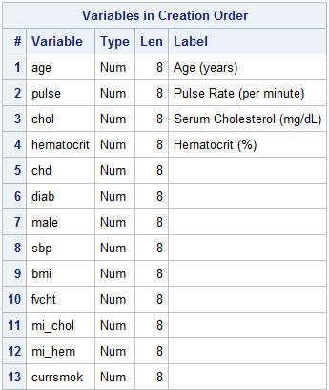

Slide 7
proc freq data=a.chd2018_a nlevels;
tables age--currsmok/noprint;
run;

Slide 8
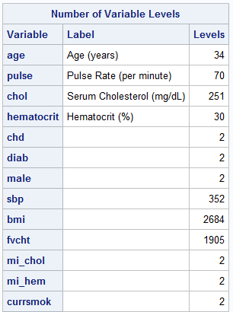
Continuous
Target
Categorical
All categorical variables are coded 0,1

Slide 9
t-tests
/*a quick screen -- ttests*/
%let target=chd;
%let continuous=age pulse chol hematocrit fvcht sbp bmi;
%let categorical=diab male mi_chol mi_hem currsmok;
ods select ttests;
proc ttest data=a.chd2018_a nobyvar plots=none;
class &target;
var &continuous &categorical;
run;

Slide 10
Correlation

Slide 11
Pearson – detects linearity

Slide 12
Spearman – Pearson correlation of ranks. Less sensitive to nonlinearities and outliers than the Pearson

Slide 13
Hoeffding’s D detects a wide variety of associations between two variables.

Slide 14
/* another quick screen*/
%let target=chd;
%let continuous=age pulse chol hematocrit fvcht sbp bmi;
%let categorical=diab male mi_chol mi_hem currsmok;
proc corr data=a.chd2018_a spearman hoeffding;
var &target;
with &continuous &categorical;
run;

Slide 15
Univariate logistics

Slide 16
/* another quick screen
univariate models
(partial)*/
%clearall
ods select parameterestimates;
proc logistic data=a.chd2018_a descending;
model chd=age;
run;
ods select parameterestimates;
proc logistic data=a.chd2018_a descending;
model chd=pulse;
run;
ods select parameterestimates;
proc logistic data=a.chd2018_a descending;
model chd=chol;
run;
ods select parameterestimates;
proc logistic data=a.chd2018_a descending;
model chd=hematocrit;
run;

Slide 17
%macro all_univ_betas(data=,
depvar=,
event=,
indepvars=);
%let numvars=%sysfunc(countw(&indepvars));
%put "Number of variables: " &numvars;
%do i=1 %to &numvars;
%let univ=%scan(&indepvars,&i);/*get ith variable*/
proc logistic data=&data;
ods select parameterestimates;
model &depvar(event="&event")=&univ;
run;
%end;
%mend;

Slide 18
%clearall
%let target=chd;
%let continuous=age pulse chol hematocrit fvcht sbp bmi;
%let categorical=diab male mi_chol mi_hem currsmok;
options mprint;
%all_univ_betas(data=a.chd2018_a,
depvar=chd,
event=1,
indepvars=&continuous &categorical)
options nomprint;

Slide 19
Logit Plots(?)

Slide 20
A simple macro
%macro all_logit_plots(data=,
depvar=,
indepvars=);
%let numvars=%sysfunc(countw(&indepvars));
%put "Number of variables: " &numvars;
%do i=1 %to &numvars;
%let univ=%scan(&indepvars,&i);/*get ith variable*/
%PlotLogits(indata=&data,numgrp=10,
indepvar=&univ,depvar=&depvar);
%end;
%mend;

Slide 21
%clearall
%let target=chd;
%let continuous=age pulse chol hematocrit fvcht sbp bmi;
%let categorical=diab male mi_chol mi_hem currsmok;
options mprint;
%all_logit_plots(data=a.chd2018_a,
depvar=chd,
indepvars=&continuous);
options nomprint;

Slide 22
A note on smoothers.

Slide 23
proc loess data=a.chd2018_a;
model chd=bmi/smooth=.25 .5 .75 1 1.25 1.5;
output out=smoothed predicted=phat;
run;
proc sort data=smoothed;
by smoothingparameter bmi;
run;
data smoothed;
set smoothed;
where 0<phat<1;
logit=log(phat/(1-phat));
proc sgplot data=smoothed;
series x=bmi y=logit/group=smoothingparameter
lineattrs=(thickness=3);
run;

Slide 24
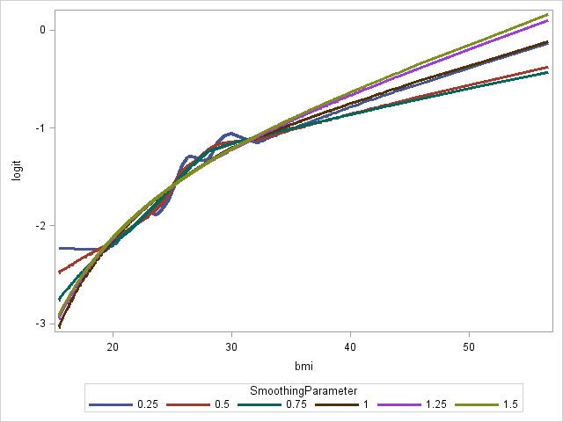

Slide 25
proc loess data=a.chd2018_a;
where bmi between 20 and 32;
model chd=bmi/smooth=.25 .5 .75 1 1.25 1.5;
output out=smoothed predicted=phat;
run;
proc sort data=smoothed;
by smoothingparameter bmi;
run;
data smoothed;
set smoothed;
where 0<phat<1;
logit=log(phat/(1-phat));
proc sgplot data=smoothed;
series x=bmi y=logit/group=smoothingparameter
lineattrs=(thickness=3);
run;

Slide 26
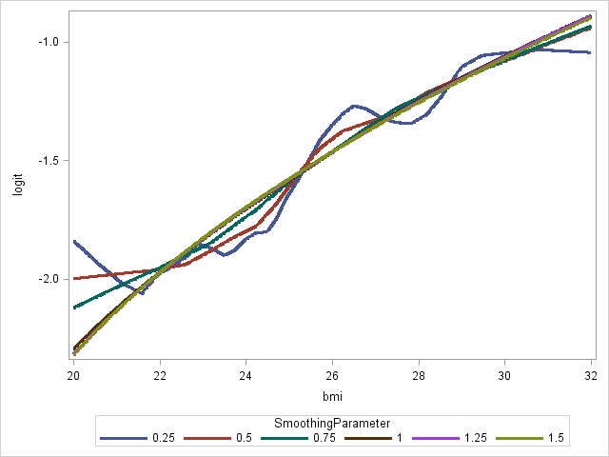

Slide 27
An easier to modify program.
%clearall
%let var=chol;
proc loess data=a.chd2018_a;
model chd=&var/smooth=.25 .5 .75 1 1.25 1.5;
output out=smoothed predicted=phat;
run;
proc sort data=smoothed;
by smoothingparameter &var;
run;
data smoothed;
set smoothed;
where 0<phat<1;
logit=log(phat/(1-phat));
proc sgplot data=smoothed;
series x=&var y=logit/group=smoothingparameter
lineattrs=(thickness=3);
run;

Slide 28
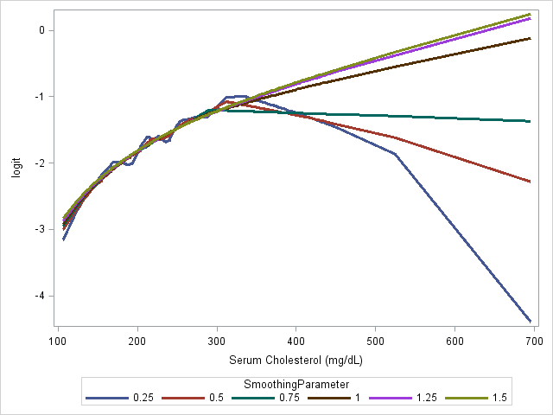

Slide 29
%clearall
%let var=fvcht;
proc loess data=a.chd2018_a;
model chd=&var/smooth=.25 .5 .75 1 1.25 1.5;
output out=smoothed predicted=phat;
run;
proc sort data=smoothed;
by smoothingparameter &var;
run;
data smoothed;
set smoothed;
where 0<phat<1;
logit=log(phat/(1-phat));
proc sgplot data=smoothed;
series x=&var y=logit/group=smoothingparameter
lineattrs=(thickness=3);
run;

Slide 30
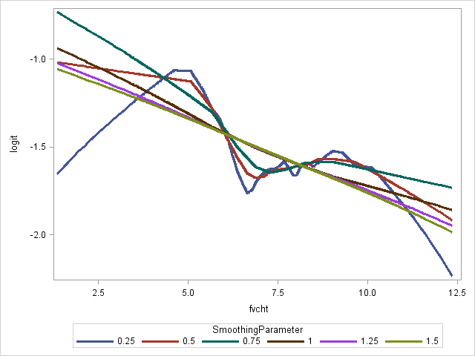

Slide 31
5
Variable Screening
Variable Clustering

Slide 32
Variable Clustering Example
title;
data simpcorr (type=CORR);
input _name_ $2. @4 _type_ $4. x1 x2 x3 x4 x5 x6;
datalines;
x1 CORR 1 -.11 -.03 -.69 -.04 .07
X2 CORR -.11 1 -.14 .07 .04 .73
X3 CORR -.03 -.14 1 .04 -.73 .09
X4 CORR -.69 .07 .04 1 .02 .07
X5 CORR -.04 .04 -.73 .02 1 .05
X6 CORR .07 .73 .09 .07 .05 1
;
run;
proc contents data=simpcorr;run;
proc print data=simpcorr;run;

Slide 33
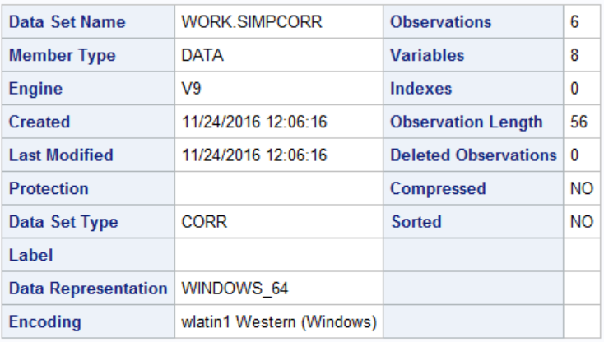

Slide 34
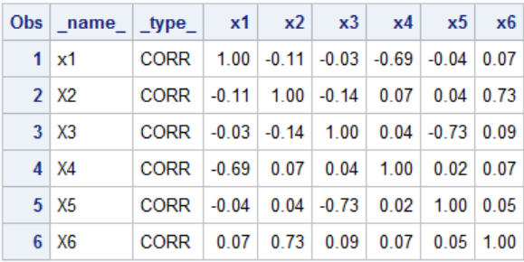
Notes:
In the example above, it seems that X₁ is correlated with X₄ and X₃ is correlated with X₅. The variable X₂ is correlated with no other variable. Therefore, there should be three variable clusters.

Slide 35
Variable Clustering
Variable clustering finds groups of variables that are as correlated as possible among themselves and as uncorrelated as possible with variables in other clusters.
The basic algorithm is binary and divisive. All variables start in one cluster. A principal components analysis is done on the variables in the cluster.

Slide 36
If the second eigenvalue is greater than a specified threshold (in other words, there is more than one dominant dimension), then the cluster is split.
The PC scores are then rotated obliquely so that the variables can be split into two groups. This process is repeated for the two child clusters until the second eigenvalue drops below the threshold.

Slide 37
The VARCLUS Procedure
PROC VARCLUS DATA=SAS-data-set <options>;
VAR variables;
RUN;
proc varclus data=simpcorr;run;
Notes:
MAXEIGEN=n specifies the largest permissible value of the second eigenvalue in each cluster. The default is 1 (using the correlation matrix).
SHORT suppresses printing of the cluster structure, scoring coefficient, and intercluster correlation matrices.
Selected VARCLUS procedure statement:
VAR specifies the variables to be clustered. If you do not specify the VAR statement, all numeric variables not listed in other statements are processed.

Slide 38
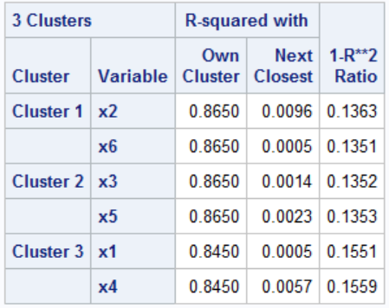

Slide 39
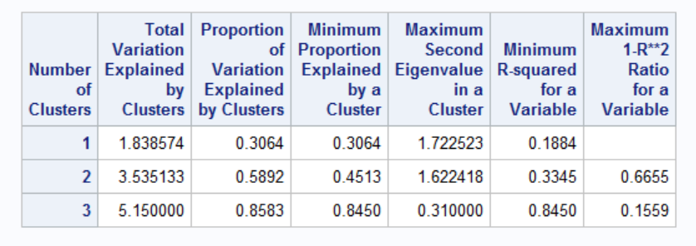

Slide 40
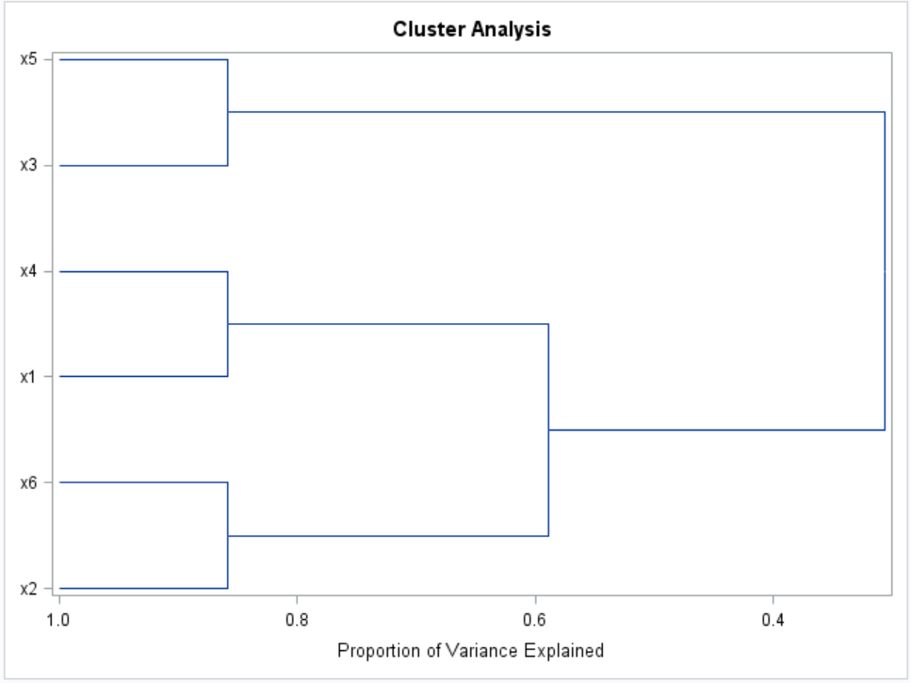

Slide 41
data bodym;
set nhanes3.bodymeasurements (drop=BMPWTFLG BMPHTFLG);
run;
proc contents data=bodym position;
run;
proc corr data=bodym;
var bm:;
run;

Slide 42
proc varclus data=bodym minclusters=3;
var bm:;
run;

Slide 43
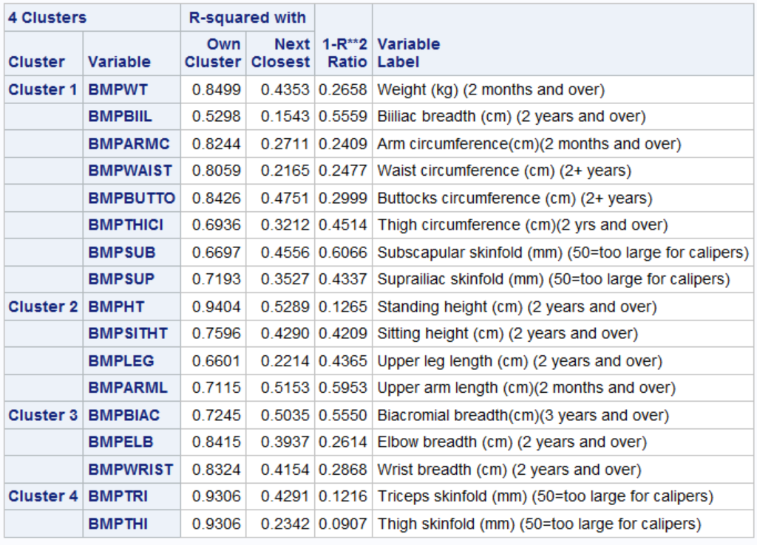

Slide 44
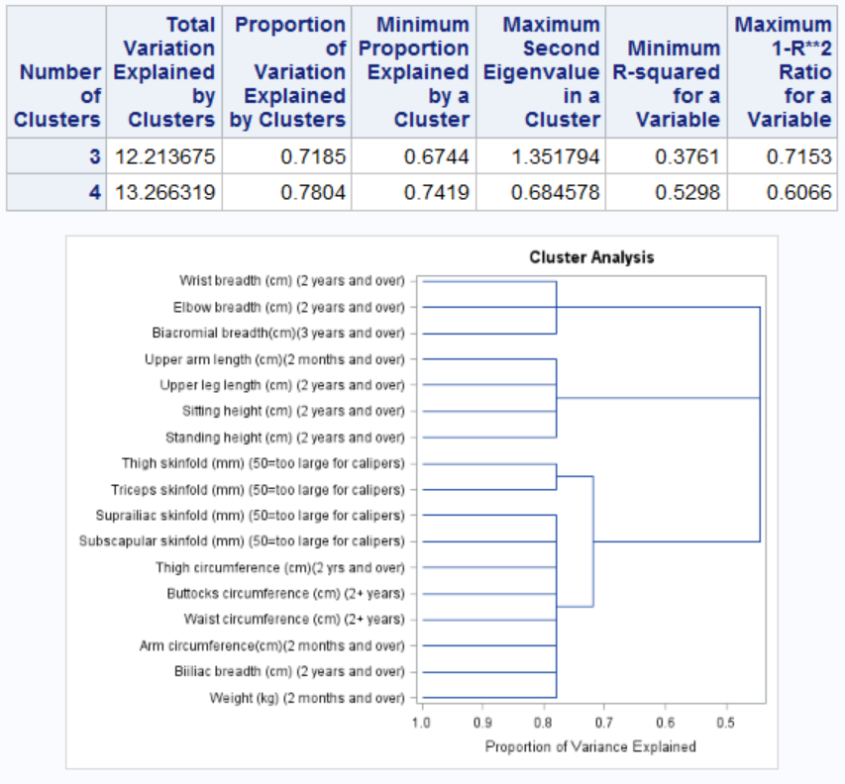

Slide 45
We formed clusters. What now?
Pick one variable from each cluster.
Principal components by cluster.

