Slide 1
Develop a main effects model.

Slide 2
1. Throw everything in.
2. Backward Stepwise.
3. Forward Stepwise.
4. All subsets.

Slide 3
Include all candidates and drop if p value too large.
1. Throw everything in.

Slide 4
%let target=chd;
%let continuous=age pulse chol hematocrit fvcht sbp bmi;
%let categorical=diab male mi_chol mi_hem currsmok;
/*throw everything in*/
ods select parameterestimates globaltests;
proc logistic data=a.chd2018_a descending;
/*since all categorical variables are 0,1
I don't need a class statement*/
model chd=&continuous &categorical;
run;

Slide 5
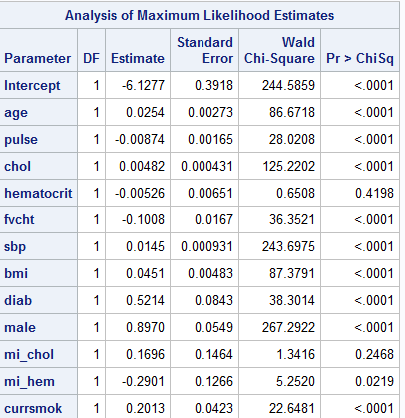

Slide 6
Probably, I’d also drop mi_hem, since the major reason for the missing indicators is scorability.
I might also drop pulse for a couple of reasons (more later)

Slide 7
/*drop hematocrit mi_chol mi_hem and re-run*/
%let target=chd;
%let continuous=age pulse chol fvcht sbp bmi;
%let categorical=diab male currsmok;
/*throw everything in*/
ods select parameterestimates globaltests;
proc logistic data=a.chd2018_a descending;
/*since all categorical variables are 0,1
I don't need a class statement*/
model chd=&continuous &categorical;
run;

Slide 8
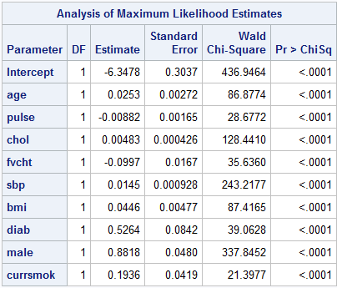
First Candidate Main Effects Model, based on “throw everything in.”

Slide 9
Backward Stepwise selection

Slide 10
%let target=chd;
%let continuous=age pulse chol hematocrit fvcht sbp bmi;
%let categorical=diab male mi_chol mi_hem currsmok;
ods select parameterestimates;
proc logistic data=a.chd2018_a descending;
model chd=&continuous &categorical/selection=backward;
run;

Slide 11
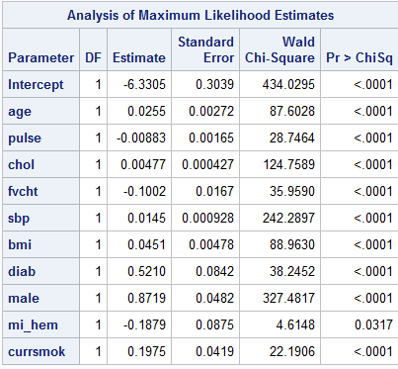
Second candidate main effects model.

Slide 12
Forward Stepwise Selection

Slide 13
%let target=chd;
%let continuous=age pulse chol hematocrit fvcht sbp bmi;
%let categorical=diab male mi_chol mi_hem currsmok;
ods select parameterestimates;
proc logistic data=a.chd2018_a descending;
model chd=&continuous &categorical/selection=forward;
run;

Slide 14
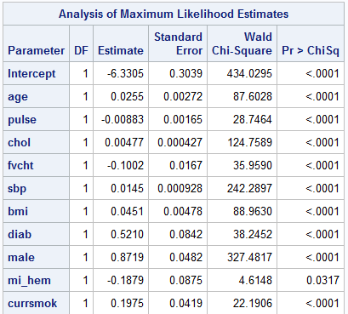
Third candidate main effects model.

Slide 15
Compare forward and backward
Backward
Forward

Slide 16
All subsets

Slide 17
All subsets
%let target=chd;
%let continuous=age pulse chol hematocrit fvcht sbp bmi;
%let categorical=diab male mi_chol mi_hem currsmok;
proc logistic data=a.chd2018_a descending;
model chd=&continuous &categorical/selection=score;
run;

Slide 18
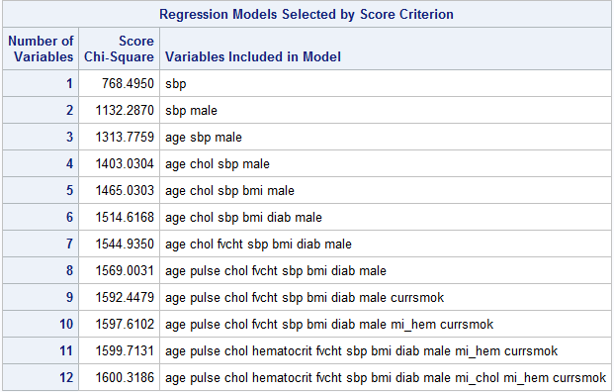

Slide 19
Final candidate main effects model, first try
%let target=chd;
%let continuous_1=age pulse chol fvcht sbp bmi;
%let categorical_1=diab male currsmok;
proc logistic data=a.chd2018_a descending;
ods select parameterestimates;
model chd=&continuous_1 &categorical_1;
run;

Slide 20
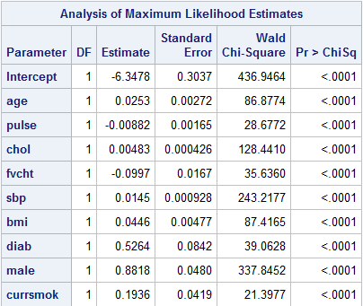
A closer look.
Negative Coefficient?

Slide 21
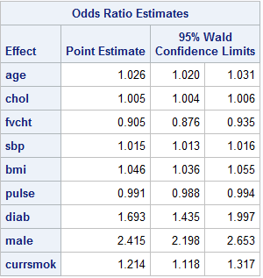
Trivial Odds Ratio

Slide 22
A logit plot
%PlotLogits(indata=a.chd2018_a,numgrp=10,
indepvar=pulse,depvar=chd);

Slide 23
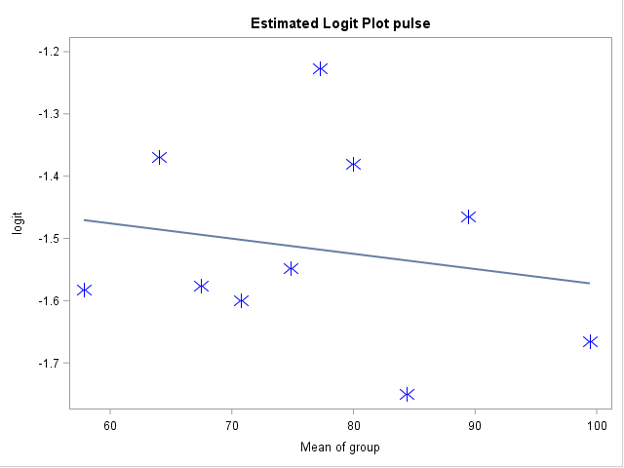
A logit plot

Slide 24
Final candidate main effects model
%let target=chd;
%let continuous_1=age chol fvcht sbp bmi;
%let categorical_1=diab male currsmok;
proc logistic data=a.chd2018_a descending;
ods select parameterestimates;
model chd=&continuous_1 &categorical_1;
run;

Slide 25
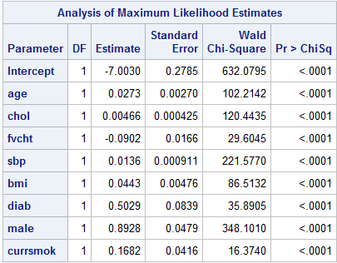
Final candidate main effects model

