Slide 1
Goodness of Fit
Divide data into g groups.
Estimate the k parameters of the distribution.
Use these parameter estimates to calculate the expected proportion in each group.
Use the expected proportion to calculate the expected number in each group (=(total observations in all groups)*(expected proportion in group))
Let O_{i} be the observed number in each group. and E_{i} the expected number in each group.

Slide 3
data bombhits;
input num numobs;/*num=5=five or more*/
datalines;
0 229
1 211
2 93
3 35
4 7
5 1
;
run;
proc print data=bombhits;
run;
/*note there were 537 total hits*/
%let mnhits= 0.9322917;/*537/576*/
Notes:
/*
During World War II, researchers wanted to determine if bombs
were falling randomly on the city of London. They split the 144
square kilometers into 576 squares, 1/2 km per side.
They then counted the number of times a bomb hit the section.
Does this fit a Poisson Distribution?
*/

Slide 4
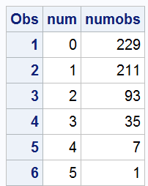

Slide 5
/*calculate expected percentage from a Poisson*/
data bombhits;
set bombhits;
phat=pdf("Poisson",num,&mnhits);
if num eq 5 then phat=1-cdf("Poisson",num-1,&mnhits);
run;
proc print data=bombhits;
run;

Slide 6
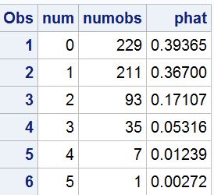

Slide 7
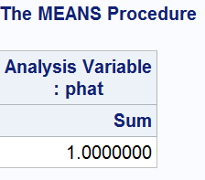
proc means data=bombhits sum;
var phat;
run;

Slide 8
proc freq data=bombhits;
tables num/testp=(0.39365 0.367 0.17107 0.05316 0.01239 0.00272);
/*can be separated with commas or blanks*/
weight numobs;
run;

Slide 9
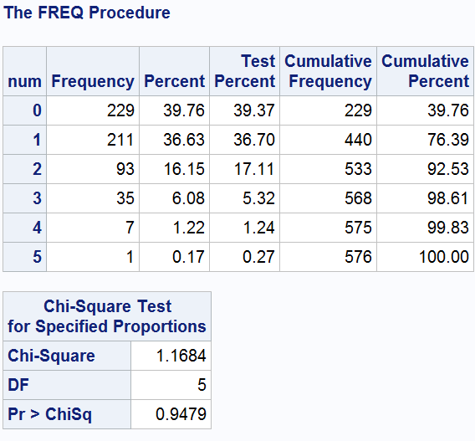

Slide 10
For our model, the question is how to form groups.
Covariate Patterns
Estimated Probabilities

