Slide 1
Goodness of fit using covariate patterns.

Slide 2
Compare observed and expected in groups.

Slide 3
Method 1, form groups based on covariate patterns.

Slide 5
proc logistic data=a.chd2018_a descending;
model chd=age /scale=none aggregate;
run;

Slide 6
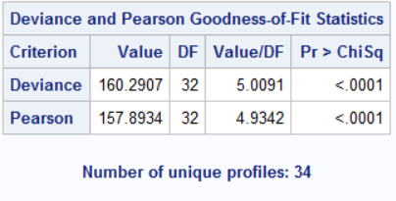

Slide 7
The problem: The number of unique covariate patterns grows with the number of variables in the model.

Slide 8
%let target=chd;
%let continuous_1=age chol fvcht sbp bmi;
%let categorical_1=diab male currsmok;
proc logistic data=a.chd2018_a descending;
model chd=&continuous_1 &categorical_1/scale=none aggregate;
run;

Slide 9
