Slide 1
Calibration plots

Slide 2
The programs in this topic are adapted from programs
that appeared in the DO LOOP, SAS Blog

Slide 3
Do a loess smooth to display the relationship between probabilities estimated by the model and the observed outcomes

Slide 4
%clearall
%let var=age;
proc logistic data=a.chd2018_a descending;
model chd=&var;
output out=Pred&var predicted=Prob&var;
run;
proc sort data=Pred&var; by Prob&var; run;
title "Calibration Plot, &var";
ods graphics/LOESSMAXOBS=25000;/*default max is 5000*/
proc sgplot data=Pred&var ;
loess x=Prob&var y=chd / interpolation=cubic nomarkers smooth=.75;
lineparm x=0 y=0 slope=1 / lineattrs=(color=grey pattern=dash);
yaxis grid; xaxis grid;
run;

Slide 5
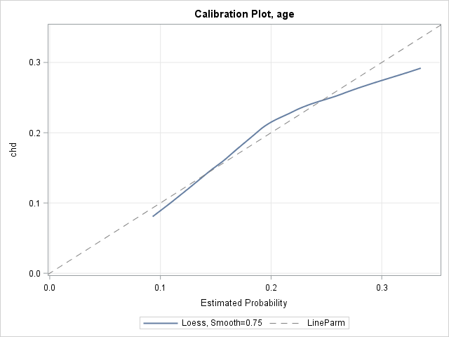

Slide 6
Model quadratic in age.
%clearall
%let var=age;
proc logistic data=a.chd2018_a descending;
model chd=&var|&var;
output out=Pred&var predicted=Prob&var;
run;
proc sort data=Pred&var; by Prob&var; run;
title "Calibration Plot, &var";
ods graphics/LOESSMAXOBS=25000;/*default max is 5000*/
proc sgplot data=Pred&var ;
loess x=Prob&var y=chd / interpolation=cubic nomarkers smooth=.75;
lineparm x=0 y=0 slope=1 / lineattrs=(color=grey pattern=dash);
yaxis grid; xaxis grid;
run;
title;

Slide 7
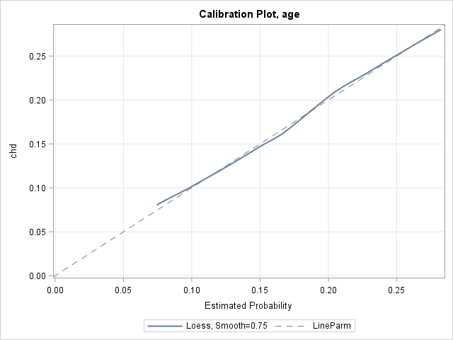

Slide 8
Does the quadratic in age make sense?
data toscore;
do age=15 to 90;
output;
end;
run;
proc logistic data=a.chd2018_a descending;
model chd=age|age;
score data=toscore out=scored;
run;
proc sgplot data=scored;
series x=age y=p_1;
/*maximum prob at 73.5*/
refline 73.5 /axis=x;
run;

Slide 9
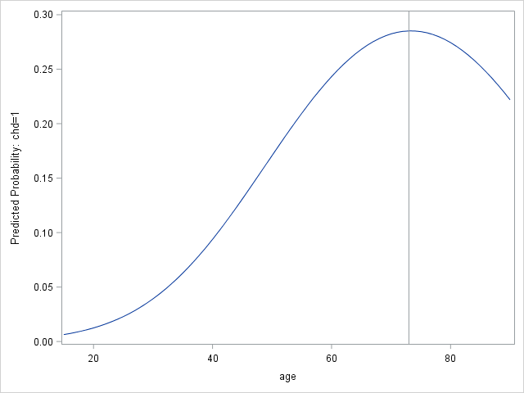

Slide 10
A reasonable(?) threshold model.
%clearall
data toscore;
do age=15 to 90;
output;
end;
run;
proc logistic data=a.chd2018_a descending;
model chd=age|age;
score data=toscore out=scored;
run;
data scored;
set scored;
if age > 73 then p_1=.28515; /*p_1 for age=73*/
run;
proc sgplot data=scored;
series x=age y=p_1;
/*maximum prob at 73*/
refline 73 /axis=x;
run;
proc print data=scored;
run;

Slide 11
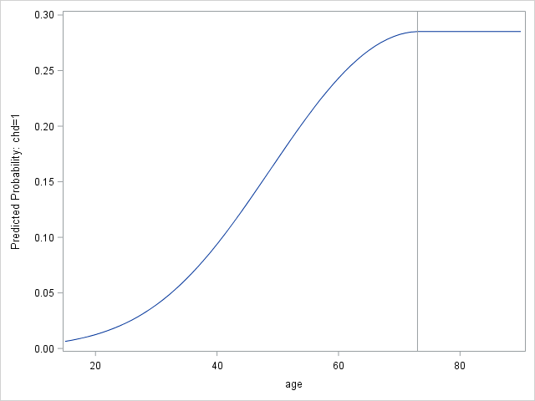
A reasonable(?) threshold model.

Slide 12
The Candidate Main Effects Model.

Slide 13
%let target=chd;
%let continuous_1=age chol fvcht sbp bmi;
%let categorical_1=diab male currsmok;
proc logistic data=a.chd2018_a descending;
model chd=&continuous_1 &categorical_1;
output out=PredMain predicted=P;
run;
proc sort data=PredMain; by p; run;
title "Calibration Plot, Main Effects Model";
ods graphics/LOESSMAXOBS=25000;/*default max is 5000*/
proc sgplot data=PredMain;
loess x=P y=chd / interpolation=cubic nomarkers smooth=.75;
lineparm x=0 y=0 slope=1 / lineattrs=(color=grey pattern=dash);
yaxis grid; xaxis grid;
run;
title;

Slide 14
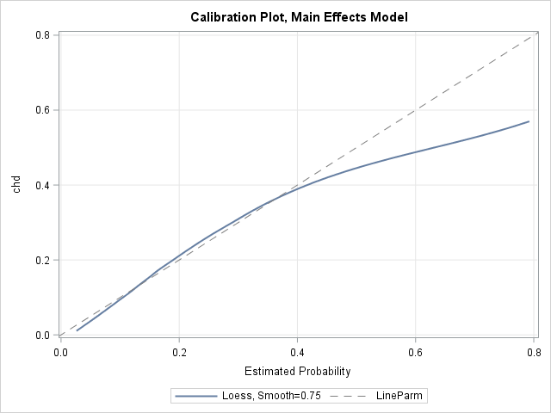

Slide 15
Decile Calibration Plots

Slide 16
Decile Calibration plots.
%clearall
%let var=age;
proc logistic data=a.chd2018_a descending noprint;
model chd = &var;
output out=Out&var predicted=Prob&var; /* save predicted probabilities in data set */
run;
proc rank data=Out&var out=Decile&var groups=10;
var Prob&var;
ranks Decile;
run;
proc means data=Decile&var noprint nway;
class Decile;
var chd prob&var;
output out=DecileOut mean=ChdMean Prob&var.Mean
lclm=yLower uclm=yUpper;
run;
proc sgplot data=DecileOut ;
lineparm x=0 y=0 slope=1 / lineattrs=(color=grey pattern=dash);
loess x=Prob&var.Mean y=chdMean; /* if you want a smoother based on deciles */
series x=Prob&var.Mean y=chdMean; /* if you to connect the deciles */
scatter x=Prob&var.Mean y=chdMean / yerrorlower=yLower yerrorupper=yUpper;
yaxis label="Observed Probability of Outcome";
xaxis label="Predicted Probability of Outcome";
run;

Slide 17
%let target=chd;
%let continuous_1=age chol fvcht sbp bmi;
%let categorical_1=diab male currsmok;
proc logistic data=a.chd2018_a descending noprint;
model chd = &continuous_1 &categorical_1;
output out=Out1 predicted=Prob; /* save predicted probabilities in data set */
run;
proc rank data=Out1 out=Deciles groups=10;
var Prob;
ranks Decile;
run;
proc means data=Deciles noprint nway;
class Decile;
var chd prob;
output out=DecileOut mean=ChdMn ProbMn
lclm=yLower uclm=yUpper;
run;
proc sgplot data=DecileOut ;
lineparm x=0 y=0 slope=1 / lineattrs=(color=grey pattern=dash);
loess x=ProbMn y=chdMn; /* if you want a smoother based on deciles */
series x=ProbMn y=chdMn; /* if you to connect the deciles */
scatter x=ProbMn y=chdMn / yerrorlower=yLower yerrorupper=yUpper;
yaxis label="Observed Probability of Outcome";
xaxis label="Predicted Probability of Outcome";
run;

Slide 18
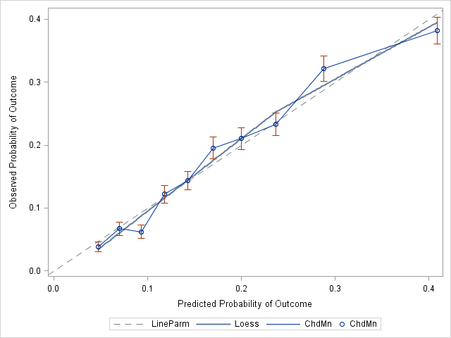

Slide 19
How about 20 groups?

Slide 20
%clearall
%let target=chd;
%let continuous_1=age chol fvcht sbp bmi;
%let categorical_1=diab male currsmok;
proc logistic data=a.chd2018_a descending noprint;
model chd = &continuous_1 &categorical_1;
output out=Out1 predicted=Prob; /* save predicted probabilities in data set */
run;
proc rank data=Out1 out=Deciles groups=20;
var Prob;
ranks Decile;
run;
proc means data=Deciles noprint nway;
class Decile;
var chd prob;
output out=DecileOut mean=ChdMn ProbMn
lclm=yLower uclm=yUpper;
run;
proc sgplot data=DecileOut ;
lineparm x=0 y=0 slope=1 / lineattrs=(color=grey pattern=dash);
loess x=ProbMn y=chdMn; /* if you want a smoother based on deciles */
*series x=ProbMn y=chdMn; /* if you to connect the deciles */
*scatter x=ProbMn y=chdMn / yerrorlower=yLower yerrorupper=yUpper;
yaxis label="Observed Probability of Outcome";
xaxis label="Predicted Probability of Outcome";
run;

Slide 21
