Slide 1
Bootstrap Sampling Distribution A simple example
Consider the population {1,2,3}

Slide 3
The complete sampling distribution for the mean of three items selected randomly with replacement.
%clearall
data replacement;
do x1=1 to 3;
do x2=1 to 3;
do x3=1 to 3;
mn=mean(x1,x2,x3);
output;
end;
end;
end;
run;
proc sql;
select * from replacement;
quit;
proc means data=replacement n mean var vardef=n;
var mn;
run;

Slide 4
Consider drawing a random sample:
We base inferences on the bootstrap sampling distribution.

Slide 5
In the simple example we examined previously, we could enumerate the entire bootstrap sampling distribution. However as the sample size increases this becomes difficult (rapidly – impossible).

Slide 7
A major use of the Bootstrap is estimating standard errors and obtaining confidence intervals.

Slide 8
For many statistics we don’t have a good analytic approximation

Slide 9
Bootstrap in SAS

Slide 10
Drawing bootstrap samples is easy with PROC SURVEY select.
data tmp;
do x=1 to 5;
output;
end;
run;
%let reps=2;
%let seed=39573293;
proc surveyselect data=tmp
reps=&reps
samprate=1
method=urs
out=outboot
seed=&seed;
run;
proc print data=outboot;
run;

Slide 11
The outhits option
data tmp;
do x=1 to 5;
output;
end;
run;
%let reps=2;
%let seed=39573293;
proc surveyselect data=tmp
outhits
reps=&reps
samprate=1
method=urs
out=outboot(drop=NumberHits)
seed=&seed;
run;
proc print data=outboot;
run;

Slide 12
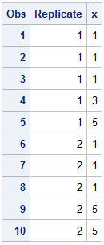

Slide 13
A macro
%macro bootsamp(indat=,outdat=outboot,reps=5,seed=3759543);
proc surveyselect data=&indat
outhits
reps=&reps
samprate=1
method=urs
out=&outdat (drop=numberhits)
seed=&seed;
run;
%mend bootsamp;

Slide 14
A simple example – s.e.(mean) & 95% C.I. chol

Slide 15
Draw 1000 Bootstrap Samples
data tmp;
set a.chd2018_a(keep=chol);
run;
%bootsamp(indat=tmp,
reps=1000,
seed=3759543)

Slide 16
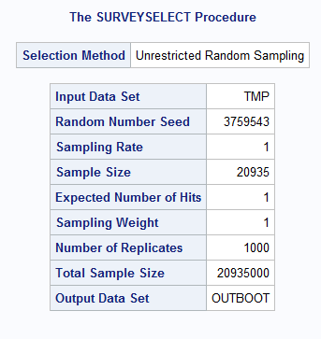

Slide 17
Calculate the mean of each bootstrap sample.
proc means data=outboot nway noprint;
class replicate;
output out=outall mean=mnchol;
run;
proc print data=outall(obs=5);
run;

Slide 18
proc univariate data=outall
var mnchol;
output out=pctls pctlpts=2.5 97.5 pctlpre=pctl
;
run;
proc print data=pctls;run;
proc means data=tmp clm stderr;
var chol;
run;

Slide 19
Print bootstrap and normal assumption confidence limits.
proc print data=pctls;
run;
proc means data=tmp clm;
var chol;
run;

Slide 20
The Process
Select bootstrap samples
Summarize each bootstrap sample separately
Draw inferences based on the distribution of the summarizations

