Slide 1
Bootstrapping Model Stability

Slide 2
The Main Effects Model (Forward Selection)
%let target=chd;
%let continuous_1=age chol fvcht sbp bmi;
%let categorical_1=diab male currsmok;
proc logistic data=a.chd2018_a descending;
ods select parameterestimates;
model chd=&continuous_1 &categorical_1/selection=forward;
run;

Slide 3
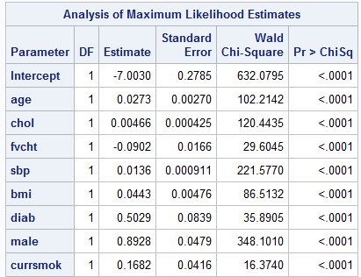
How stable are these results?

Slide 4
What does “stability” mean in this context?
If we sampled the population from which this data was selected multiple times, and we did the same modeling strategy, how often would we get the same model?

Slide 5
The Process
Select bootstrap samples
Summarize each bootstrap sample separately
Draw inferences based on the distribution of the summarizations

Slide 6
Some details: outest noprint keyword by group processing

Slide 7
noprint keyword, outest= option
proc logistic data=tmp.chdfm outest=betas descending noprint;
model chd10yr=age male chol sbp bmi diab currsmok/
selection=forward;
run;
proc print data=betas;
run;

Slide 9
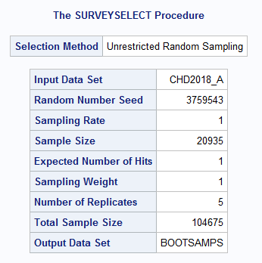
Select 5 bootstrap samples to work out details of by group processing
%bootsamp(indat=a.chd2018_a,outdat=bootsamps)

Slide 10
Logistic results by replicate
%let target=chd;
%let continuous_1=age chol fvcht sbp bmi;
%let categorical_1=diab male currsmok;
proc logistic data=bootsamps descending outest=betas descending noprint;;
by replicate;
model chd=&continuous_1 &categorical_1/selection=forward;
run;
proc print data=betas;
run;

Slide 12
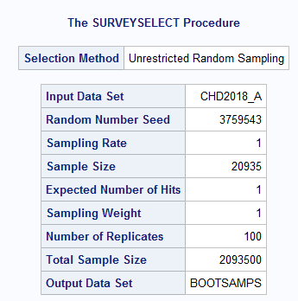
Do it a lot of times
%bootsamp(indat=a.chd2018_a,outdat=bootsamps,reps=100)

Slide 13
Do variable selection on each replicate and output estimated coefficients.
%let target=chd;
%let continuous_1=age chol fvcht sbp bmi;
%let categorical_1=diab male currsmok;
proc logistic data=bootsamps descending outest=betas descending noprint;;
by replicate;
model chd=&continuous_1 &categorical_1/selection=forward;
run;
proc means data=betas n nmiss;
run;

Slide 14
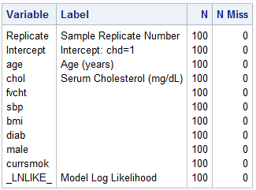

Slide 15
The outset option creates a value for each variable in the model statement. When a selection method is specified, the value is set to missing for those variables not selected.
proc logistic data=tmp.nh1diet descending outest=betas noprint;
model dead=age male black calories--cholesterol/
selection=forward;
run;
proc print data=betas;
run;

Slide 16
%bootsamp(indat=tmp.nh1diet,outdat=bootsamps,reps=100)
proc logistic data=bootsamps descending outest=betas noprint;
by replicate;
model dead=age male black calories--cholesterol/
selection=forward;
run;
proc means data=betas n nmiss;
run;

Slide 17
