Slide 1
Predictive and Explanatory Analysis

Slide 2
Linear Model
Focus of Prediction
Focus of Analytical or Explanatory Analysis

Slide 3
Logistic Model
Focus of Prediction
Focus of Analytical or Explanatory Analysis

Slide 4
The term predication is often used interchangeably with classification.
In our case we wish to categorize observations into two classes, those who have the event of interest (y=1) and those who do not (y=0).
In classification our estimate is used to assign observations to class, in our case, which of the two categories do we predict the observation to be a member of.

Slide 6
Using thresholds for prediction

Slide 7
Example
%let target=chd;
%let continuous_1=age chol fvcht sbp bmi;
%let categorical_1=diab male currsmok;
proc logistic data=a.chd2018_a descending;
model chd=&continuous_1 &categorical_1;
score data=a.chd2018_a out=scored;
run;
data scored;
set scored;
yhat=p_1 ge .5;
run;
proc freq data=scored;
tables yhat*chd/nocol norow;
run;

Slide 8
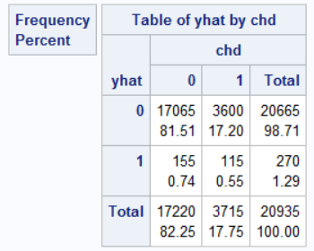
“Accuracy” could defined as the percent agreement

Slide 9
/*
calculates percentage agreement
between two nominal variables, v1, v2
on the dataset data
*/
%macro calcagree(data,v1,v2);
proc sql;
select count(*) into : agree
from &data
where &v1=&v2
;
title "Percent agreement &v1 and &v2";
select &agree / count(*) as pcagree
from &data
;
quit;
title;
%mend calcagree;

Slide 10
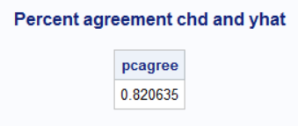
%calcagree(scored,chd,yhat);

Slide 11
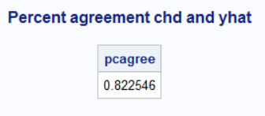
The problem with percent agreement
data example;
set a.chd2018_a;
yhat=0;
run;
%calcagree(example,chd,yhat);

Slide 12
What threshold?

Slide 13
Distribution of estimated probabilities.
%let target=chd;
%let continuous_1=age chol fvcht sbp bmi;
%let categorical_1=diab male currsmok;
proc logistic data=a.chd2018_a descending;
model chd=&continuous_1 &categorical_1;
score data=a.chd2018_a out=scored;
run;
proc univariate data=scored;
var p_1;
histogram p_1;
run;

Slide 14
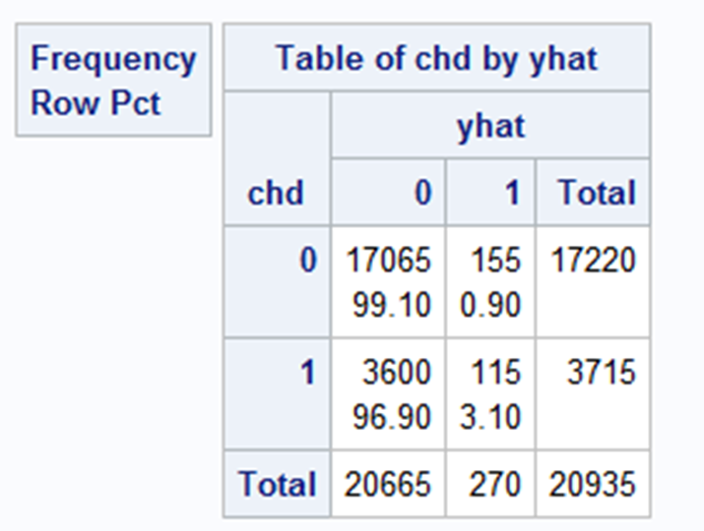
Threshold=.5
%let target=chd;
%let continuous_1=age chol fvcht sbp bmi;
%let categorical_1=diab male currsmok;
proc logistic data=a.chd2018_a descending;
model chd=&continuous_1 &categorical_1;
score data=a.chd2018_a out=scored;
run;
data threshold;
set scored;
yhat=p_1>.5;
run;
proc freq data=threshold;
tables chd*yhat/nocol nopercent;
run;

Slide 15
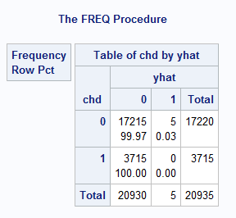
Threshold=.75
data threshold;
set scored;
yhat=p_1>.75;
run;
proc freq data=threshold;
tables chd*yhat/ nocol nopercent;
run;

Slide 16
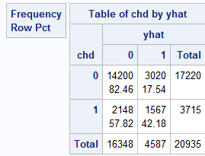
Threshold=.25
data threshold;
set scored;
yhat=p_1>.25;
run;
proc freq data=threshold;
tables chd*yhat/ nocol nopercent;
run;

Slide 17
We need some index of overall predictive accuracy. There are numerous. We will focus on AUROC

Slide 18
Concordant and Discordant Pairs
Sensitivity and Specificity
Receiver Operating Characteristic Curve
Area Under the Receiver Operating Characteristic Curve

