Slide 1
Sensitivity, specificity, positive and negative predictive value.

Slide 2
Some notation:

Slide 5
Area Under the Receiver Operating Characteristic Curve (AUROC)
Assign score to each observation equal to the ordered probability that the observation is a case. In logistic regression, this is usually the estimated probability.
For each unique score
Set this score as the threshold for deciding the classification
calculate sensitivity and specificity
Create a plot (Receiver Operating Characteristic Curve) that plots
sensitivity (y-axis) versus 1-specificity (x-axis)
Calculate the Area under the curve -- AUROC

Slide 6
%let target=chd;
%let continuous_1=age chol fvcht sbp bmi;
%let categorical_1=diab male currsmok;
proc logistic data=a.chd2018_a descending plots(only maxpoints=none)=roc;
model chd=&continuous_1 &categorical_1;
run;

Slide 7
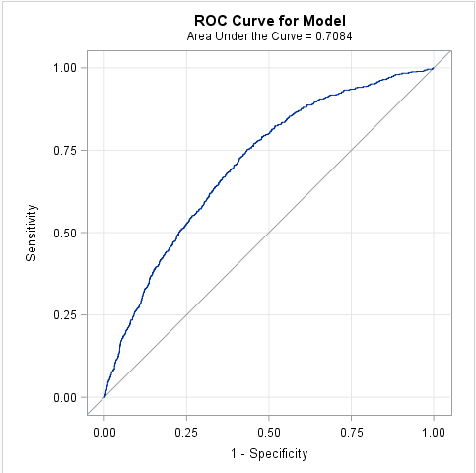
ROC:
Receiver
Operating
Characteristic
Curve
AUROC:
Area
Under the
Receiver
Operating
Characteristic
Curve

Slide 8
SAS’s Algorithm

