Slide 1
Area Under the Receiver Operating Characteristic Curve (AUROC)

Slide 2
Hanley and McNeil: The Meaning and Use of the Area under a Receiver Operating Characteristic (ROC) Curve, Radiology 1982

Slide 3
Data from Hanley and McNeil:
x | Normal (Y=0) | Abnormal (Y=1)
1 | 33 | 3
2 | 6 | 2
3 | 6 | 2
4 | 11 | 11
5 | 2 | 33
Total | 58 | 51
#Pairs | 2958

Slide 4
Data from Hanley and McNeil:
x | Normal (Y=0) | Abnormal (Y=1) | Threshold for Classifying as abnormal
1 | 33 | 3 | x>1
2 | 6 | 2 | x>2
3 | 6 | 2 | x>3
4 | 11 | 11 | x>4
5 | 2 | 33 | x>5

Slide 5
x | Normal (Y=0) | Abnormal (Y=1) | Threshold for Classifying as abnormal | #ties
1 | 33 | 3 | x>1 | 99
2 | 6 | 2 | x>2 | 12
3 | 6 | 2 | x>3 | 12
4 | 11 | 11 | x>4 | 121
5 | 2 | 33 | x>5 | 66

Slide 6
x | Normal (Y=0) | Abnormal (Y=1) | Threshold for Classifying as abnormal | #ties | #discordant
1 | 33 | 3 | x>1 | 99 | 75
2 | 6 | 2 | x>2 | 12 | 38
3 | 6 | 2 | x>3 | 12 | 26
4 | 11 | 11 | x>4 | 121 | 22
5 | 2 | 33 | x>5 | 66 | 0

Slide 7
x | Normal (Y=0) | Abnormal (Y=1) | Threshold for Classifying as abnormal | #ties | #discordant
1 | 33 | 3 | x>1 | 99 | 75
2 | 6 | 2 | x>2 | 12 | 38
3 | 6 | 2 | x>3 | 12 | 26
4 | 11 | 11 | x>4 | 121 | 22
5 | 2 | 33 | x>5 | 66 | 0

Slide 8
Data from Hanley and McNeil:
x | Normal (Y=0) | Abnormal (Y=1) | Threshold for Classifying as abnormal | #ties | #discordant | #concordant
1 | 33 | 3 | x>1 | 99 | 75 | 0
2 | 6 | 2 | x>2 | 12 | 38 | 66
3 | 6 | 2 | x>3 | 12 | 26 | 78
4 | 11 | 11 | x>4 | 121 | 22 | 495
5 | 2 | 33 | x>5 | 66 | 0 | 1848
Total | 58 | 51 |  | 310 | 161 | 2487
#Pairs | 2958 |  |  |  |  | 2958
%concordant |  |  |  |  |  | 0.893171062

Slide 9
data hanley;
do x=1 to 5;
do y=0,1;
input num @@;
output;
end;
end;
datalines;
33 3 6 2 6 2 11 11 2 33
;
proc logistic data=hanley plots(only)=roc;
class x (param=ref ref="1");
model y(event="1")=x;
score data=hanley;
freq num;
run;

Slide 10
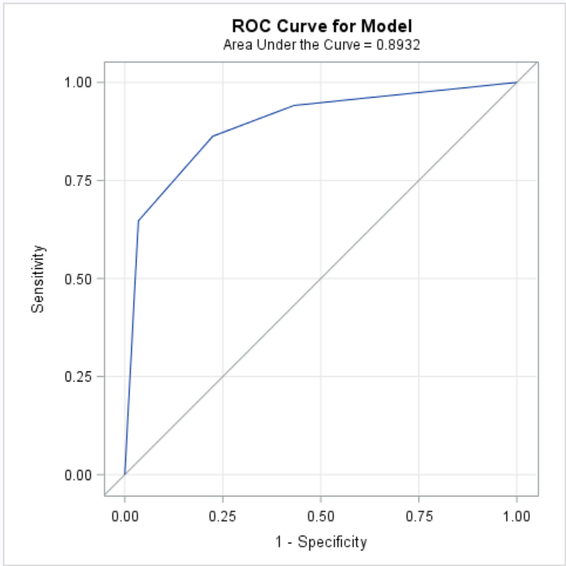
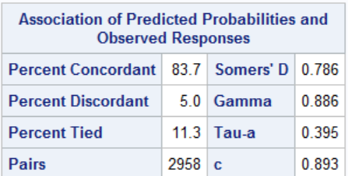

Slide 11
proc logistic data=hanley plots(only)=roc;
class x (param=ref ref="1");
model y(event="1")=x;
score data=hanley outroc=roc out=scored;
freq num;
run;
proc print data=scored noobs;run;
proc print data=roc noobs;run;

Slide 12
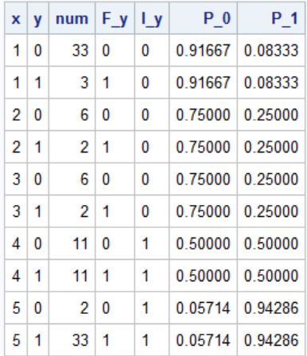
Scored
ROC
_PROB_, the estimated probability of an event. These estimated probabilities serve as cutpoints for predicting the response.
_POS_, the number of correctly predicted event responses
_NEG_, the number of correctly predicted nonevent responses
_FALPOS_, the number of falsely predicted event responses
_FALNEG_, the number of falsely predicted nonevent responses
_SENSIT_, the sensitivity, which is the proportion of event observations that were predicted to have an event response
_1MSPEC_, one minus specificity, which is the proportion of nonevent observations that were predicted to have an event response

Slide 13
AUROC -- Interpretation
Percentage of all possible pairs (event, non-event) that have the case rated higher than the non-case.
Probability that a random pair (event,non-event) will have the correct ordering.

Slide 14
Facts
Perfect prediction -> Area Under ROC=1
x | Normal (Y=0) | Abnormal (Y=1) | Threshold for Classifying as abnormal | #ties | #discordant | #concordant
1 | 33 | 0 | x>1 | 0 | 0 | 0
2 | 6 | 0 | x>2 | 0 | 0 | 0
3 | 6 | 0 | x>3 | 0 | 0 | 0
4 | 0 | 11 | x>4 | 0 | 0 | 495
5 | 0 | 33 | x>5 | 0 | 0 | 1485
Total | 45 | 44 |  | 0 | 0 | 1980
#Pairs | 1980 |  |  |  |  | 1980
%concordant |  |  |  |  |  | 1

Slide 15
If all observations are given the same score
C-statistic=Area Under ROC =.5

Slide 16
If non-events are given a score greater that events the Area Under ROC <.5
x | Normal (Y=0) | Abnormal (Y=1) | Threshold for Classifying as abnormal | #ties | #discordant | #concordant
1 | 3 | 33 | x>1 | 99 | 1584 | 0
2 | 2 | 6 | x>2 | 12 | 276 | 18
3 | 2 | 6 | x>3 | 12 | 264 | 30
4 | 11 | 11 | x>4 | 121 | 363 | 77
5 | 33 | 2 | x>5 | 66 | 0 | 36
Total | 51 | 58 |  | 310 | 2487 | 161
#Pairs | 2958 |  |  |  |  | 2958
%concordant |  |  |  |  |  | 0.106828938

Slide 17
The Area Under ROC depends only on the ranking of the scores.
x | Normal (Y=0) | Abnormal (Y=1) | Threshold for Classifying as abnormal | #ties | #discordant | #concordant
1 | 3 | 33 | x>1 | 99 | 1584 | 0
2 | 2 | 6 | x>2 | 12 | 276 | 18
3 | 2 | 6 | x>3 | 12 | 264 | 30
4 | 11 | 11 | x>4 | 121 | 363 | 77
5 | 33 | 2 | x>5 | 66 | 0 | 36
Total | 51 | 58 |  | 310 | 2487 | 161
#Pairs | 2958 |  |  |  |  | 2958
%concordant |  |  |  |  |  | 0.106828938
x | Normal (Y=0) | Abnormal (Y=1) | Threshold for Classifying as abnormal | #ties | #discordant | #concordant
.5 | 3 | 33 | x>1 | 99 | 1584 | 0
1.7 | 2 | 6 | x>2 | 12 | 276 | 18
2.1 | 2 | 6 | x>3 | 12 | 264 | 30
2.11 | 11 | 11 | x>4 | 121 | 363 | 77
2.33 | 33 | 2 | x>5 | 66 | 0 | 36
Total | 51 | 58 |  | 310 | 2487 | 161
#Pairs | 2958 |  |  |  |  | 2958
%concordant |  |  |  |  |  | 0.106828938

Slide 18
Some facts.
If a variable is added to a logistic model, the likelihood does not decrease.
The same is not necessarily true of the Area Under ROC
Nonetheless, AUROC is probably the most often used index of predictive accuracy.

