Slide 1
Transformations

Slide 2
Check, at least visually, the linearity assumption

Slide 3
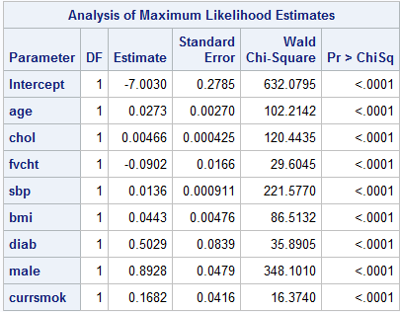
Final candidate main effects model

Slide 4
%macro PlotLogits(indata=,numgrp=7,indepvar=,depvar=);
proc rank data=&indata groups=&numgrp out=Ranks;
var &indepvar;
ranks Bin;
run;
proc sql;
create table toplot as
select
avg(&indepvar) as mean label="Mean of group",
sum(&depvar) as num_chd label="Number of Events",
count(*) as binsize label="Number at Risk",
log((calculated num_chd+1)/
(calculated binsize-calculated num_chd+1)) as logit
from ranks
group by bin;
quit;
proc sgscatter data=toplot;
plot Logit*mean /
reg markerattrs=(symbol=asterisk color=blue size=15);
title "Estimated Logit Plot &indepvar, &numgrp groups";
run;
title;
%mend PlotLogits;

Slide 5
%clearall
%PlotLogits(indata=a.chd2018_a,numgrp=8,indepvar=age,depvar=chd)
%PlotLogits(indata=a.chd2018_a,numgrp=12,indepvar=age,depvar=chd)
%PlotLogits(indata=a.chd2018_a,numgrp=17,indepvar=age,depvar=chd)

Slide 6
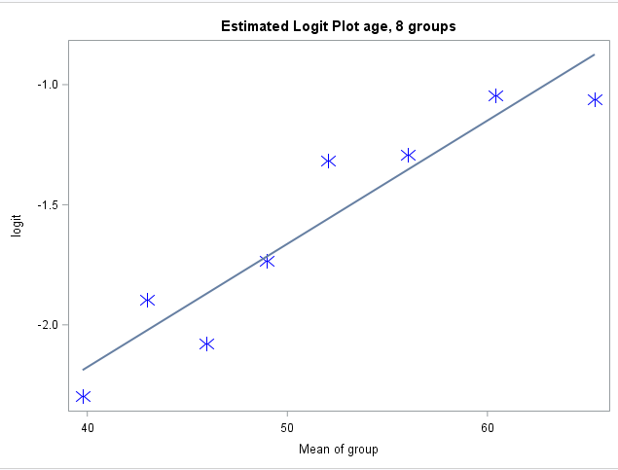
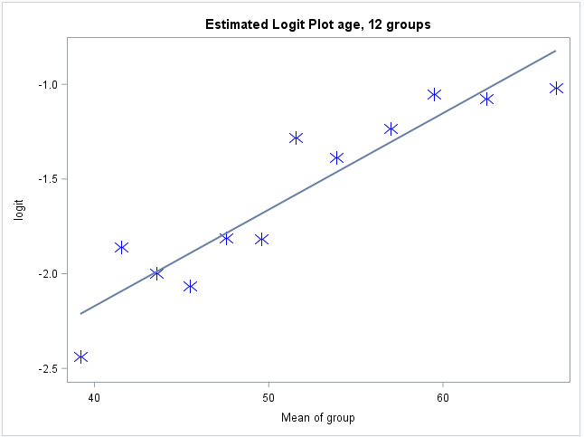
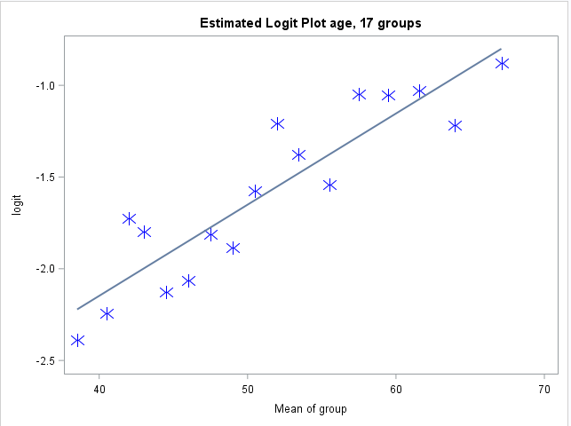

Slide 7
%clearall
%PlotLogits(indata=a.chd2018_a,numgrp=8,indepvar=chol,depvar=chd)
%PlotLogits(indata=a.chd2018_a,numgrp=12,indepvar=chol,depvar=chd)
%PlotLogits(indata=a.chd2018_a,numgrp=17,indepvar=chol,depvar=chd)

Slide 8
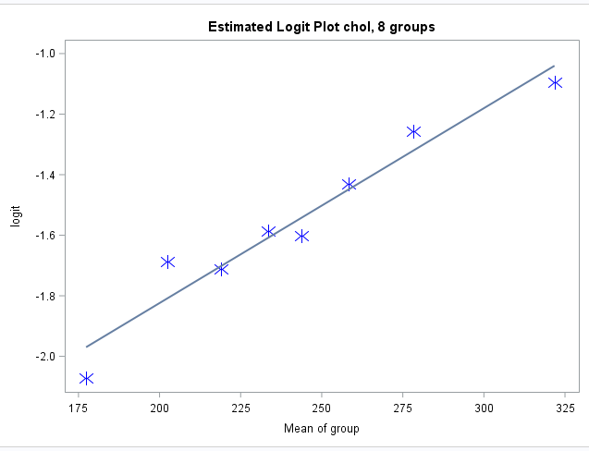
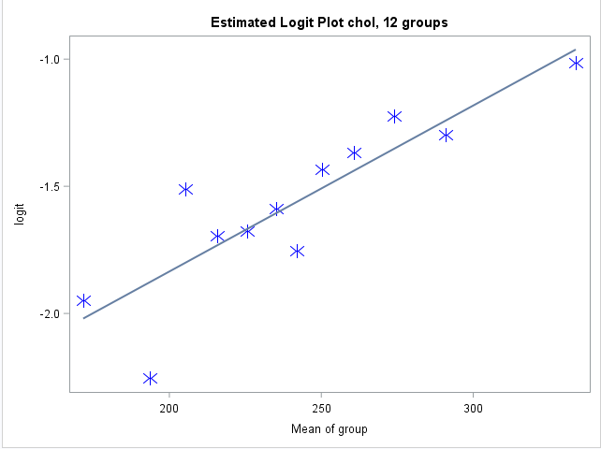
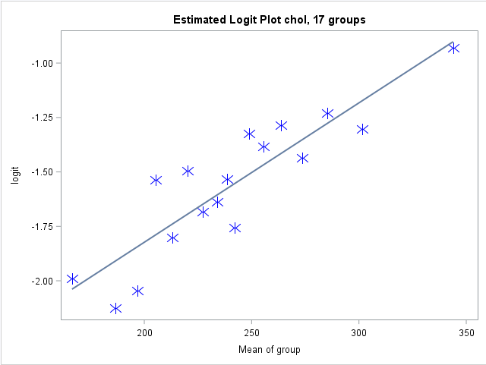

Slide 9
%clearall
%PlotLogits(indata=a.chd2018_a,numgrp=8,indepvar=fvcht,depvar=chd)
%PlotLogits(indata=a.chd2018_a,numgrp=12,indepvar=fvcht,depvar=chd)
%PlotLogits(indata=a.chd2018_a,numgrp=17,indepvar=fvcht,depvar=chd)

Slide 10
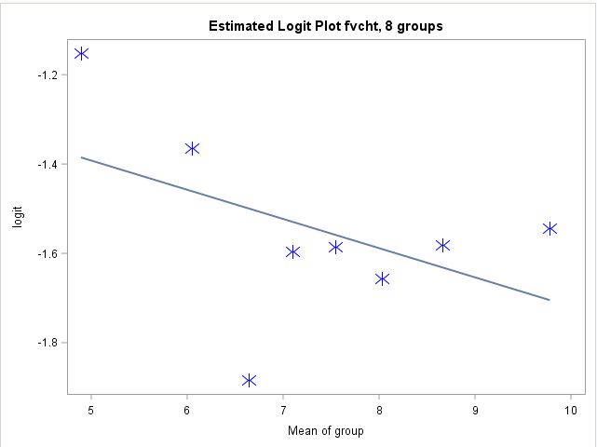
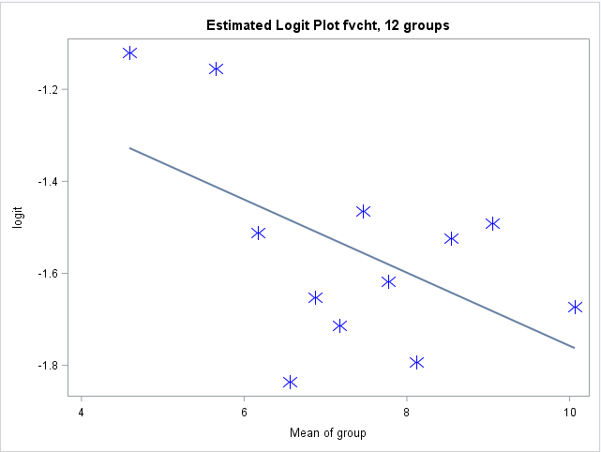
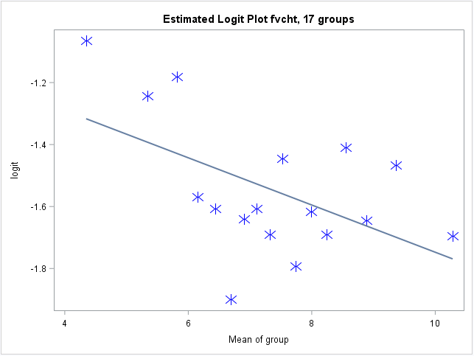

Slide 11
%clearall
%PlotLogits(indata=a.chd2018_a,numgrp=8,indepvar=sbp,depvar=chd)
%PlotLogits(indata=a.chd2018_a,numgrp=12,indepvar=sbp,depvar=chd)
%PlotLogits(indata=a.chd2018_a,numgrp=17,indepvar=sbp,depvar=chd)

Slide 12
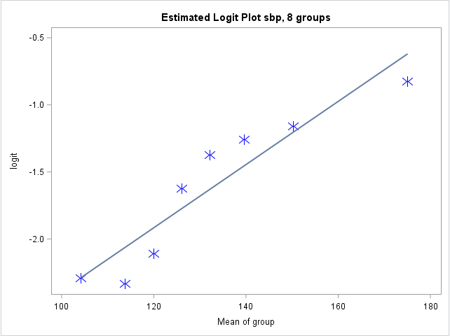
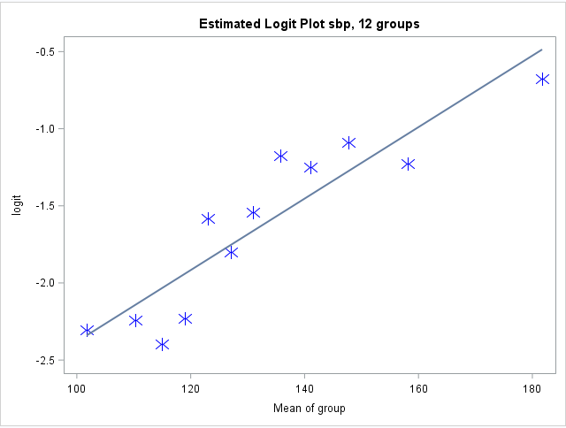
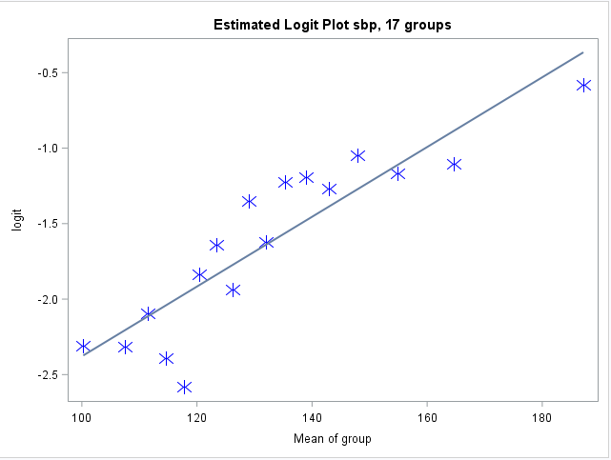

Slide 13
%clearall
%PlotLogits(indata=a.chd2018_a,numgrp=8,indepvar=bmi,depvar=chd)
%PlotLogits(indata=a.chd2018_a,numgrp=12,indepvar=bmi,depvar=chd)
%PlotLogits(indata=a.chd2018_a,numgrp=17,indepvar=bmi,depvar=chd)

Slide 14
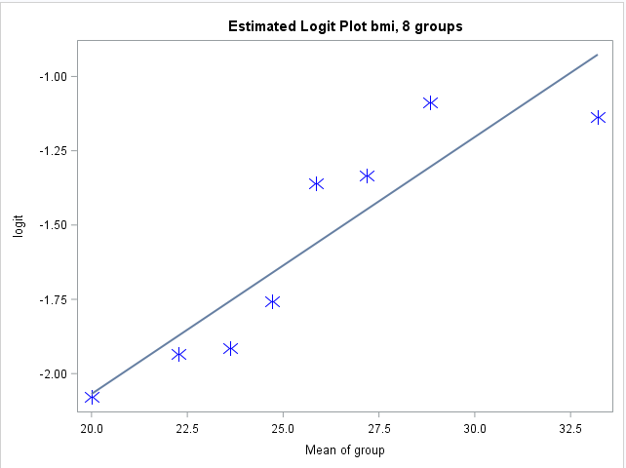
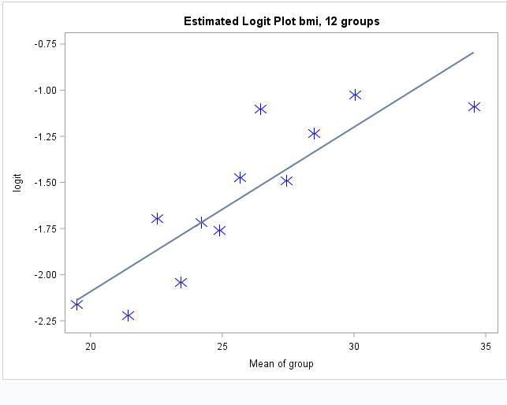
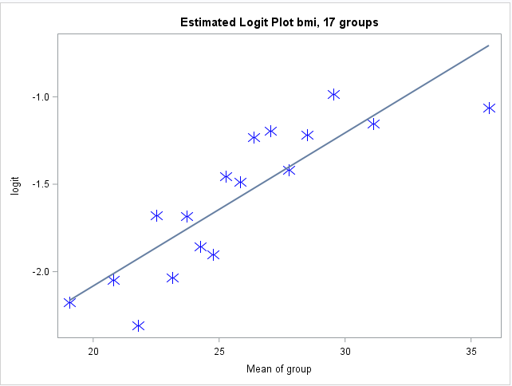

Slide 15
Leaving well enough alone.
Final candidate main effects model

