Slide 1
Interaction

Slide 3
Interaction, simplest case: dichotomous covariate.
proc freq data=a.chd2018_a ;
tables male*diab*chd/norow nocol nopercent or plots=none;
run;

Slide 4
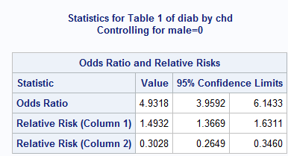
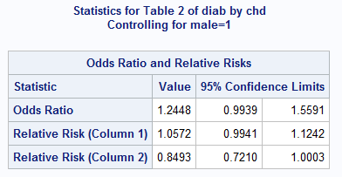

Slide 5
Main effects model.
proc logistic data=a.chd2018_a descending;
model chd=male diab;
run;

Slide 6
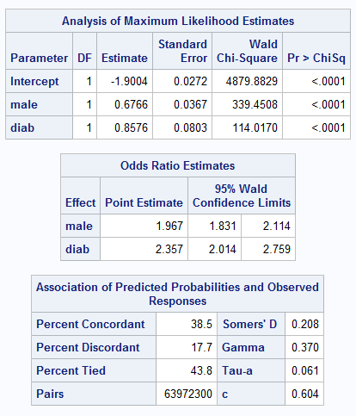

Slide 7
Interaction model.
proc logistic data=a.chd2018_a descending;
model chd=male diab male*diab;
run;

Slide 8
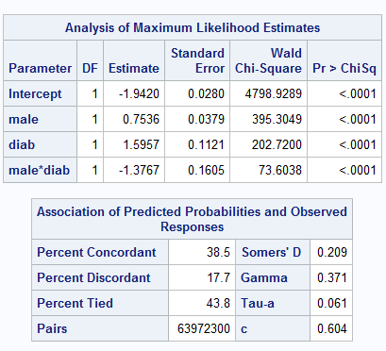
Interaction Model
Note: no odds ratios

Slide 9
The “bar” shortcut for specifying models with interaction.
proc logistic data=a.chd2018_a descending;
model chd=male|diab ;
run;

Slide 10
Main Effects and an interaction term are included.

Slide 11
The oddsratio statement
proc logistic data=a.chd2018_a descending plots=none;
model chd=male|diab ;
oddsratio diab/at(male=0 1) ;
run;

Slide 13
Note equivalence of separate models.
ods select OddsRatiosWald;
proc logistic data=a.chd2018_a descending plots=none;
model chd=male|diab ;
oddsratio diab/at(male=0 1) ;
run;
ods trace off;
proc logistic data=a.chd2018_a descending;
title "Males";
ods select OddsRatios;
where male;
model chd=diab ;
run;
proc logistic data=a.chd2018_a descending;
title "Females";
ods select OddsRatios;
where not male;
model chd=diab ;
run;
title;

Slide 14
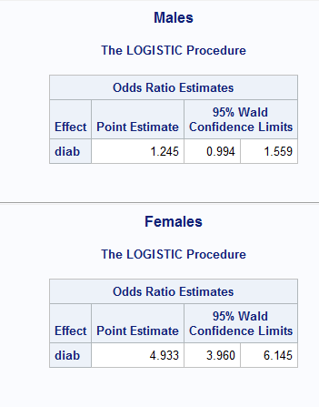
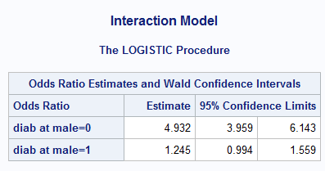

Slide 15
The model:

Slide 16
The models for male and female.

Slide 17
Age and gender are usually interaction candidates.
Sometimes there are other subject matter candidates.

Slide 18
Examine all gender interaction candidates

Slide 19
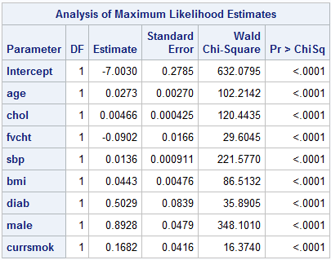
/*starting point
initial main effects model
*/
%let target=chd;
%let continuous_1=age chol fvcht sbp bmi;
%let categorical_1=diab male currsmok;
proc logistic data=a.chd2018_a descending;
ods select parameterestimates;
model chd=&continuous_1 &categorical_1;
run;

Slide 20
Variable lists can’t be used with the bar notation.
%let male_inter=age chol fvcht sbp bmi diab currsmok;
proc logistic data=a.chd2018_a descending;
ods select parameterestimates;
model chd=male|(&male_inter);
run;

Slide 21
Examine Gender interactions. Intro to the effect statement.
/*examine gender interactions
the effect statement
*/
%let male_inter=age chol fvcht sbp bmi diab currsmok;
proc logistic data=a.chd2018_a descending;
ods select parameterestimates;
effect a=collection(&male_inter);
model chd=male|a;
run;

Slide 22
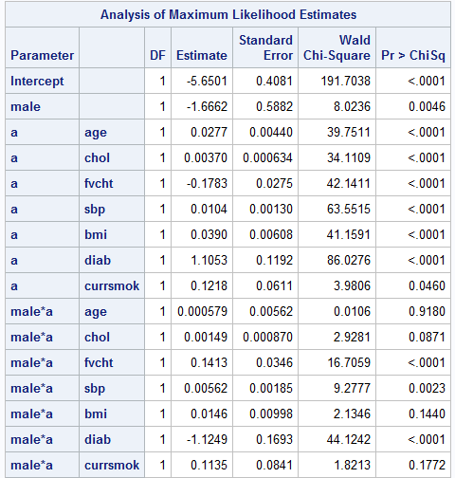

Slide 23
Examine age interaction candidates

Slide 24
/*examine age interactions*/
%let age_inter=male chol fvcht sbp bmi diab currsmok;
proc logistic data=a.chd2018_a descending;
ods select parameterestimates;
effect b=collection(&age_inter);
model chd=age|b;
run;

Slide 25
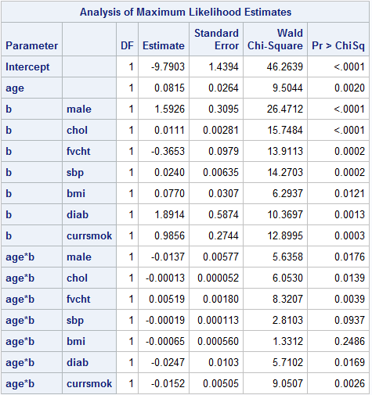

Slide 26
Examine both age and gender interaction candidates

Slide 27
/*examine both interactions*/
%let male_inter=age chol fvcht sbp bmi diab currsmok;
%let age_inter=male chol fvcht sbp bmi diab currsmok;
proc logistic data=a.chd2018_a descending;
ods select parameterestimates;
effect a=collection(&male_inter);
effect b=collection(&age_inter);
model chd=age|b male|a;
run;

Slide 28
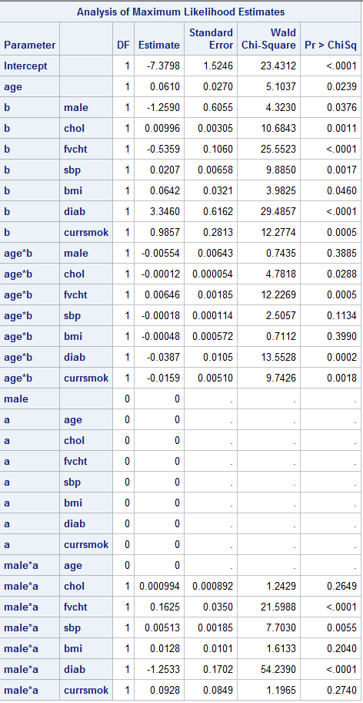

Slide 29
Use variable selection with interactions

Slide 30
/*now use forward stepwise to examine interactions*/
%let target=chd;
%let continuous_1=age chol fvcht sbp bmi;
%let categorical_1=diab male currsmok;
%let age_i=age|chol age|fvcht age|sbp age|bmi age|diab age|male age|currsmok;
%let male_i=male|chol male|fvcht male|sbp male|bmi male|diab male|currsmok;
proc logistic data=a.chd2018_a descending;
ods select parameterestimates;
model chd=&male_i &age_i/selection=forward;
run;

Slide 31
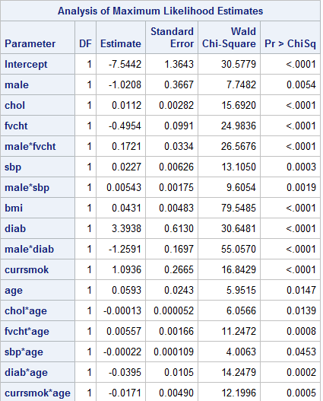
Forward selection, results

Slide 32
Backward selection
/*now use backward stepwise to examine interactions*/
%let target=chd;
%let continuous_1=age chol fvcht sbp bmi;
%let categorical_1=diab male currsmok;
%let age_i=age|chol age|fvcht age|sbp age|bmi age|diab age|male age|currsmok;
%let male_i=male|chol male|fvcht male|sbp male|bmi male|diab male|currsmok;
proc logistic data=a.chd2018_a descending;
ods select parameterestimates;
model chd=&male_i &age_i/selection=backward;
run;

Slide 33
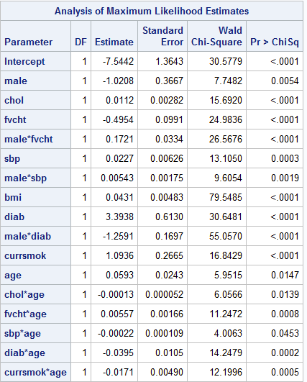
Backward selection, results

Slide 34
Forward
Backward

Slide 35
Check stability.
/***** check stability, 100 bootstrap samples*****/
%bootsamp(indat=a.chd2018_a,reps=100,outdat=bootsamps)
/*rerun forward stepwise on bootstrap samples*/
%let target=chd;
%let continuous_1=age chol fvcht sbp bmi;
%let categorical_1=diab male currsmok;
%let age_i=age|chol age|fvcht age|sbp age|bmi age|diab age|male age|currsmok;
%let male_i=male|chol male|fvcht male|sbp male|bmi male|diab male|currsmok;
options nonotes;/*turns off log notes*/
proc logistic data=bootsamps descending noprint outest=bootresults;
by replicate;
model chd=&male_i &age_i/selection=forward;
run;
options notes;
proc means data=bootresults n nmiss;
run;

Slide 36
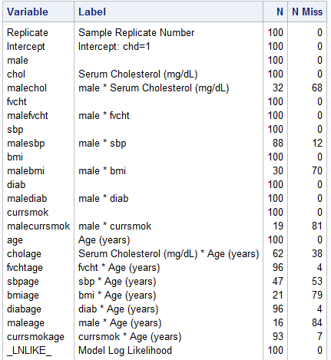

Slide 37
The question – stratify or model?
At this point, I’d usually consult with “users” and stratify at least for gender. (Do the entire process again for males and females separately.)

Slide 38
Final Model
/*candidate final model*/
%let target=chd;
%let continuous_1=age chol fvcht sbp bmi;
%let categorical_1=diab male currsmok;
%let interaction=male|fvcht male|diab male|sbp age|currsmok age|fvcht;
proc logistic data=a.chd2018_a descending;
model chd=&continuous_1 &categorical_1 &interaction;
run;

Slide 39
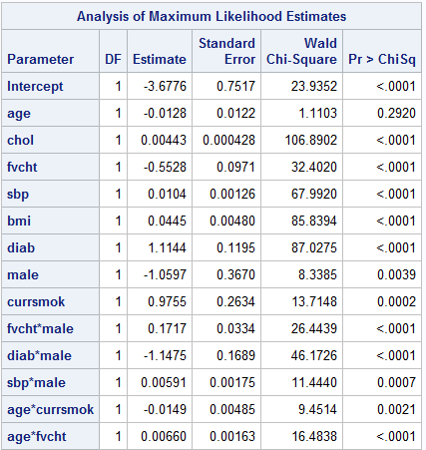
Final Model

Slide 40
A different approach
/* a different approach
allow all two way interactions
*/
proc logistic data=a.chd2018_a descending;
model chd=age |chol |fvcht |sbp |bmi |diab |male |currsmok/selection=forward;
run;

Slide 41
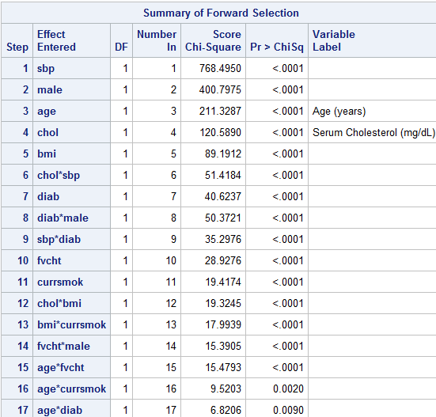

Slide 42
The hierarchical modeling principle.
%clearall
/*something that probably shouldn't be done*/
proc logistic data=a.chd2018_a descending;
model chd=age |chol |fvcht |sbp |bmi |diab |male |currsmok @3/
selection=forward hierarchy=none ;
run;

Slide 43
