Slide 1
2
Predictive Modeling
Introduction

Slide 2
The principal aim of predictive modeling is to predict the outcome on new cases.
Unknown
Input Variables
x₁
x₂
x₃
x₄
x₅
x₆
...
x_{k}
1
...
2
...
3
...
New
Cases
4
...
5
...
.
.
.
.
.
.
.
.
.
.
.
.
.
.
.
.
.
.
.
.
.
.
.
.
>n
...

Slide 3
Supervised Classification
target is a class label. Predictive model assigns, to each case, a score that measures the propensity that the case belongs to a particular class.
(Binary) Target
Input Variables
y
x₁
x₂
x₃
x₄
x₅
x₆
...
x_{k}
1
...
2
...
3
...
Cases
4
...
5
...
.
.
.
.
.
.
.
.
.
.
.
.
.
.
.
.
.
.
.
.
.
.
.
.
.
.
.
n
...

Slide 4
There is much overlap in the two types of modeling. But also major differences in approach.
Traditional statistical modeling
The principal purpose is to understand relationships.
The validity of the inference relies statistical theory.
Predictive statistical modeling.
Principal purpose is classifying new observations.
The validity of predictive modeling methods is assessed empirically.
Notes:
If a model predicts new cases that may be sufficient.
Some predictive modeling methods such as neural nets are essentially impossible to interpret and are not estimated using formal inferential methods, but they are still found to be highly useful.

Slide 5
Caveat emptor

Slide 6
Predictive Modeling often involves Opportunistic Data
Operational / Observational
Massive
Errors and Outliers
Missing Values
Different Scales
Notes:
.

Slide 7
A somewhat extreme example The clickthrough data set from Kaggle
libname k "&path\Clickthrough";
proc contents data=k.train;
run;

Slide 8
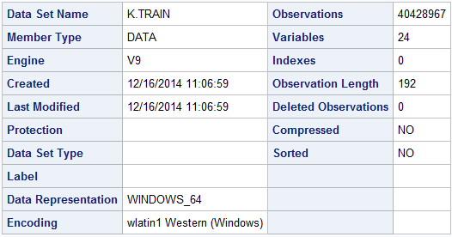
libname k "&path\Clickthrough";
proc contents data=k.train position;
run;
proc print data=k.train(obs=25);
var id--device_id;
run;

Slide 9
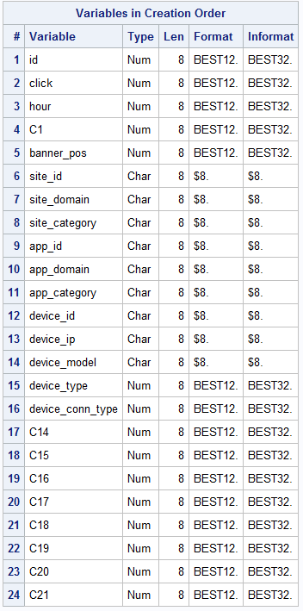

Slide 10
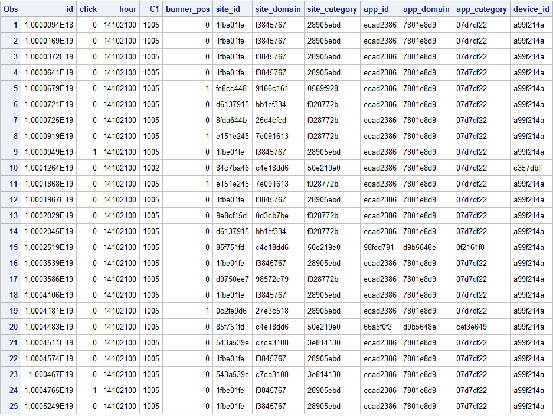

Slide 11
proc freq data=k.train nlevels;
tables click--c21/noprint;
run;
Note: To get this to run, I had to increase SAS memory.

Slide 12
Some major applications of predictive modeling
Target Marketing – Find segments of customers that are likely to respond to some offer so they can be targeted. Predict who is most likely to buy/use a product.
Attrition Prediction -- predict who is likely to switch brands or cancel services (churn). Loyalty promotions can then be targeted at new cases that are at risk.
Credit Scoring -- Decide whether to extend credit to applicants
Fraud Detection -- anticipate fraud or abuse on new transactions or claims so that they can be investigated or impeded.
Notes:
There are many business applications of predictive modeling. Database marketing uses customer databases to improve sales promotions and product loyalty. The aim is to find segments of customers that are likely to respond to some offer so they can be targeted. Historic customer databases can also be used to predict who is likely to switch brands or cancel services (churn). Loyalty promotions can then be targeted at new cases that are at risk.
Credit scoring (Hand and Henley 1997) is used to decide whether to extend credit to applicants. The cases are past applicants. Most input variables come from the credit application or credit reports. A relevant binary target is whether the case defaulted (charged-off) or paid-off the debt. The aim is to reduce defaults and serious delinquencies on new applicants for credit.
In fraud detection, the cases are transactions (for example, telephone calls, credit card purchases) or insurance claims. The inputs are the particulars and circumstances of the transaction. The binary target is whether that case was fraudulent. The aim is to anticipate fraud or abuse on new transactions or claims so that they can be investigated or impeded.
Supervised classification also has less business-oriented uses. Image classification has applications in areas such as astronomy, nuclear medicine, and molecular genetics (McLachlan 1992; Ripley 1996; Hand 1997).

Slide 13
A targeted marketing example

Slide 14
The Develop Data Set
Retail-banking example. The data set has 32,264 observations (banking customers).
Binary target variable Ins indicates whether the customer has an insurance product (variable annuity).
The data are over sampled.
Predict customers most likely to purchase an annuity

Slide 15
Acknowledgement The Develop Data Set is from SAS. It is used in a SAS course on predictive modeling with logistic regression.

Slide 16
Variable Annuity Data Set
Other product usage in a three month period
Did customer purchase variable annuity product?
1= yes
0= no
Demographics
Notes:
A target marketing campaign for a bank was undertaken to identify segments of customers who are likely to respond to a variable annuity (insurance product) marketing campaign. A data set was created with 32,264 cases (banking customers) and 47 input variables. The binary target variable Ins indicates whether the customer bought the variable annuity product. The 47 input variables represent other product usage in a three month period and demographics. Two of the inputs are nominally scaled; the others are interval or binary. The data is in a SAS data set called develop.

Slide 17
Examine the Data Compare with chd2018_a
libname d "d:\dropbox\develop\_data";
data d.develop;
set s5238.develop;
run;
proc contents data=d.develop position;
run;

Slide 18
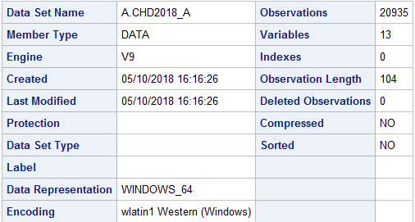
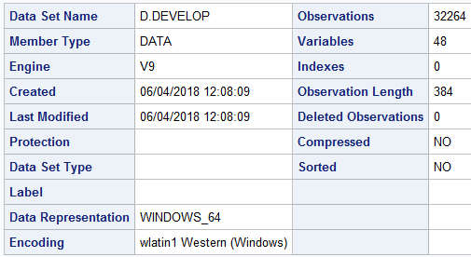

Slide 19
A comparison
 | chd2018 | develop
Source of data | Random Sample | opportunistic
Reason for collecting | Scientific study of chd | administrative
Data items | Standardized and quality controlled | Limited control
Data items | Modifiable | Fixed
Data set | All collected data | Over sampled
Purpose of analysis | Model relationship | Targeted marketing

Slide 20
Predictive Modeling, Summary
Objective – Predict new cases.
Data often not collected for analytic purposes
Large number of independent variables
Rare Target (dependent variable)
Over-fitting

